Slide 1
Beyond What Works:
When Research Meets Reality
2014 – Second Annual Reading Conference
Middle Tennessee State University
Deborah Simmons • Texas A&M University
Notes:
Not interventions themselves
Instructional Design
How to structure, align, modify
Structure, alignment, economy

Slide 2
Session Purpose and Context
Highlight findings from research in primary and middle schools
Personal observations from time in schools
Address questions that go beyond the “What Works” question to those that help us make decisions regarding
  Is it more effective than our standard practices?
  How do we responsively adjust instruction?
  On what should we focus at the middle/secondary grades?

Slide 3
National Assessment of Educational Progress
Academic yardstick, began in 1971
Representative sample across U.S.
Students participating in the assessment read passages and respond to questions in three 15-minute sections.
Each section contained three or four short passages (approximately 10 questions).
Majority of the questions are multiple choice and some constructed responses.

Slide 4
Trend in NAEP Reading Average Scores for 9-, 13-, and 17-year-Old Students

Slide 5
Summary of NAEP Results
Nine- and 13-year-olds make gains
Both 9- and 13-year-olds scored higher in reading in 2012 than students their age in the early 1970s.
Scores were 8 to 25 points higher in 2012 than in the first assessment year.
Seventeen-year-olds, however, did not show similar gains.

Slide 6
Why Improvement in Grades 4 & 8 But not 11?
More extensive research in earlier grades.
Pipeline of best practices in place.
Reading difficulties are more difficult to change at the later grades
Bigger kids bigger problems
Reality: In most schools no one is responsible for READING instruction in the upper grades.
Competing priorities

Slide 7
Shout Out to Tennessee !!
Reading 4th grade scores
 | TN | National Public Avg.
2011 | 215* | 220
2013 | 220 | 221
Change | 5 pts
Reading 8th grade scores
 | TN | National Public Avg.
2011 | 259* | 264*
2013 | 265 | 266
Change | 6 pts | 2 pts
* indicates a statistically significant improvement from 2011 to 2013 NP = National public.

Slide 8
Celebrate! Then Back to Work!
Percentage at or above Proficient compared to the nation (public)
NP = National public.
 | TN | NP
Reading 4th Grade | 34% | 34%
Reading 8th Grade | 33% | 34%

Slide 9
What Works: Questions to Ponder
As We Think
About How to Reach the 60%
Primary Grades
Middle Secondary Grades

Slide 10
It works compared to what?
We have them in tiers now what?
What are the pressure points for secondary students?
Notes:
10
10

Slide 11


http://dwwlibrary.wested.org/
http://dwwlibrary.wested.org/

Slide 12

What Works Clearing House:
http://ies.ed.gov/ncee/wwc/
There have not been Zyrtec, Allegra, Claritin comparisons.
Notes:
12
12

Slide 13
Beyond What Works…..
What We Really Learned About Early Reading Intervention
Deborah Simmons • Texas A&M University
Michael Coyne • University of Connecticut
Notes:
Not interventions themselves
Instructional Design
How to structure, align, modify
Structure, alignment, economy

Slide 14


IES Research Collaborators
Deborah Simmons, Oi-man Kwok, Shanna Hagan-Burke, Leslie Simmons, Minjung Kim, Eric Oslund, & Melissa Fogarty
Michael Coyne, Maureen Ruby, Athena Lentini, & Yvel Crevecoeur
Mary Little & D’Ann Rawlinson
The research reported here was supported by the Institute of Education Sciences, U.S. Department of Education, through Grant R324E060067 to Texas A&M University. The opinions expressed are those of the authors and do not represent views of the U.S. Department of Education.

Slide 15
Credits
The research reported was supported by the Institute of Education Sciences, U.S. Department of Education, through Grant R324E060067 to Texas A&M University. The opinions expressed are those of the authors and do not represent views of the U.S. Department of Education.
National Center for Special Education Research (NCSER)
Kristen Lauer – Project Officer
Deb Speece – Commissioner of NCSER
School districts, teachers, and students

Slide 16
We Need to Know the Conditions Under Which Practices Work
Progress
Schools are increasingly implementing interventions to meet the academic needs of students at risk of reading difficulties.
In many instances, these instructional practices or programs “work” or result in substantial achievement differences over typical practices for many children.
Need to Know
To move beyond “what works” to understand whether it will work in my school. Will it be more effective than the practices I currently use?
We Know

Slide 17
What Do We Need to Know?
Research Questions: Does it Work in the Real World?
Does “it” work when:
  Delivered by school based personnel?
  When the comparison group receives comparable amounts of intervention?
  In different settings and states?
Do the effects replicate across sites?
Do effects endure beyond K?
Can we make it more effective by using data to adjust intervention?

Slide 18
It Works Compared to What?
Does it explicitly and systematically teach high priority skills?
2. Are students learning??
3. Is instruction closing the
achievement gap?

Slide 19
Early Reading Intervention Efficacy Studies
RCTs to compare the efficacy of supplemental interventions under standardized conditions:
Interventions
Years 1 & 2: Early Reading Intervention (ERI) to School Designed Tier 2
Standardized Conditions
Group Size (3-5 students)
Duration (approximately 20 weeks)
Time (30 minutes, 5 days per week)
School-based interventionists
How do these compare

Slide 20
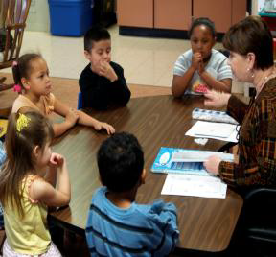
Early Reading Intervention – ERI
Curriculum Design Features & Targets
Published supplemental reading program for kindergarten students
Explicit, code-based intervention
Formative assessments at end of each curriculum part
Includes 126 lessons taught in 30-minute, small-group sessions
High priority alphabetic, phonemic, reading, and spelling skills
Opportunities to respond
High priority phonemic awareness skills: 1st and last sound isolation, sequential blending and segmentation.
Word reading and spelling
High frequency irregular sight words.
Pearson/Scott Foresman. (2004). Scott Foresman Sidewalks: Early reading intervention. Glenview, IL: Author.

Slide 21
Comparison Condition
Taught in small groups for 30 minutes daily
Variety of teacher-made and published materials in use
  48% reported sustained use of a published program
  52% used a compilation of teacher-made and commercial materials
Focus of instruction was early literacy
School-Designed Intervention
(SDI)

Slide 22
Participants & Setting
Kindergarteners selected from a pool of low-performing children nominated by classroom teachers
Phase 1 Screening (Years 01 and 02)
  Letter naming fluency: ≤36th percentile and CTOPP sound matching: ≤37th percentile

Slide 23
Year 01 and 02 Study Design
s
 | Year 01 (N = 206) |  | Year 02 (N = 162)
Condition | ERI | SDI | ERI | SDI
Sample | 112 | 94 | 87 | 75
Sites | TX/CT |  | FL
Note. N = student sample size.

Slide 24
Standardized Differences (Hedge’s g) for Initial Study
Measure | ERI vs. SDI
Alphabet Knowledge
WRMT-R/NU Supplementary Letter | 0.19
Checklist-Name
Letter Sound Knowledge
WRMT-R/NU Supplementary Letter | 0.44
Checklist-Sounds
Phonemic Awareness
CTOPP Sound Matching | 0.43
CTOPP Blending Words | 0.40
DIBELS Phonemic Segmentation | 0.46
Fluency
Word Attack
DIBELS Nonsense Word Fluency | 0.36
WRMT-R/NU Word Attack | 0.51
Word Identification
WRMT-R/NU Word ID | 0.25
Note. Bolded: significant effect

Slide 25
Illustration of Year 01 & Year 02 Findings
Student Outcomes
ERI
Year 01
SDI
Year 01
ERI
Year 02
SDI
Year 02

Slide 26
Look at Your Existing Practices!!! It May Not Take An Instructional Overhaul!
Findings did not replicate across settings, WHY…..
BECAUSE, the strength of comparison (school-designed) interventions varied across settings!
Effects of the standardized intervention were comparable between sites.

Slide 27
What We Know Now
BAU
There is evidence that research is being translated to practice in SOME but not all sites. BAU in SOME sites produced strong effects.
Context
Context Matters – Important to consider the conditions, experiences, and current practices.

Slide 28
Beyond What Works: The Instructional Puzzle

Slide 29
More Things to Ponder…….
How to Optimize Reading Support
Some general ed teachers have difficulty providing small group instruction daily
When intervention occurs in pull out settings, there is limited alignment between Tier 1 and 2
When to Adopt Standardized Tier 2?
Observations revealed considerable variability within and between schools.

Slide 30
Does Adjusting Intervention in Response to Learner Performance Improve Kindergarten and First Grade Outcomes?
Coyne, M. D., Simmons, D. C., Hagan-Burke, S., Simmons, L. E., Kwok, O., Kim, M., Fogarty, M., Oslund, E., Taylor, A., Capozzoli-Oldham, A., Ware, S., Little, M. E., & Rawlinson, D. M. (2013). Adjusting beginning reading intervention based on student performance: An experimental evaluation. Exceptional Children.

Slide 31
How to Use Student Performance Data to Intensify/Enhance Intervention?
Adjusting intervention in response to student performance is an essential component of RTI.
Although there is limited experimental evidence of the effects of how to adjust instruction in response to learner performance.

Slide 32
How do you teach more in less time?
Students are placed in appropriate instructional material.
Materials/instruction focus on the “most important” skills.
Students accelerate based on mastery.
Regrouping.

Slide 33
What Are the Implications of RTI and Acceleration?
Frequent progress monitoring
Not all students are on the same page.
Teachers who know how to use data to modify instruction
Instructional and schedule flexibility
Coordinated effects among ALL teachers.
How many of you are using data to adjust intervention?

Slide 34
RCT to Compare Effects of Adjusting Progression through ERI
Interventions
Year 3: ERI Experimental to ERI Conventional
Standardized Conditions
Group Size (3-5 students)
Duration (approximately 20 weeks)
Time (30 minutes, 5 days per week)
School-based interventionists
Pull Out Setting
NO BAU or typical practice condition

Slide 35
Participants
103 students from 9 schools in TX, CT, & FL
Selected from a pool of lowest-performing children nominated by classroom teachers
WRMT-R letter identification: ≤9th percentile and/or CTOPP rapid object naming: ≤16th percentile

Slide 36
ERI-E: Adjusted Curriculum Pacing & Grouping: Mastery & Monitoring
ERI-Experimental: Every 4 weeks (midpoint and end of curriculum parts)
Strong: ≥ 90% on 2 assessments: Accelerated lesson progression
Moderate: 70-89%: Normal lesson progression & specific skill review as needed
Students were regrouped (when possible) to attain greater instructional homogeneity.
Weak: < 70%: Repeat targeted lessons then resume normal lesson progression with specific skill review
Experimental Manipulation
Appropriate Placement:
Curricular Adjustments
Appropriate Placement:
Regrouping

Slide 37
Effect Sizes (Hedges’ g) for Group Differences on Reading Outcomes
K Posttest | Effect Size (Hedge’s g)
Phonemic Awareness Skills
CTOPP: Sound Matching | .38
CTOPP: Blending Words | .28
DIBELS: PSF | .29
Alphabetic Skills
WRMT: Letter-Name Checklist | .57*
WRMT: Letter-Sound Checklist | .54*
WRMT: Word Attack | .34
DIBELS: NWF | .37
Word Identification: WRMT: Word ID | .76*
Spelling: TWS-4 | .29
Oral Reading Fluency | .46*
* Statistically significant effect after Benjamini-Hochberg correction.

Slide 38
Effect Sizes (Hedges’ g) for Group Differences on Reading Outcomes
1st Grade Follow up | Effect Size (Hedge’s g)
Alphabetic Skills: WRMT: Word Attack | .39*
Word Identification: WRMT: Word ID | .58*
Spelling: TWS-4 | .69*
Oral Reading Fluency | .61*
Reading Comprehension: WRMT: Passage Comp | .64*
* Statistically significant effect after Benjamini-Hochberg correction.

Slide 39
Overall Conclusion
Findings provide support for an essential component of RTI models – adjusting intervention in response to student performance

Slide 40
What We Know and Need to Know..
    Week 8: When we could identify students who would need more intensive intervention
    Inoculation or Insulin: It depends on how solid the skills are.
    The Transience of Success: As the curriculum changes some students will need more.
    The Need for Strong Foundations to Support the Upper Tiers.
    No More Letters: The need for curriculum alignment..

Slide 41
What Works or Doesn’t Work in Middle/Secondary Grades
Sharon Vaughn
Meadows Center for Preventing Educational Risk
University of Texas at Austin
Deborah Simmons
Texas A&M University
Notes:
What we’ve learned by working in secondary grades in English language arts classrooms.
With a focus on struggling readers
When main effects are not robust, we need to look at factors that influence outcomes.

Slide 42
Acknowledgements
The research reported here was supported by the Institute of Education Sciences, U.S. Department of Education, through Grant R305F100013 as part of the Reading for Understanding Research Initiative.
The opinions expressed are those of the authors and do not represent views of the Institute or the U.S. Department of Education.

Slide 43
Why Reading Comprehension?
Adolescents in the United States and their educators face an enormous challenge with respect to reading comprehension.
College and career readiness standards outlined in the Common Core State Standards Initiative (2012) place increased emphasis on preparing students to read complex text across a range of content areas.
At issue is how to develop the necessary skills to be able to read the texts required of college classes and literacy-demanding occupations when fewer than 35% of students in the secondary grades read proficiently (U.S. Department of Education, 2013).
Notes:
- Read first bullet
Increased emphasis in the Common Core on preparing students to read complex texts across a range of areas, in science, social studies, and literature
But the problem that seems to be a persistent one….developing these skills for college readiness and preparing them to succeed in a technological, literacy-rich society when only about a third of secondary students read proficiently

Slide 44



Reading Comprehension Framework Failure
Orthographic System
Linguistic System
Mapping to phonology
Phonology, Syntax,
Morphology
Working Memory
Lexicon
Comprehension
Processes
Orthographic
Units
Meaning
Morphology
Syntax
- argument
structure
- thematic
roles
Parser
Word
Identification
Meaning and
Form Selection
Visual Input
Text Representation
Inferences
Phonological
Units
Situation
model
Conceptual knowledge
Perfetti (1999); Perfetti, Landi & Oakhill, 2005
Notes:
Perfetti illustrates the complexity of the knowledge and processes involved in comprehending text.
In the first rectangle you will see processes related to word identification, where familiar letter strings (words) are recognized in our orthographic memory, and mapped to phonological pronunciations
Reading words triggers meaning, In the second rectangle the processes associated with vocabulary/lexicon - understanding the meaning of the words being read
And in the last rectangle the comprehension processes involved in moving from sentence level comprehension to text representation (what the text says) to a situation model (what the text means – this moving and evolving picture in your mind)
Comprehension can fail at many and any of these points……
And we see how absolutely critical vocabulary is in this system – it provides the bridge, the link from decoding to comprehension.
It also acts reciprocally….Vocabulary feeds back and aids word recognition, particularly with new words
Comprehension builds and reinforces vocabulary, by helping to add new word knowledge, and promoting a deeper understanding of previously known words.

Slide 45
Instructional Context
English Language Arts Classes – Content focused
  Symbolism, foreshadowing, author’s purpose, critical analysis of text
Heterogeneous Classes – 30% of students performed below the 15th percentile.
Teacher Directed classes
  Read alouds, audio, question and answer

Slide 46

A Tale of Two ELA Studies
Study 1: Findings
Study 2: Do-Over Study
Does Increasing Secondary Students’ Roles and Activity Improve Reading Comprehension?

Slide 47
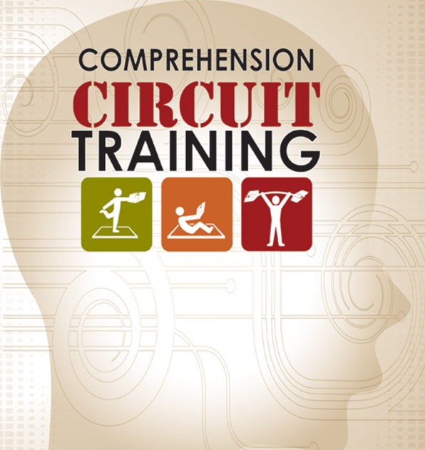
Theory of Change
Theory of Change
Used in ELA classes will increase knowledge, amount of text read, & depth of processing
Improved performance for readers on standardized and researcher-developed measures
Teacher-directed and student-regulated generalizable comprehension processes introduced in narrative and expository text
Fidelity
Range of Readers

Slide 48
Comprehension Circuit Training
Knowledge flex station
Warm-Up station
Reading core station
Read and Check
Take Team-Based Learning Quizzes
Preview Text
Develop Background Knowledge
Set Checkpoints
“Fix It “
Answer the Read to Find Out Question
Notes:
Script:
Locate your Comprehension Circuit Training Chart and Checklist at the front of your workbook. This chart and checklist will help us learn and remember the station. In Comprehension Circuit Training, the first station is the Reading Warm-Up Station. It consists of three main exercises: the Preview Text exercise, the Develop Background Knowledge exercise and the Set Checkpoints exercise. We will learn the steps and practice today.

Slide 49
Pre/Post Performance on Gates MacGinitie Reading Comprehension
Study 1: Pre/Post Performance on Gates MacGinitie Reading Comprehension

Slide 50
Conclusions
Findings
Efficacy:
No between-group effects
Both groups improved
Trends that Intervention benefitted students > 15th percentile more than students < 15th
Modest implementation & no relation of fidelity to student outcomes
Extensive time on teacher-directed components
Limited fidelity to student regulated and knowledge application phases.
Lack of relevance for students
Limited “depth of processing”

Slide 51
Situated Professional Development
Improvements in Do-Over Study
PD at each school for ELA teachers
Focused on content and pedagogy
Opportunities for collaborative, active learning
Followup, individualized sessions.
Made intervention more student focused

Slide 52
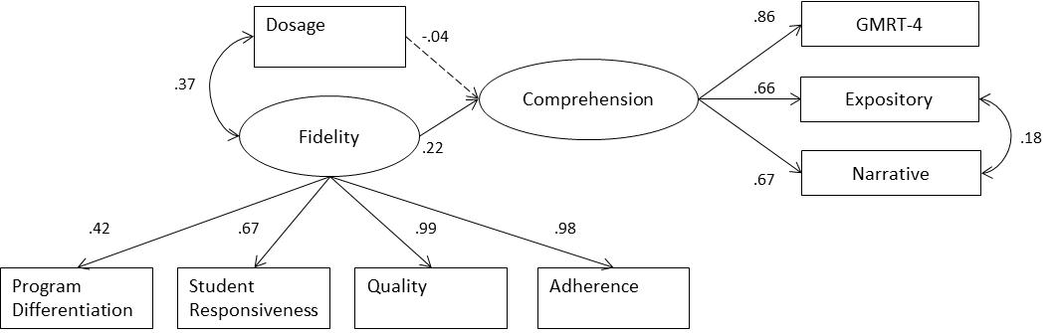
Structural Model Examining
Structural Model Examining Role of Fidelity in Treatment Condition
Variable
Variable
Note. Covariates not included in figure include pretest GMRT-4 scores and dummy coded variables for grade level. χ² (32) = 36.15, p = .28, RMSEA = .02; CFI = .99, SRMR = .06.

Slide 53
Summary
Efficacy – Classwide interventions in heterogeneous secondary classrooms were inadequate to promote differential comprehension.
Differential Benefit: No clear benefit for struggling readers.
Fidelity: Intervention did not take hold consistently despite enhanced PD.
20%: 1 in 5 teachers implemented faithfully and showed significant growth.

Slide 54
Why “It” Didn’t Work
Responsibility – ELA teachers have many responsibilities and there was a perception that the intervention didn’t address the problem.
Sufficiency: Whole class “broad” interventions at the secondary level do not address the fundamental problems of some students.
Capacity: Students – unable to “assist” each other; Teachers – unable to integrate practices into repertoire.

Slide 55
How “No Effects” May be A Desirable Difficulty
Sharpened understanding of heterogeneity.
Made me question the proposition that content area teachers should be responsible for reading instruction.
Strategic reading routines for all teachers: vocabulary, discussion questions, reading methods and active engagement
Realized the importance of highly trained professionals at the secondary level
Re-examine the focus on Process!
Recognized the role of knowledge (vocabulary) and word identification

Slide 56
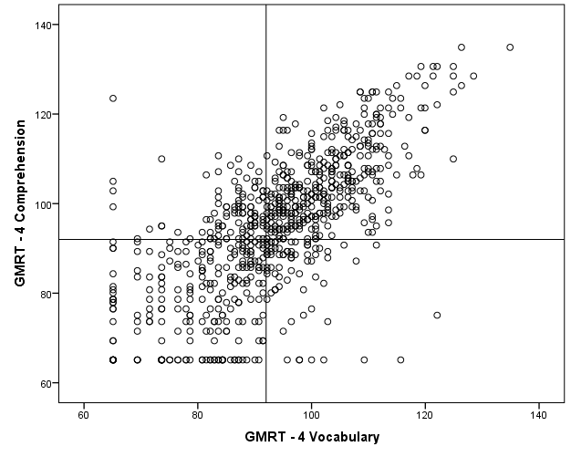
Sources of Student Difficulty: Pressure Points
30th %ile
13%
47%
n = 422
30th %ile
n = 278
28%
12%
70% of low comprehenders demonstrated vocabulary scores below the 30th percentile
Notes:
We form part of the intervention arm of the PACT project…what we were struck by following the first two years of intervention work was the level of basic reading skills deficits. Our team went in armed for comprehension strategy instruction….but we soon found how deficient basic processes in vocabulary and word reading were

Slide 57
Conclusions and Next Steps
Struggling adolescent comprehenders demonstrate significant deficiencies in vocabulary and word reading test performance
Vocabulary achievement of students with learning disabilities is quite similar to non-identified low achievers
Vocabulary deficits appear to be greater than word/text fluency, and perhaps more critical
Need to think differently about interventions for struggling comprehenders…
  Strategy instruction is important, but is unlikely to be effective if vocabulary skills are poor
Knowledge instruction
Findings underscore the importance of vocabulary instruction, knowledge acquisition, and wide reading in early elementary school

Slide 58
Imagine a Systemic Focus on Knowledge Development: What is Possible?
Identifying Core Knowledge Concepts across the Disciplines and Classes
Ensuring that Students are Taught and Use Priority Academic Vocabulary
Reading More!
Talking More About Words – Using Vocabulary in Oral and Written Discourse

Slide 59
Possible Sources
The Academic Word List (Averil Coxhead, 2000):
a list of 570 high-incidence and high-utility academic word families
There is a very important specialized vocabulary for learners intending to pursue academic studies in English at the secondary and post-secondary levels.

Slide 60
Level 1 Coxhead
analyze approach area assess assume authority available benefit concept consist context constitute contract data define derive distribute economy environment establish estimate evident factor finance formula function income indicate individual interpret involve issue labor legal legislate major method occur percent period principle proceed process policy require research respond role section sector significant similar source specific structure theory vary

