Slide 1
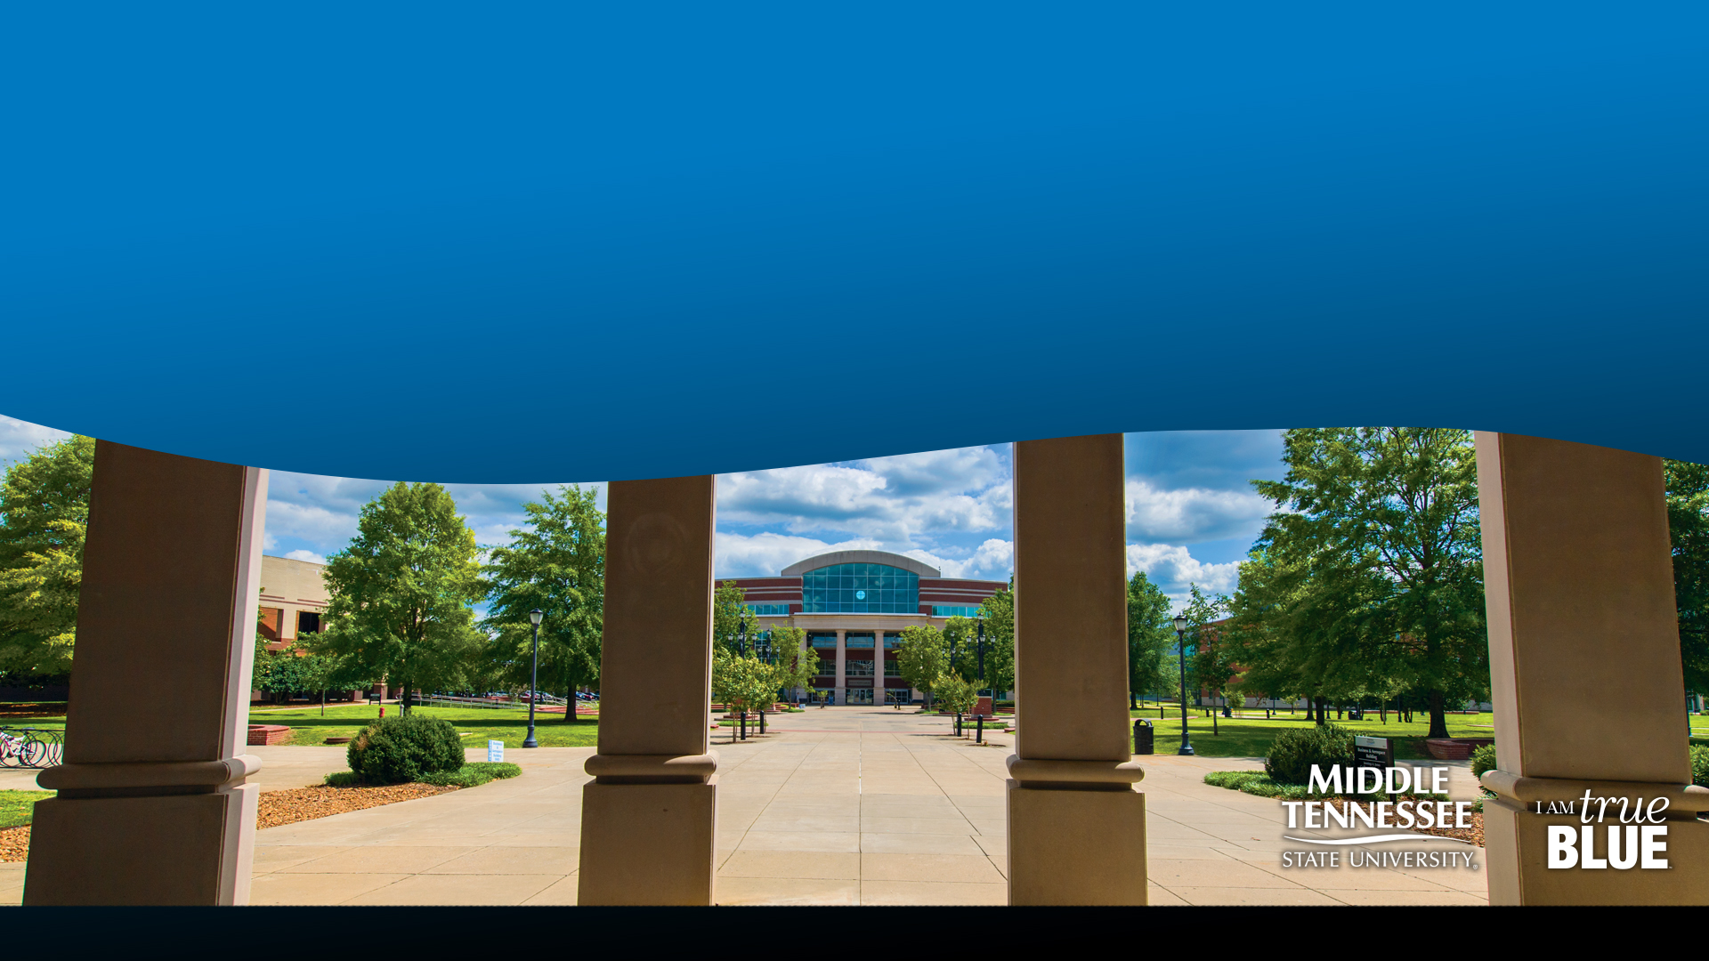
Transforming the image of STEM careers for female middle and high school students across Tennessee

Slide 2
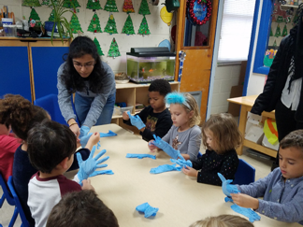
WISTEM Center volunteers have been visiting the MTSU Day Care Lab for several years. In the past we have shown the pre-K children (ages 3-5) simple yet engaging science experiments. This past semester, WISTEM women presented a several experiments using Colors as a theme.
The experiments performed by the kids include:
Tie Dye butterflies
Rainbow skittle art
Colorful Volcano

Slide 3
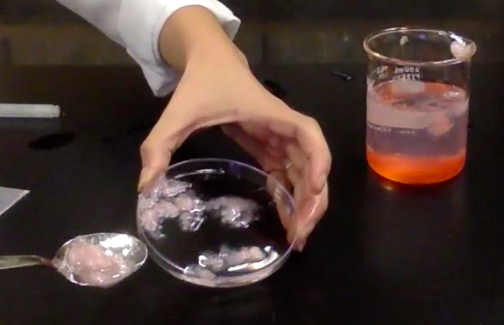
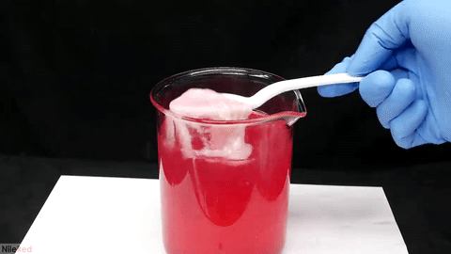
Our Strawberry DNA Extraction workshop allowed the participants to observe what DNA looks like to the human eye.
This simple DNA extraction method uses everyday materials.
The girls can then repeat this experiment at home with friends and family.

Slide 4
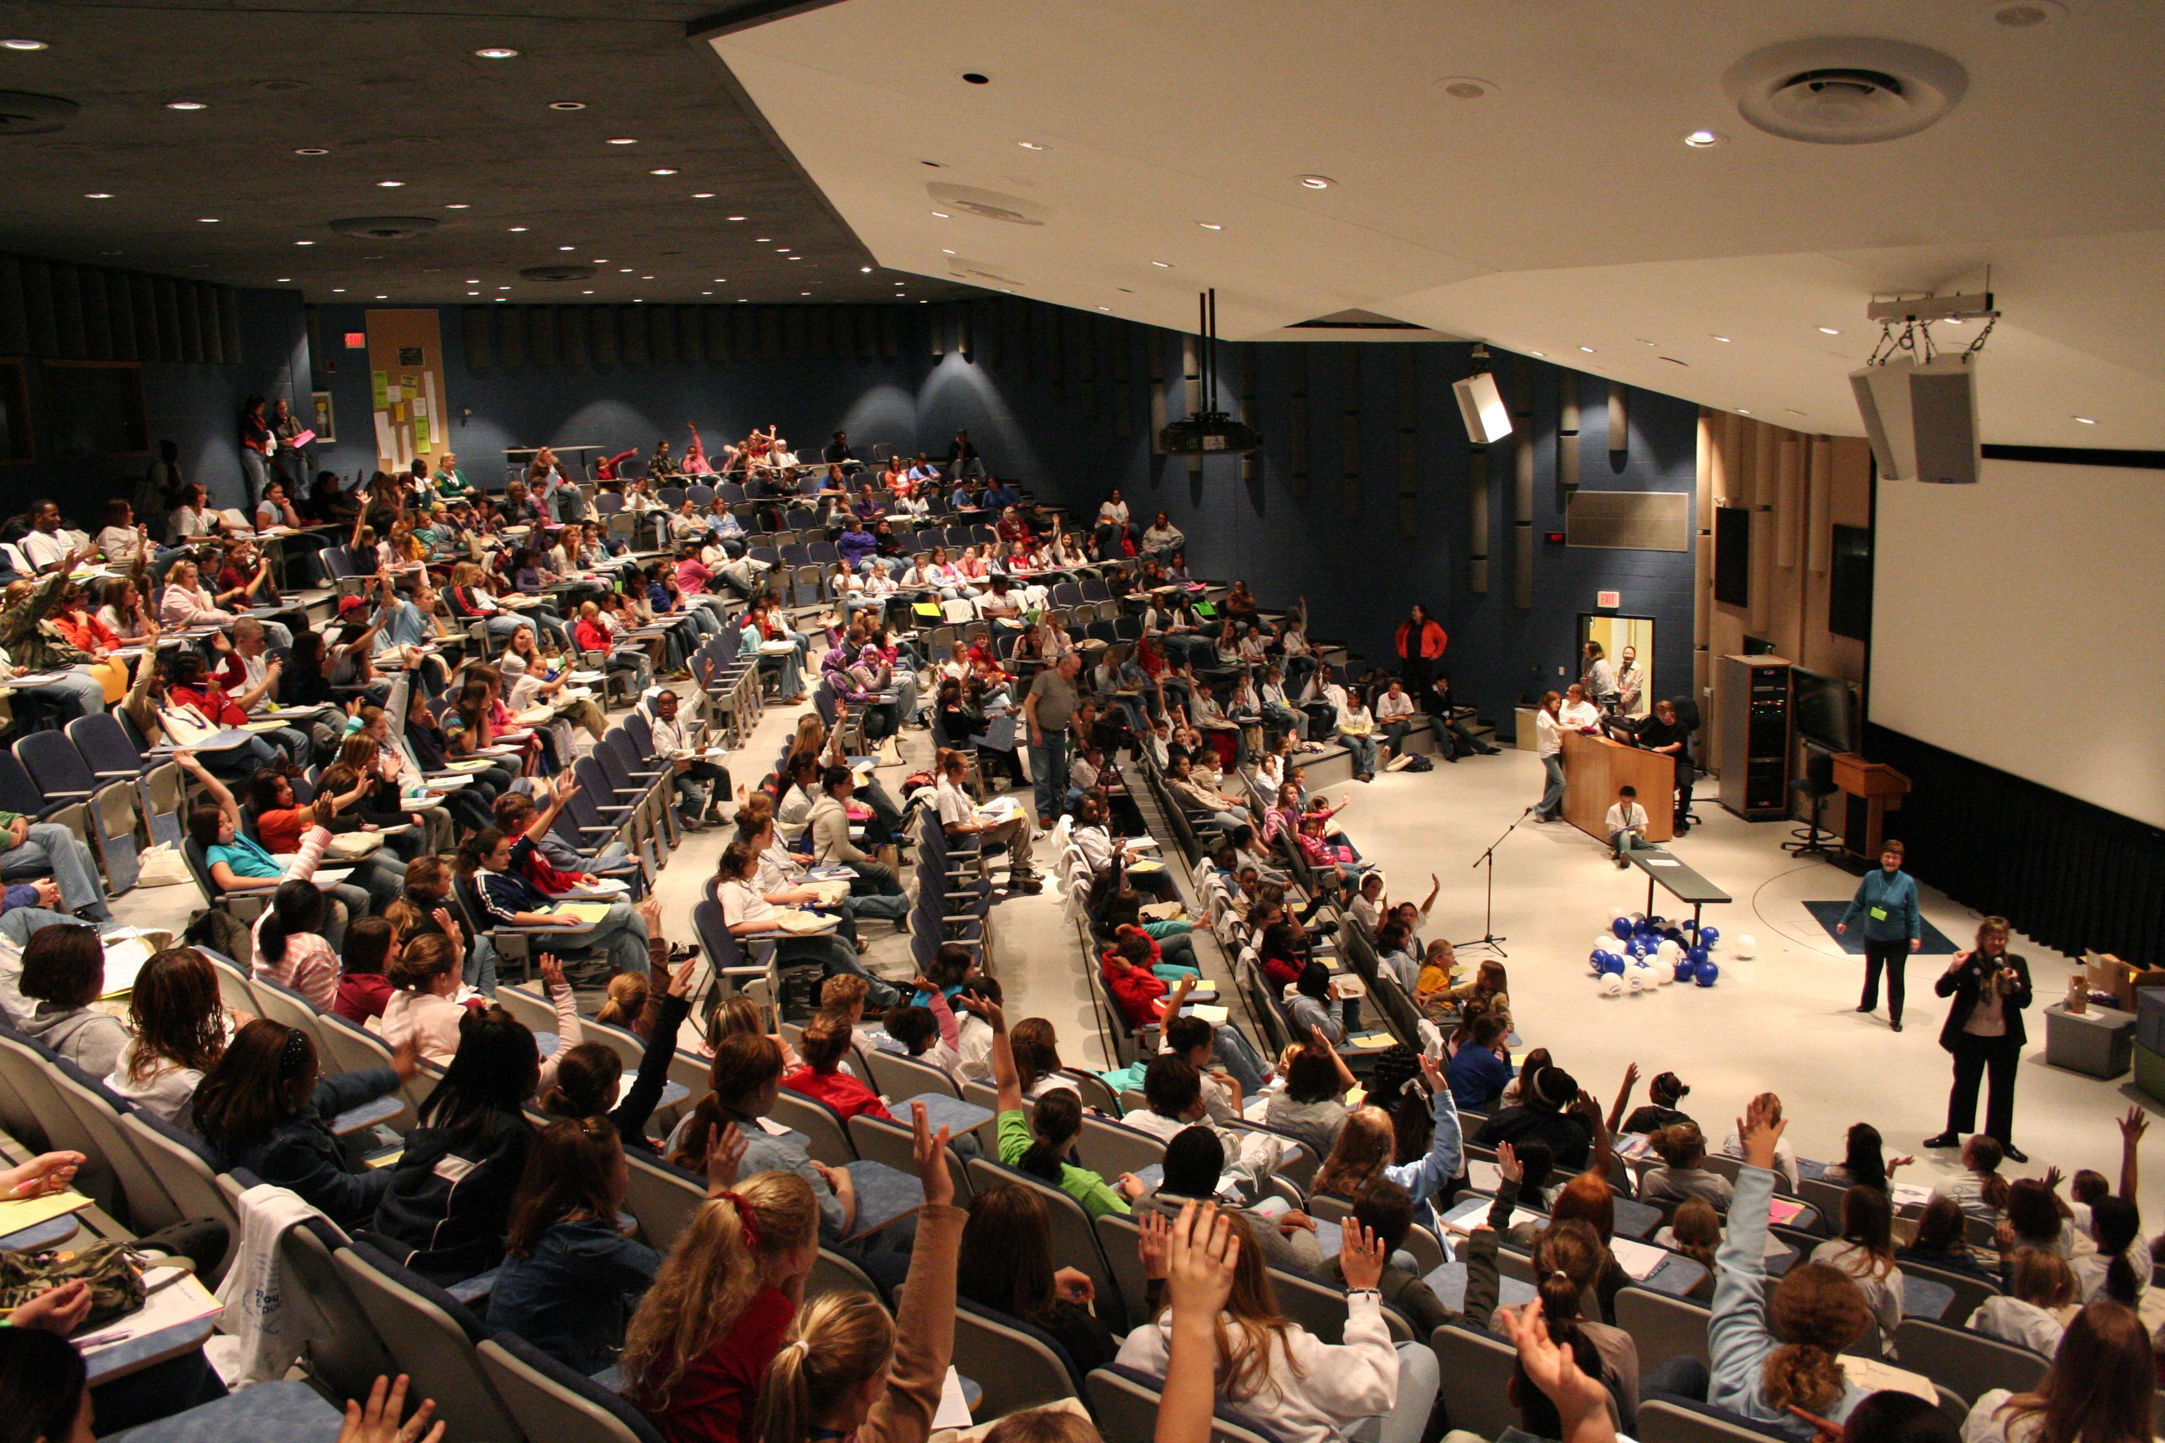
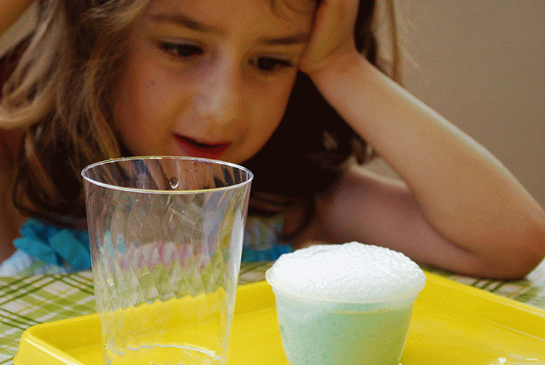
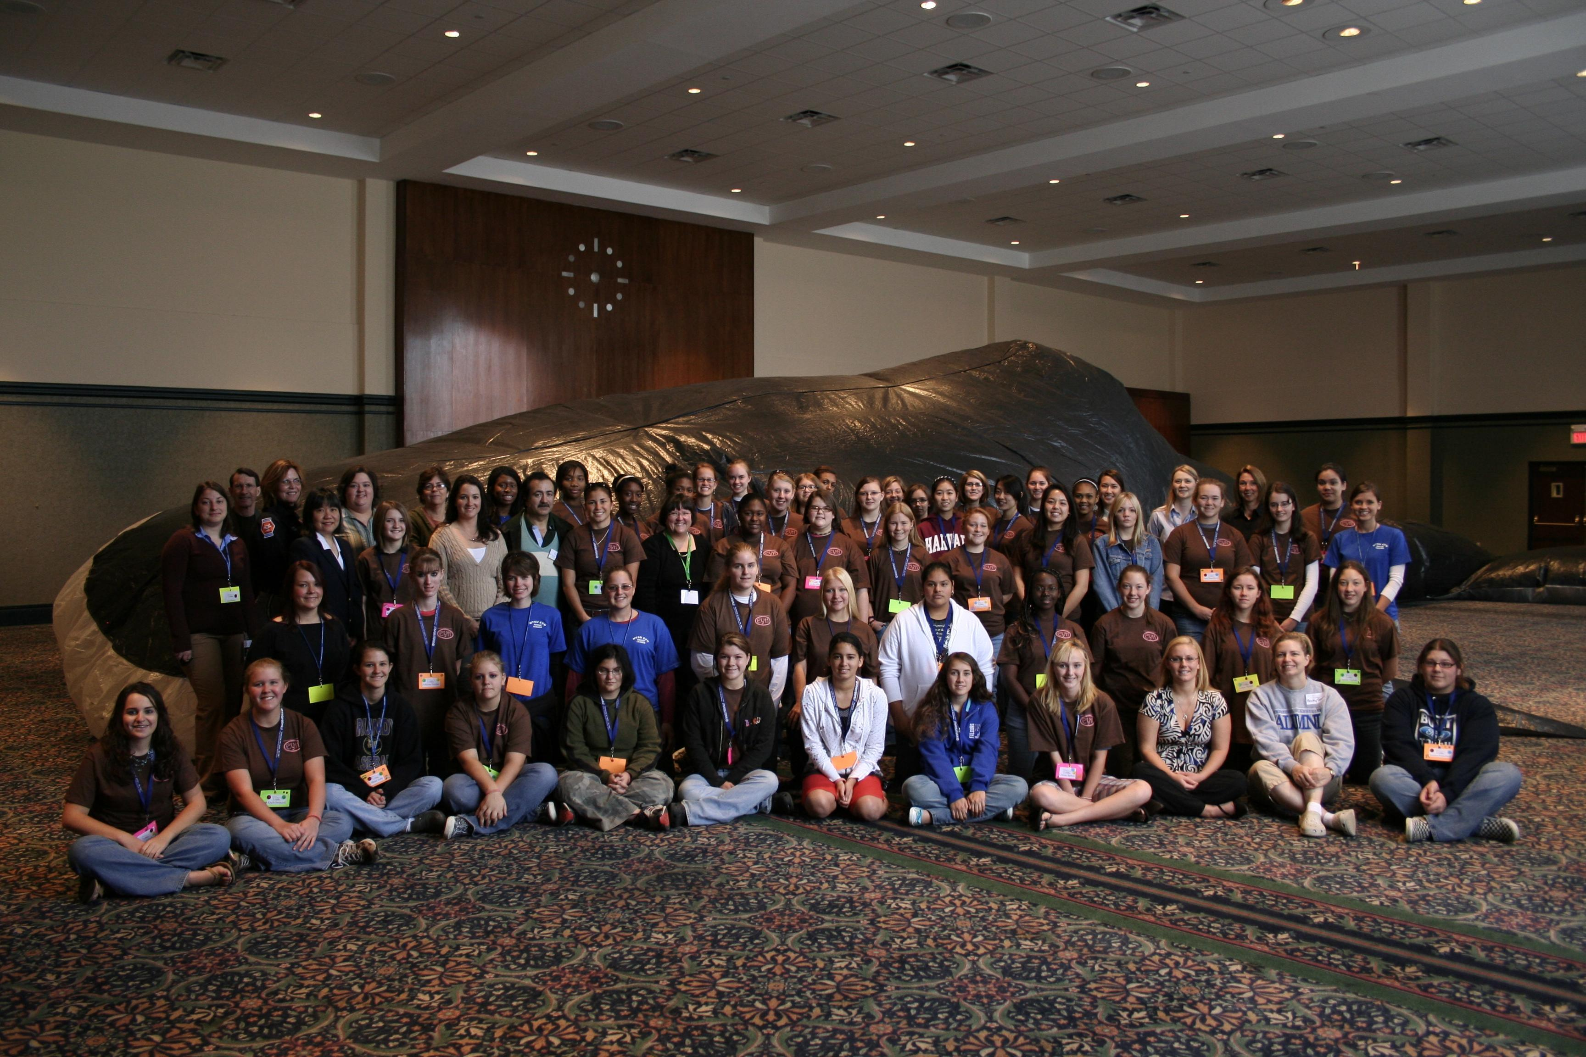
No one told me I could go to college.
Can I do science with the skittles again?
Woah science is fun! Can you do that again?
This was cool, I didn’t know strawberries had DNA

Slide 5
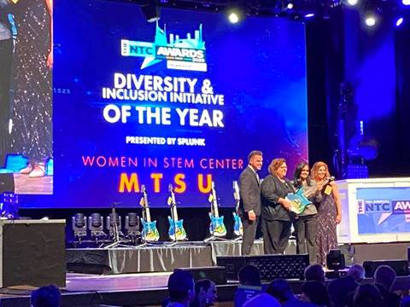
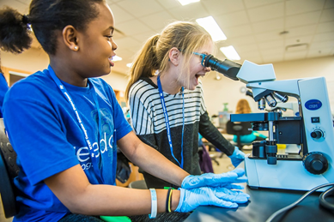
WISTEM Center
Current programs:
Professional Development
EYH
Daycare Lab Science
Chocolate Challenge
Dinner with accomplished speakers
Mentoring high school students
Awards:
2020 Award for Diversity and Inclusion Initiative of the Year from the Nashville Technology Council
Conferences:
The 150th Anniversary of the Periodic Table at the 2019 TSTA conference
2021 Pacifichem Congress

