Slide 1
How Effective is Your Communication?
Best Practices Across Centers

Slide 2
“The characteristics of being a good communicator as well as genuine and caring are conducive to productive advising sessions and result in successful student outcomes.”
Hughey, Nacada Journal (2011)
Notes:
Not just with students, but with campus centers, staff, faculty, etc.

Slide 3
Let’s start a conversation!
Roundtable discussion of best practices and areas of concern for communication with students
Referrals
Campaigns and appointments
Building trust and relationships
Share with the room
Roundtable discussion of best practices and areas of concern for communication across departments/resources
Resources used
Strategies for connecting them with students
Networking and building relationships
Share with the room

Slide 4
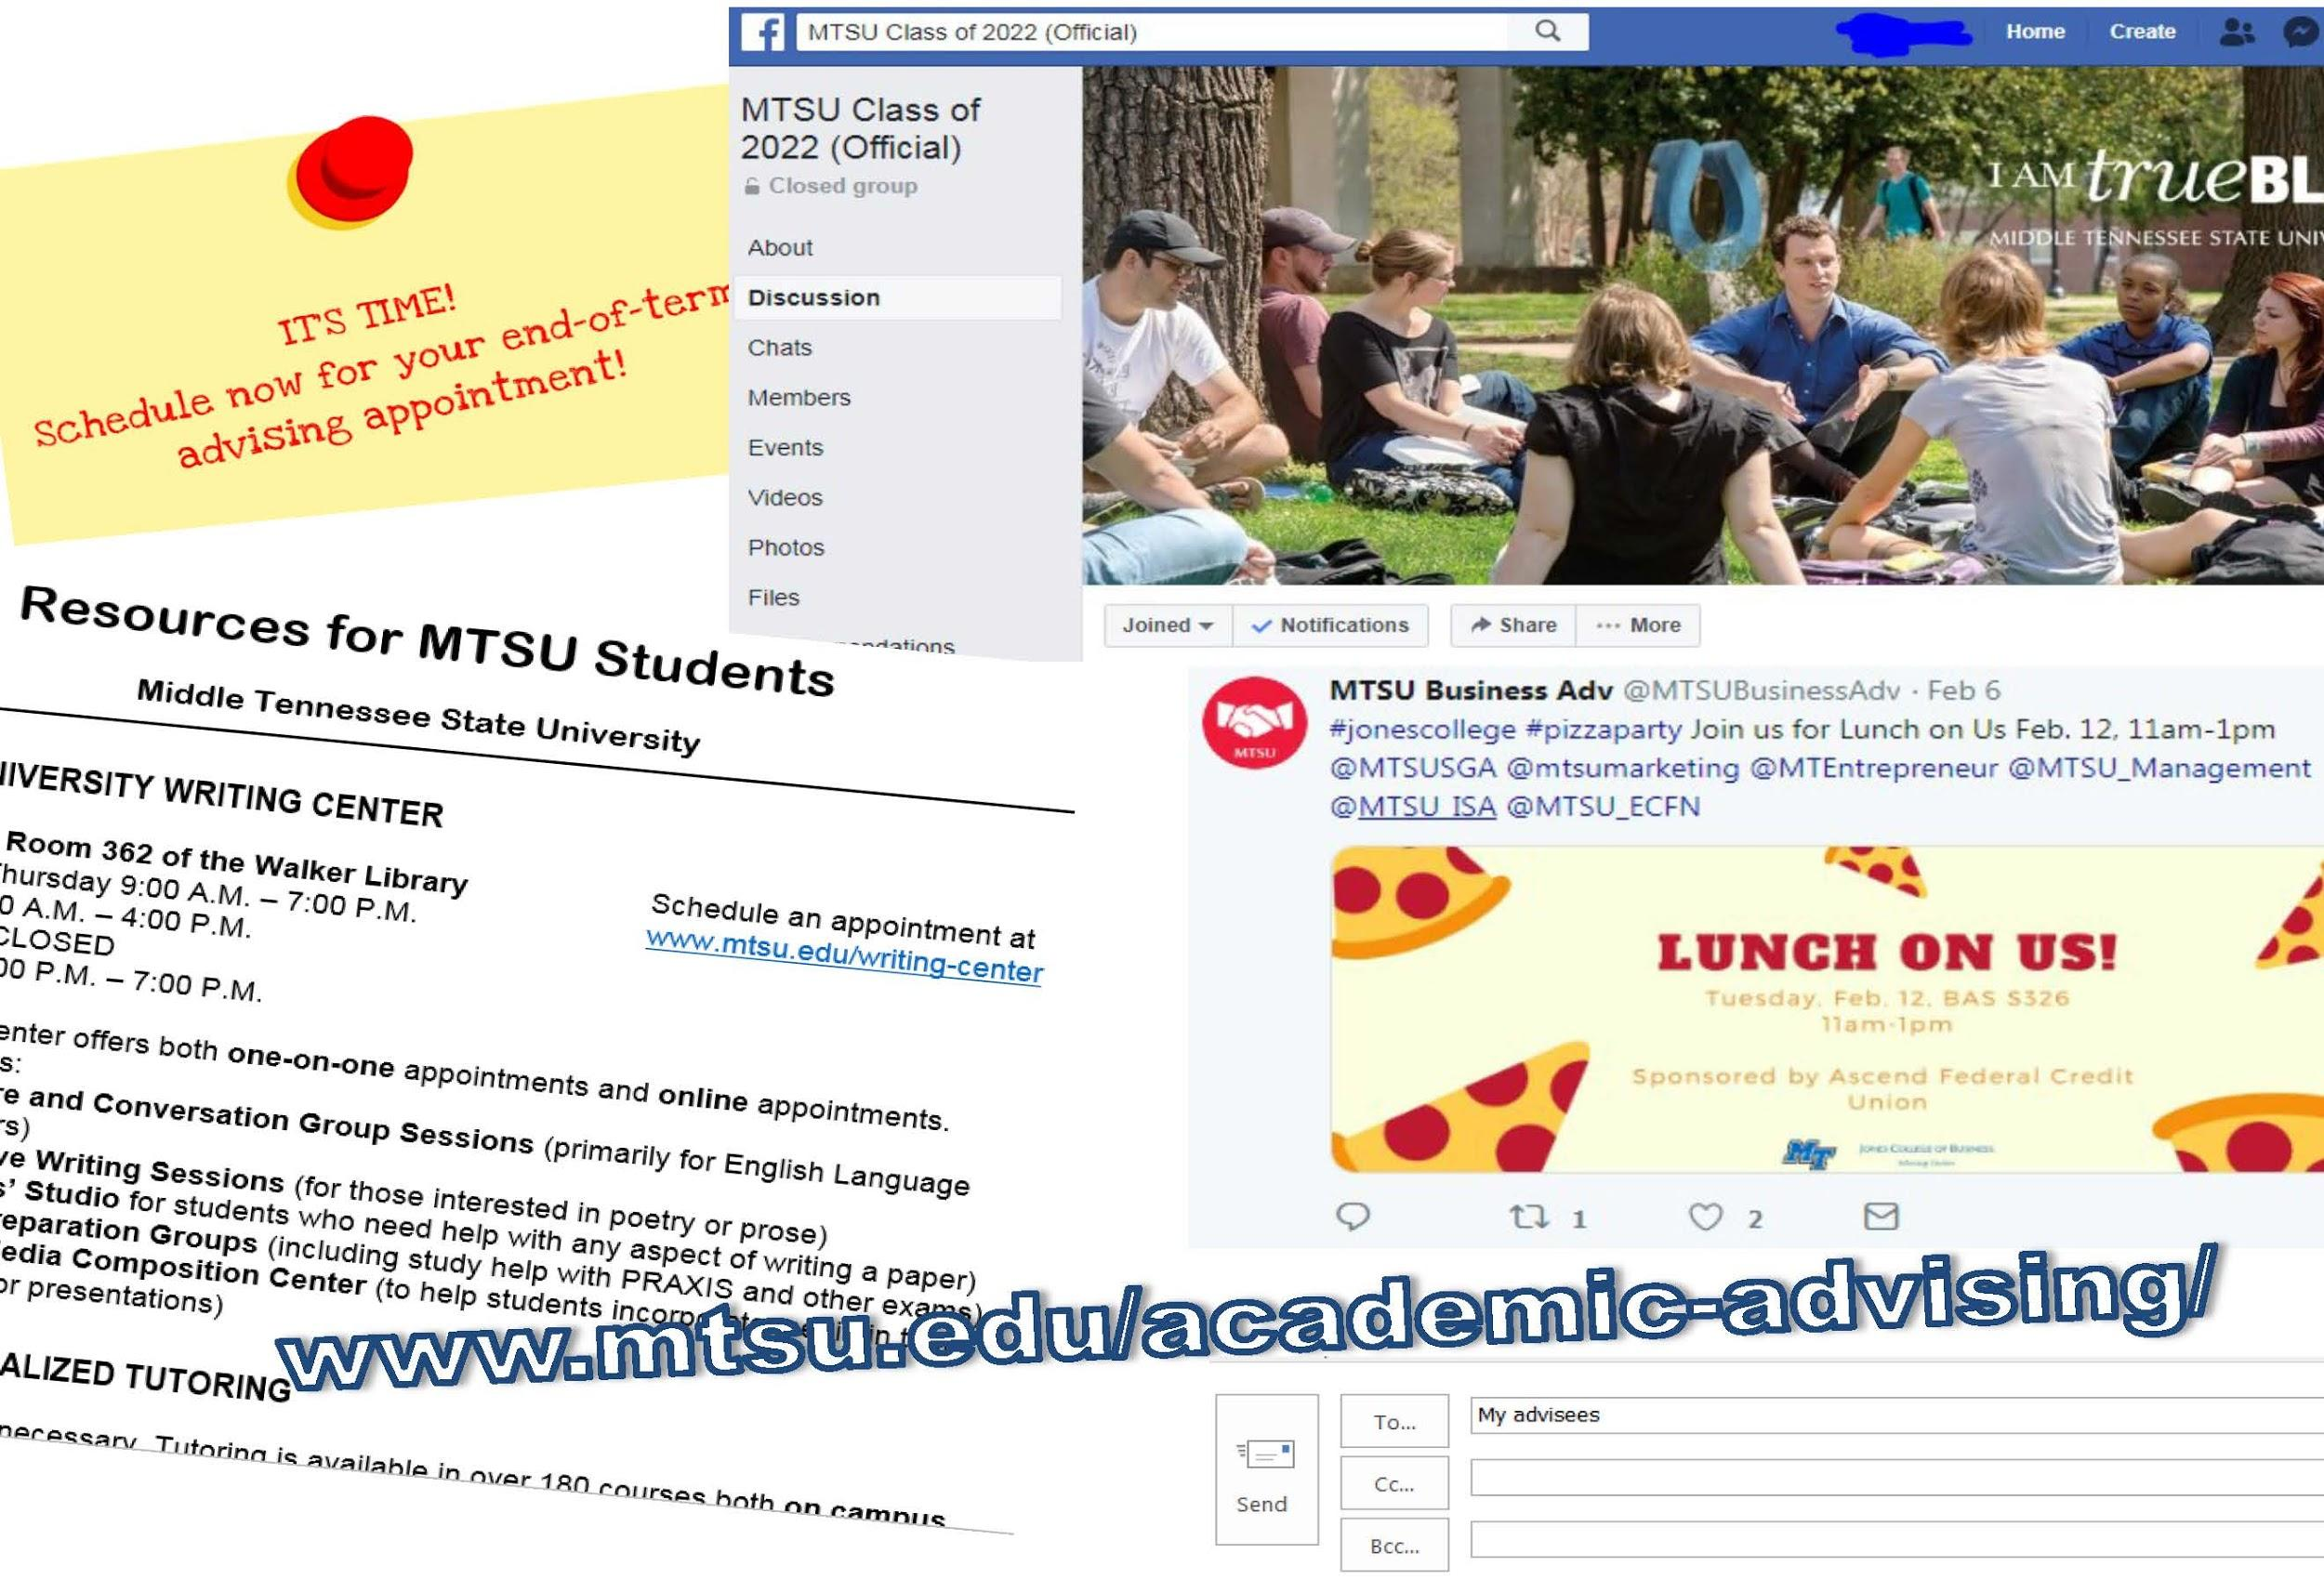
Best Practices: Communicating with Students

Slide 5
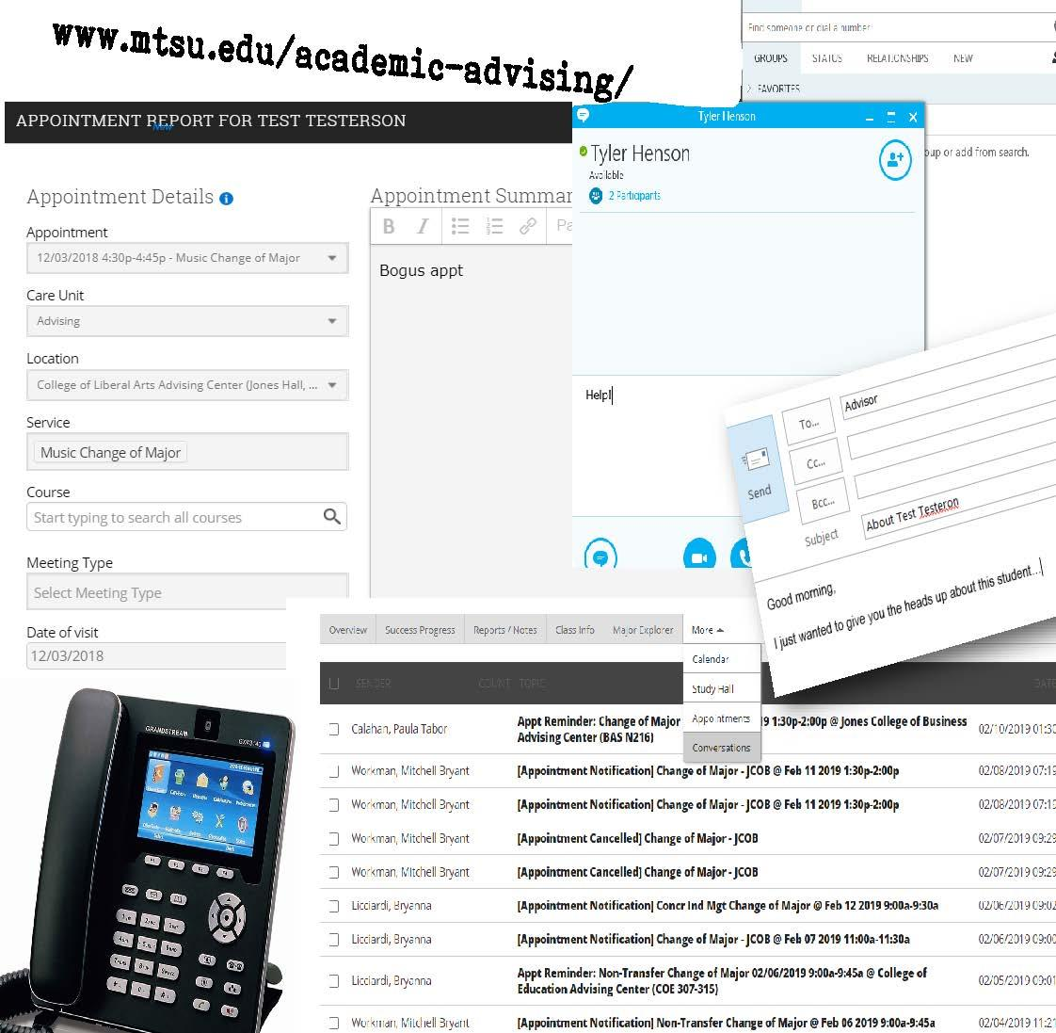
Best Practices: Communicating Across Campus

Slide 6
Effective Communication: Best Practices Resources
https://www.nacada.ksu.edu/Resources/Clearinghouse/View-Articles/Effective-communication-in-academic-advising.aspx
https://www.nacada.ksu.edu/Resources/Academic-Advising-Today/View-Articles/Adapting-Solution-Focused-Questioning-into-Advising.aspx
https://www.nacada.ksu.edu/Portals/0/Resources/Clearinghouse/Documents/C202-H01.docx
https://nacadajournal.org/doi/pdf/10.12930/0271-9517-31.2.22
https://www.nacada.ksu.edu/Resources/Clearinghouse/View-Articles/Tips-on-making-effective-referrals.aspx
https://www.nacada.ksu.edu/Resources/Academic-Advising-Today/View-Articles/How-to-Make-Effective-Referrals-A-Three-Step-Framework.aspx
http://www.mtsu.edu/academic-advising
https://www.nacada.ksu.edu/Portals/0/Resources/Publications/documents/59.%20Building%20college%20knowledge%20-%20YES.pdf
https://www.nacada.ksu.edu/Portals/0/Webinars/documents/DW65%20HANDOUT.pdf

