Slide 1
Growing Voters Abby Kiesa, Director of Impact, CIRCLE

Slide 2
A national, nonpartisan research center founded in 2001 and focused on young people in the United States, especially those who are marginalized or disadvantaged in political life.
CIRCLE’s scholarly research informs policy and practice for healthier youth development and a better democracy.
Innovation Broker
Research and Analysis
Collaborative Enabler of Systems Change
Notes:
Important point about differences among youth
We do not have a lot of disaggregated data yet

Slide 3
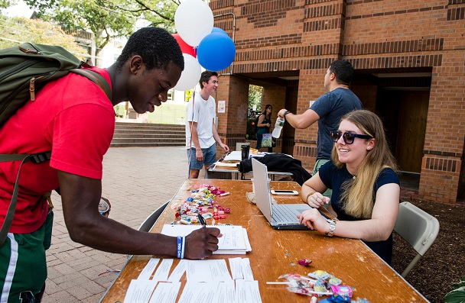
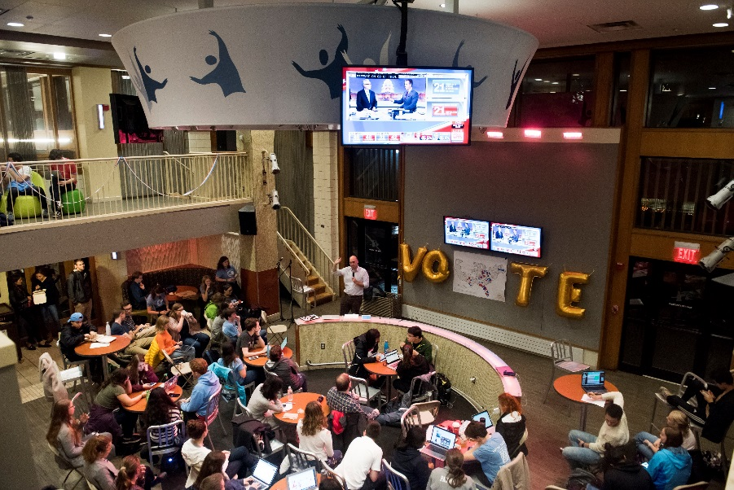
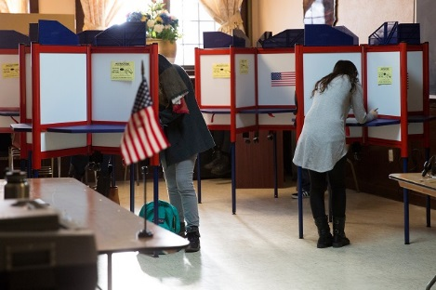
@TischCollege @civicyouth

Slide 4
Our Approach to Youth Voting
Voting is an entry point into civic life for many
We are concerned with HOW MANY,
HOW, and WHICH young people participate
A tool to help reduce SYSTEMIC GAPS
in youth civic opportunity

Slide 5
What We Do
CIRCLE Research
Who participates? Votes?
What are their experiences?
Research Informs Action & More Inclusive Systems
Future of Democracy
Equitable representation
Diverse Youth Voices
What do they do after?
Thriving Communities
Notes:
[Abby introduces CIRCLE]

Slide 6
MYTHS #1 and #2
Youth voting has been on a decline for decades.
Young people are apathetic for the most part.

Slide 7
Youth voter turnout in 2018 increased in EVERY STATE we looked at…
In 31 states, youth turnout increased by double digits
In 19 states it increased by 15 or more percentage points
In 5 states it increased by 20 or more percentage points
Notes:
Let me share some of what we learned in 2018
Highest youth turnout in a midterm election in at least the last 25 years!

Slide 8
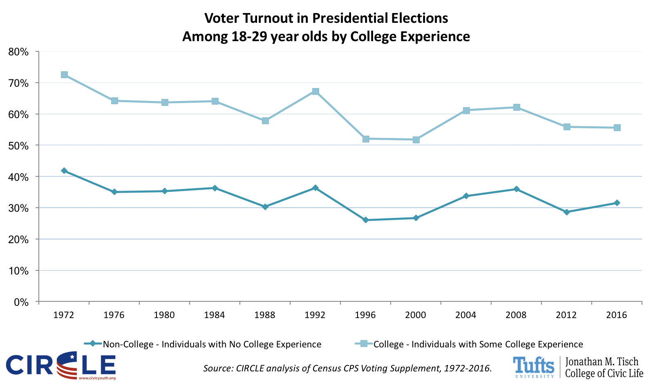

Slide 9
Myths #3 and #4
Young people choose not to vote.
There are lots of ways that young people are encouraged to participate and to find out about elections, but they ignore it.

Slide 10
Most c4 Outreach in 2018 Was Focused On Those Who Voted in 2016
Notes:
Almost two-thirds (65%) of those who had voted in 2016 were contacted at least once in 2018, among those who hadn’t voted in 2016, just 37% were contacted.

Slide 11
Access Even to Traditional Civic Institutions Differs

Slide 12
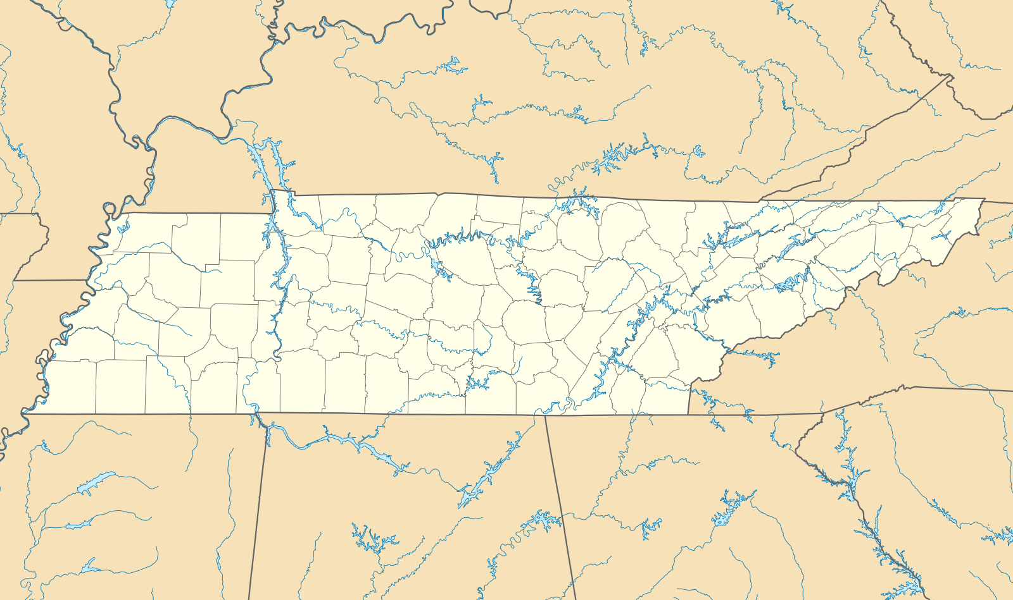
Opportunity to build on 2018 when Tennessee youth voter turnout jumped 13 percentage points

Slide 13
But, across the state, turnout differs dramatically by county. In 2016, the lowest was 13% and the highest 52%.
BUT, youth in every county matter.

Slide 14
In other forms of engagement, youth in TN look like the national average:
53% discuss political or social issues with friends or family,
7% have contacted or visited a public official to express an opinion,
25% volunteer,
14% work with neighbors to do something positive in their community

Slide 15
How can conversations about and participation in elections be…
VISIBLE
ACCESSIBLE
MEANINGFUL
...TO A WIDE DIVERSITY OF YOUTH?
Notes:
PETER
These are all amazing examples…and, we know from research that there are some youth who are left out, who aren’t asked what they think and who aren’t reached out to during elections.
So, how can we make elections more visible, accessible and meaningful to more and more diverse young people?

Slide 16
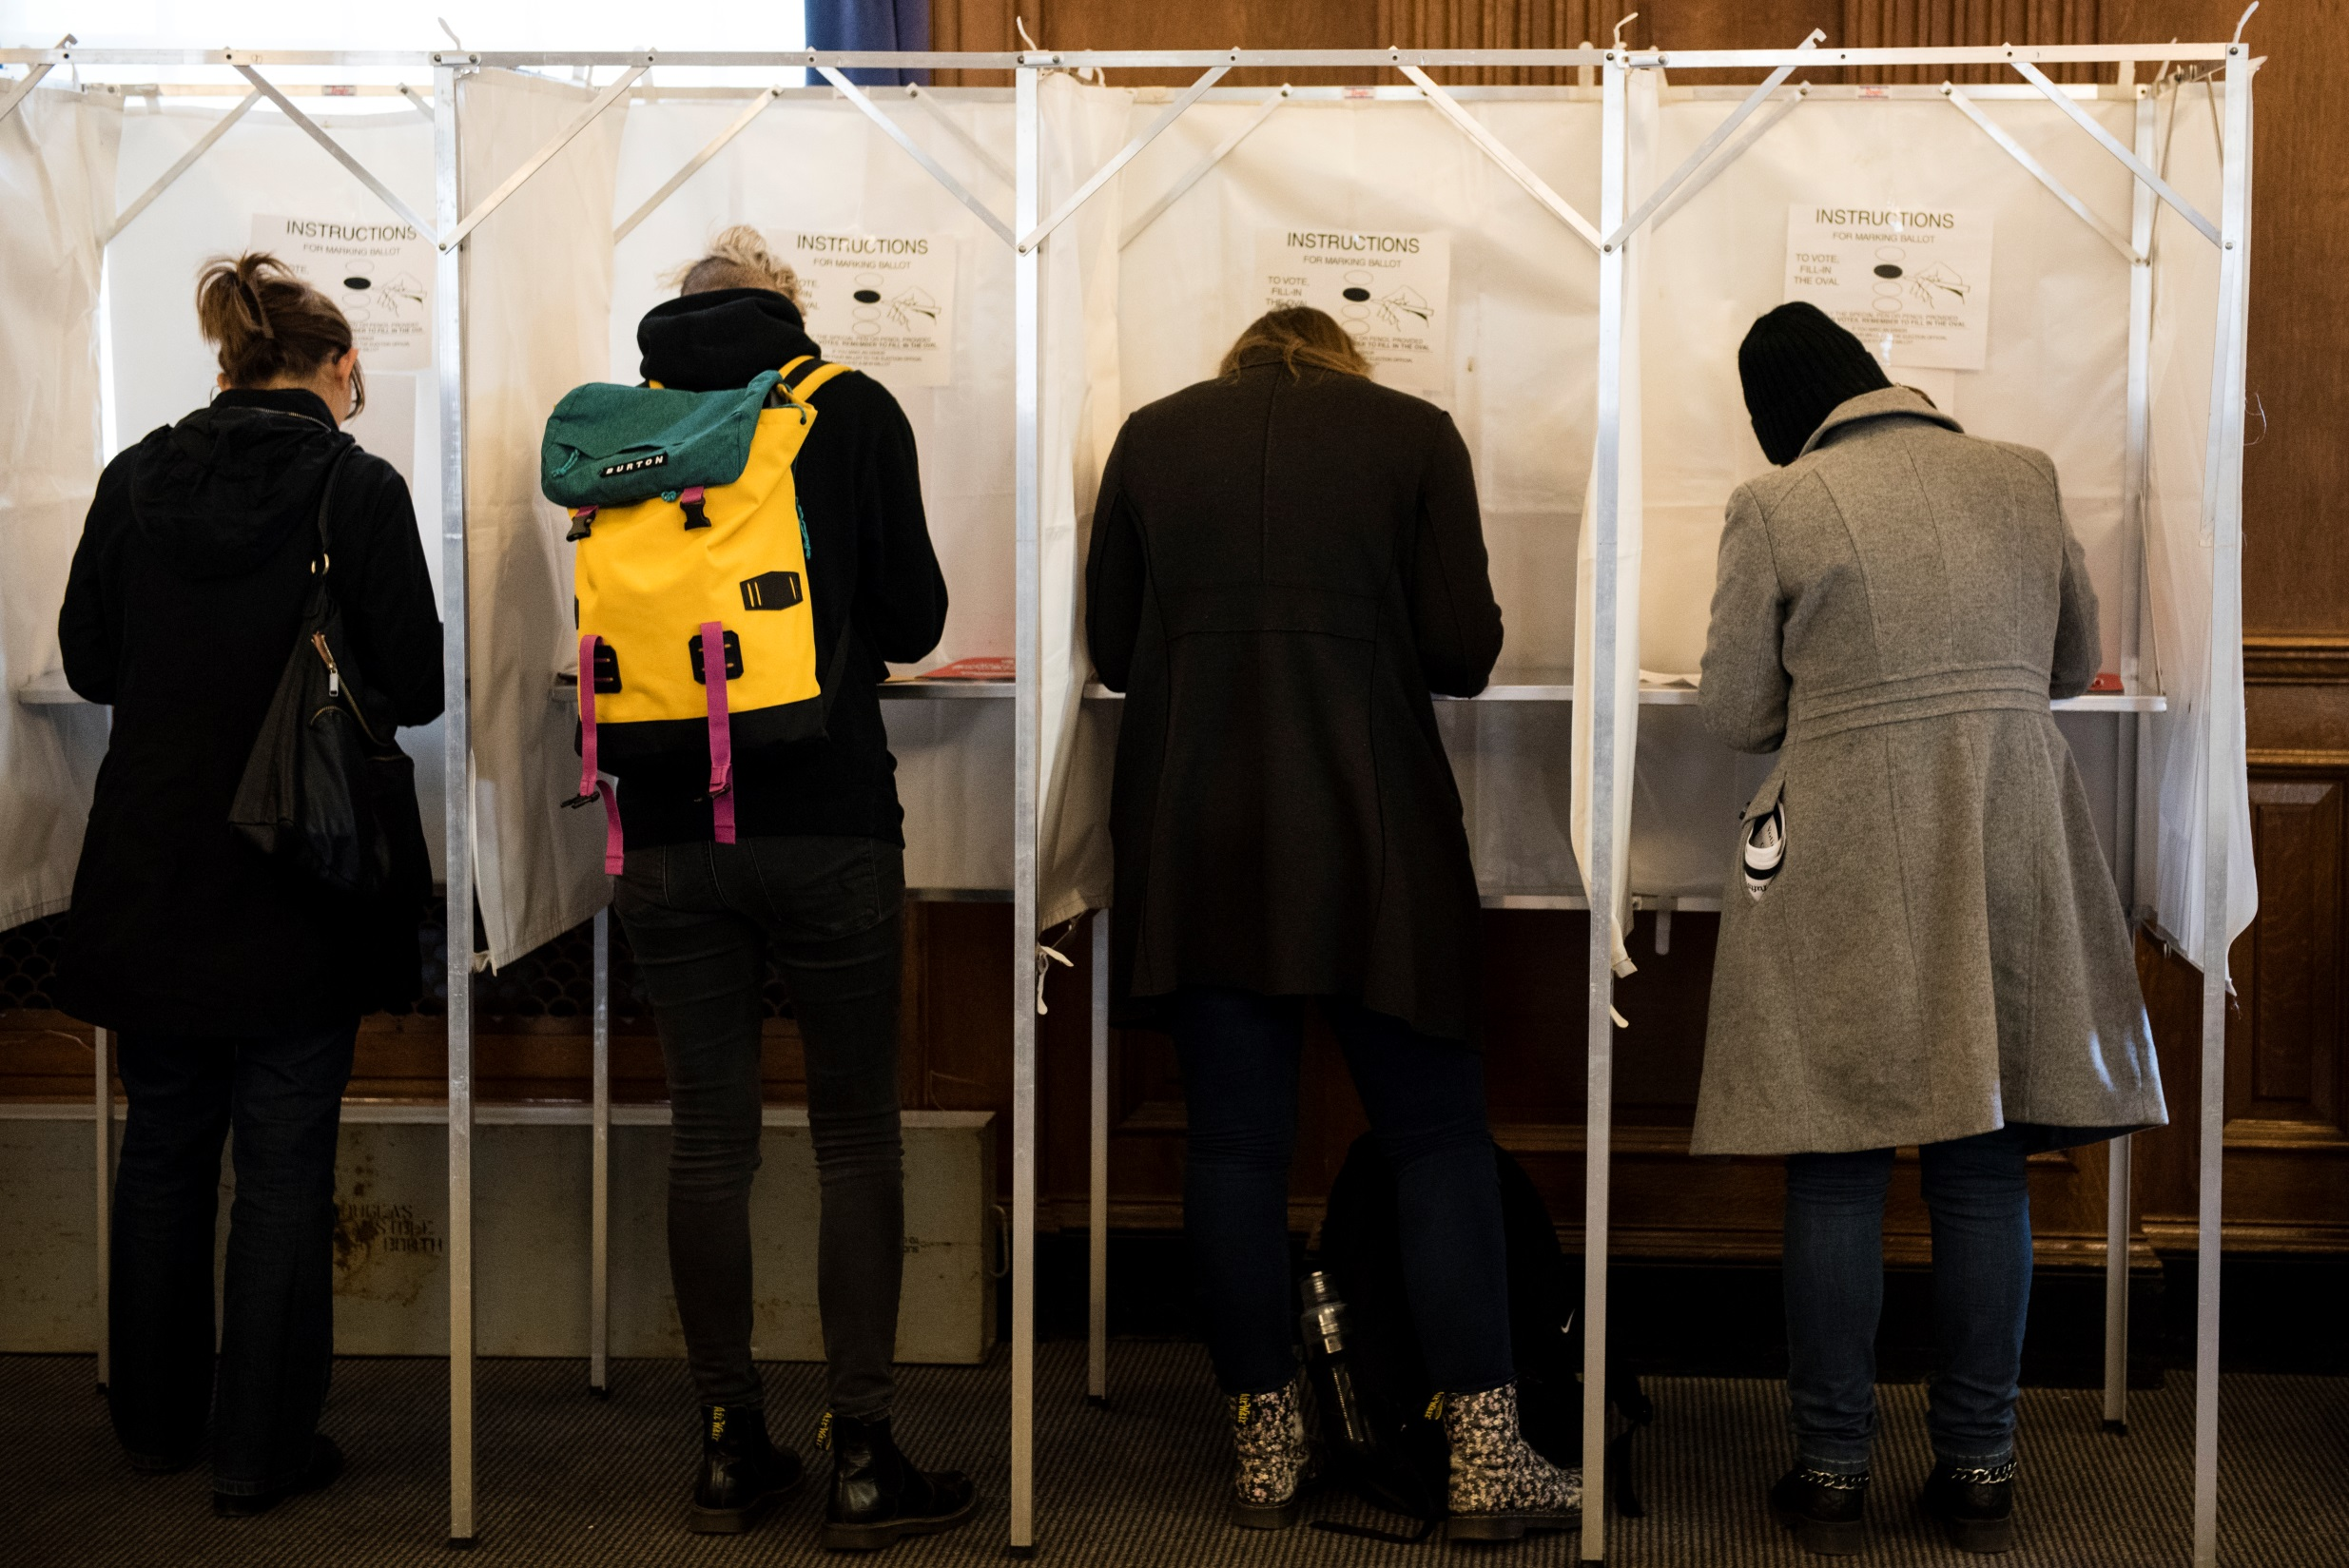
A paradigm shift . . .
FROM
TO
“Mobilizing”
Voters
“Growing”
Voters

Slide 17
AND WE NEED MANY STAKEHOLDERS TO SUPPORT A DIVERSITY OF PATHWAYS

Slide 18
Many stakeholders can influence youth voting, both positively and negatively…
Community Conditions
Local Voter Outreach
Civic Culture
Youth
County Voting Locations and Times
Election Administrators
Local nonprofit community/social service centers
Neighborhoods
Local Youth Organizations
K12 schools

Slide 20
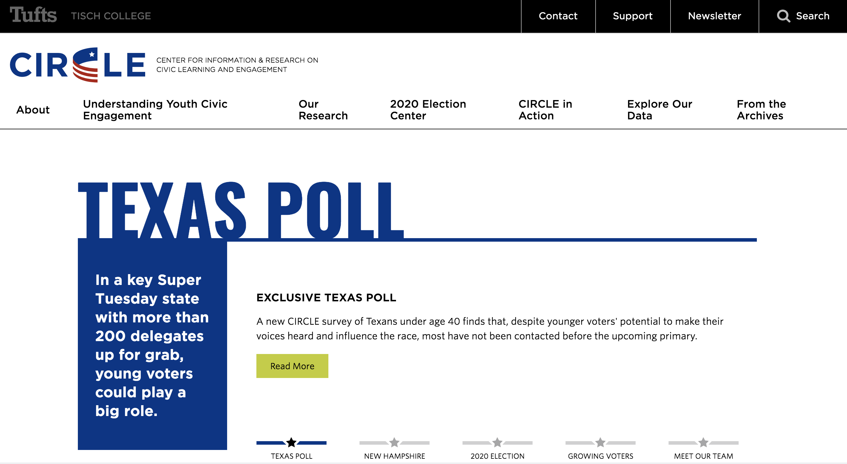
CIRCLE.tufts.edu

