Slide 1
Athletics Year in Review 2020-2021
Academic and Athletic Achievement

Slide 2
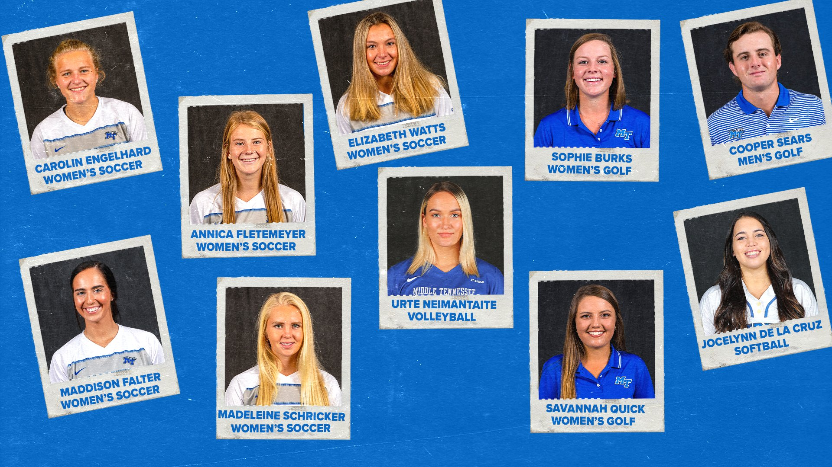
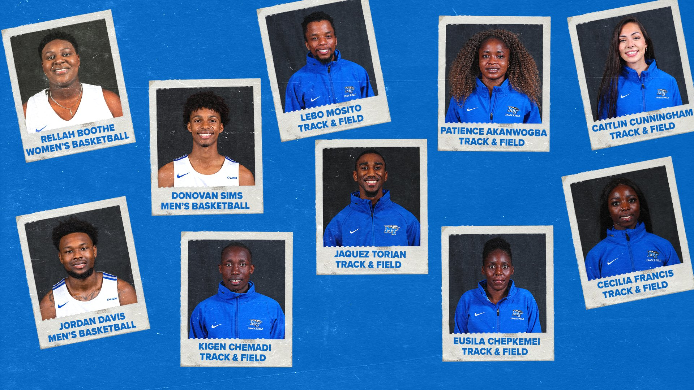
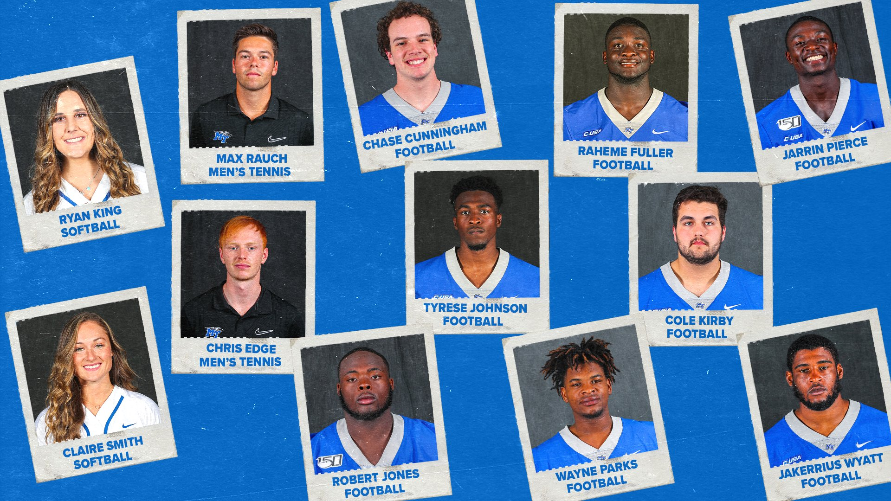
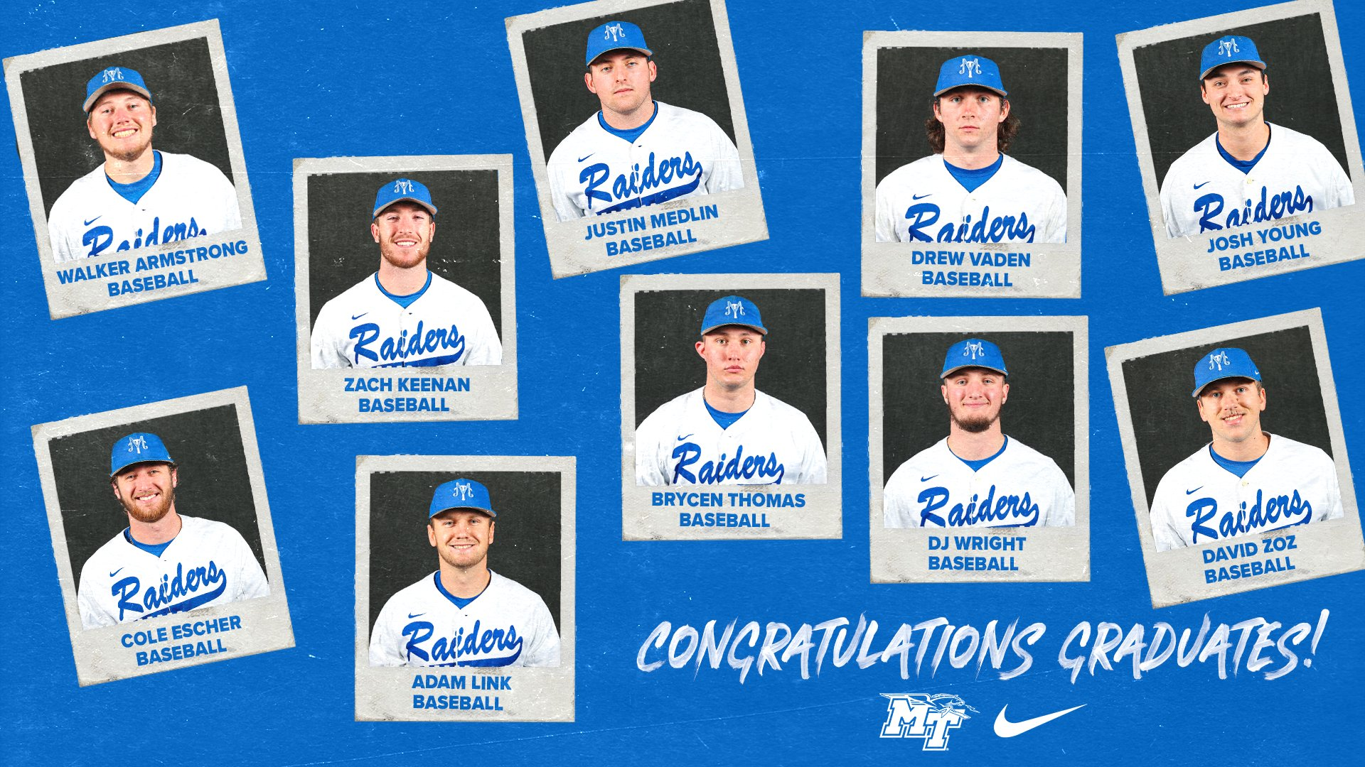
Student Athlete Graduation
Fall of 2020 18
Spring of 2021 46

Slide 3
Academic Achievement
Conference USA Honor Roll (3.0 GPA and higher) 209 student athletes achieved (up from 186 from last year)
Conference USA Academic Medal (3.75 GPA or higher) 67 student athletes (up from 58 last year)
57 Student Athletes earned a perfect 4.0 Spring Semester
213 of 335student athletes had a 3.0 or higher (64%) Spring Semester
Women’s Golf had the highest semester GPA for women’s sports 3.789
Men’s Tennis had the highest semester GPA for men’s sports 3.907

Slide 4
4 YR TEAM ANNUAL PROGRESS RATES

Slide 5
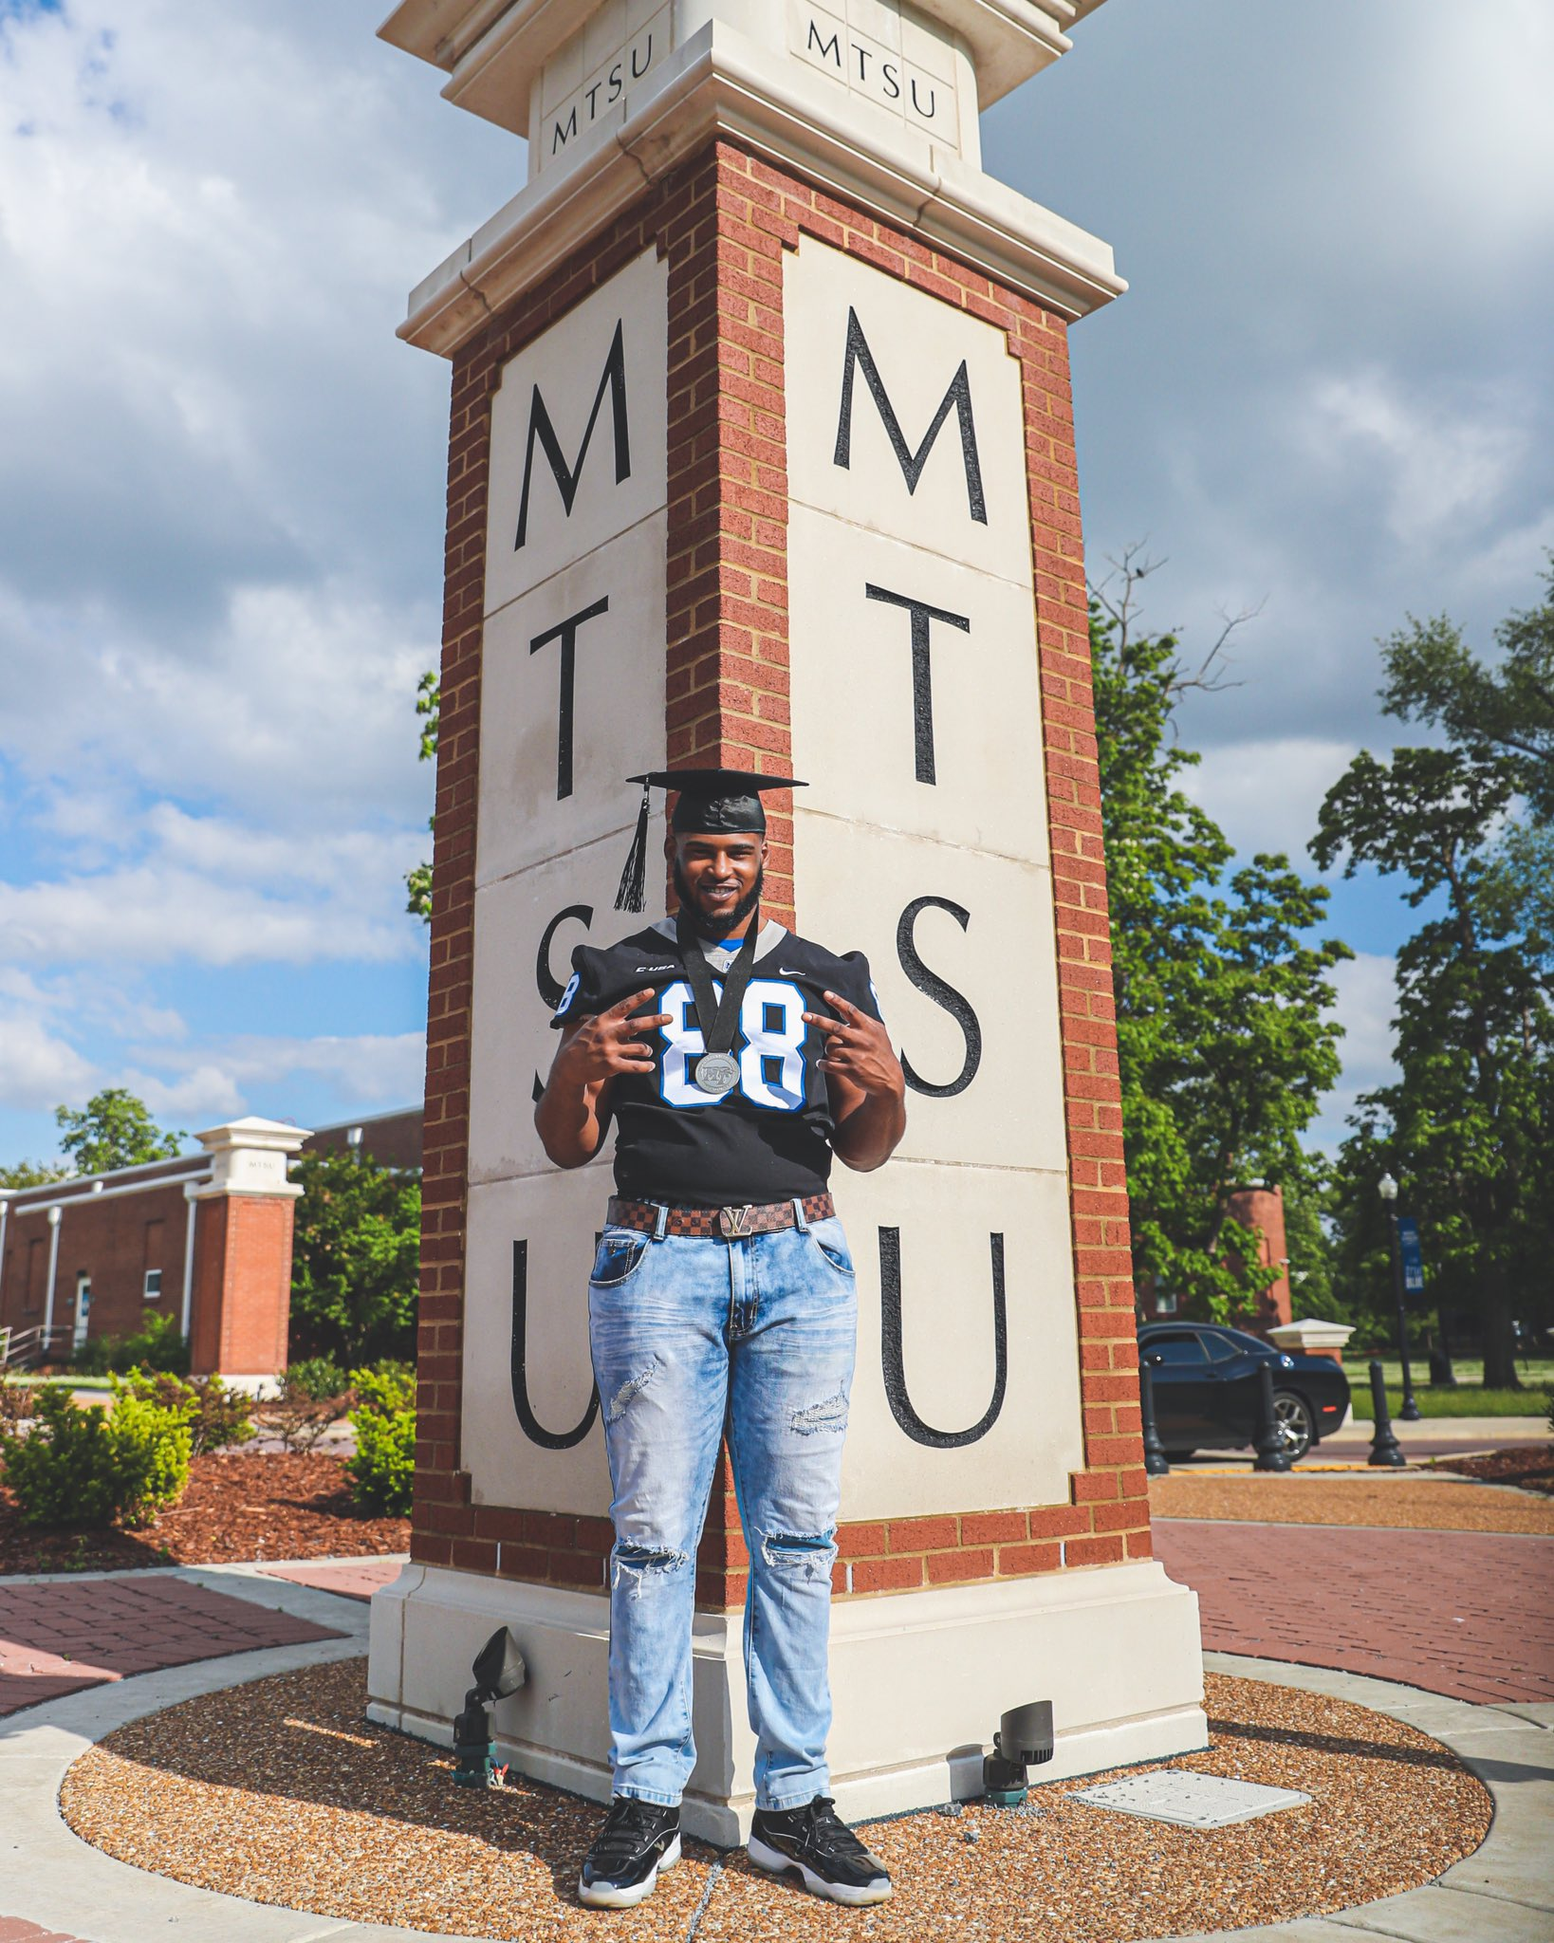
Graduation Success Rate
Department 93%
Football 95%
Tied for third nationally
(Northwestern 97, Duke 97, MT 95, Vanderbilt 95)
Eight programs scored a perfect 100% GSR score

Slide 6
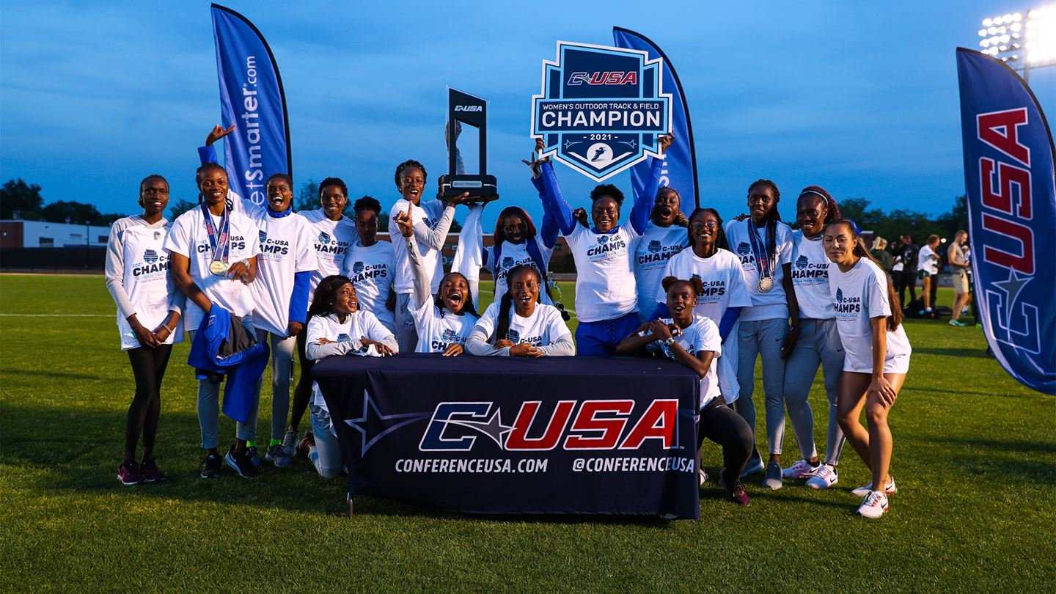
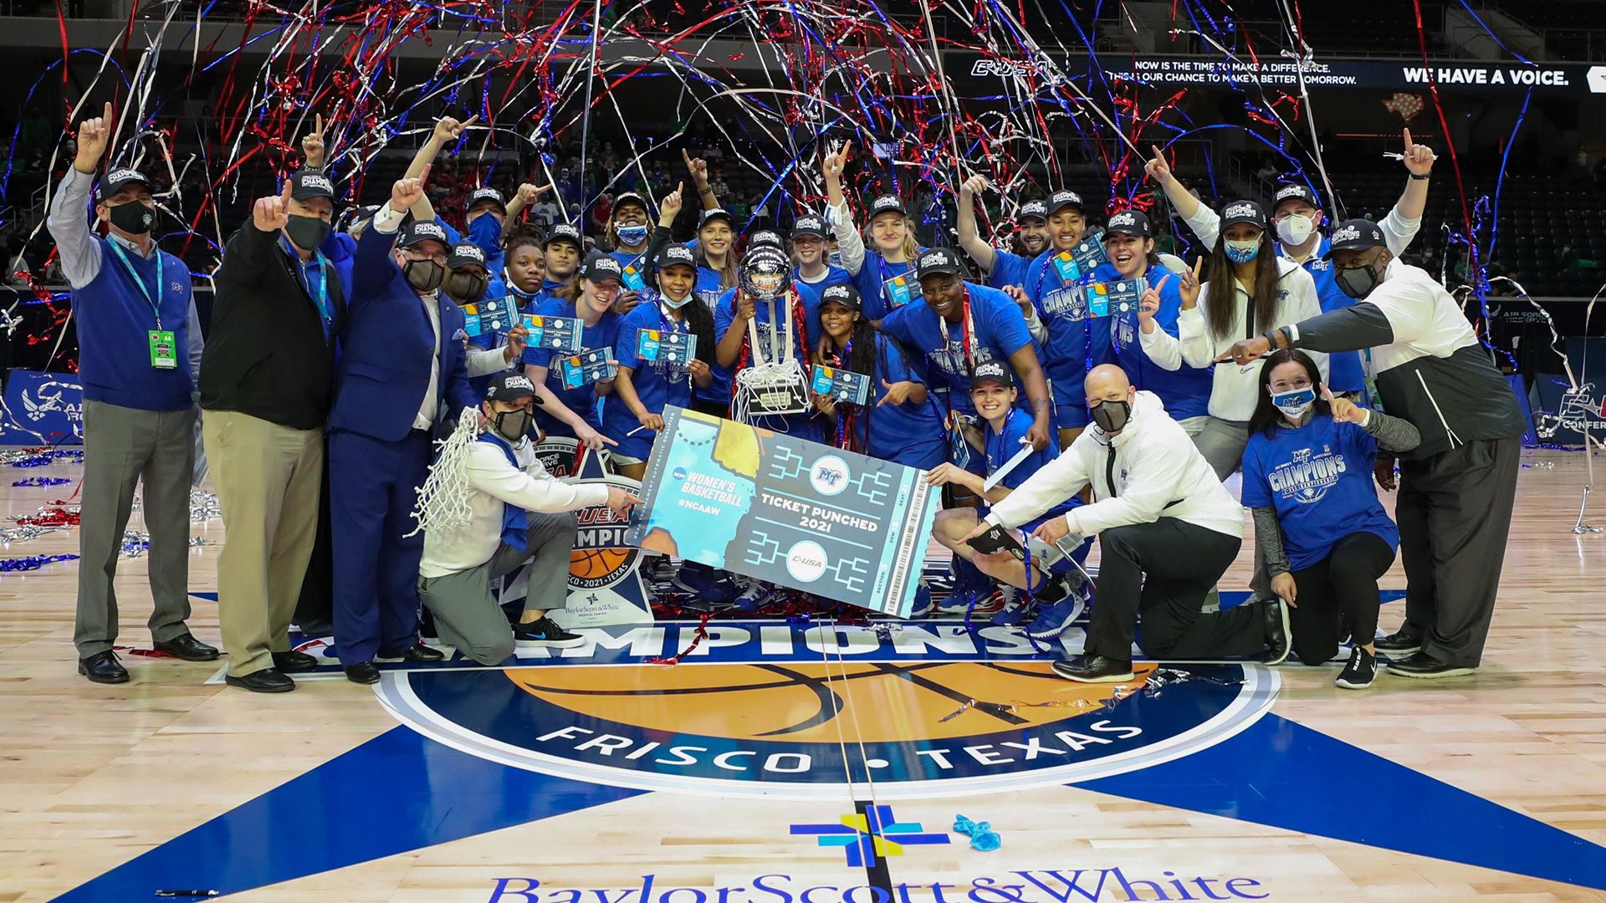
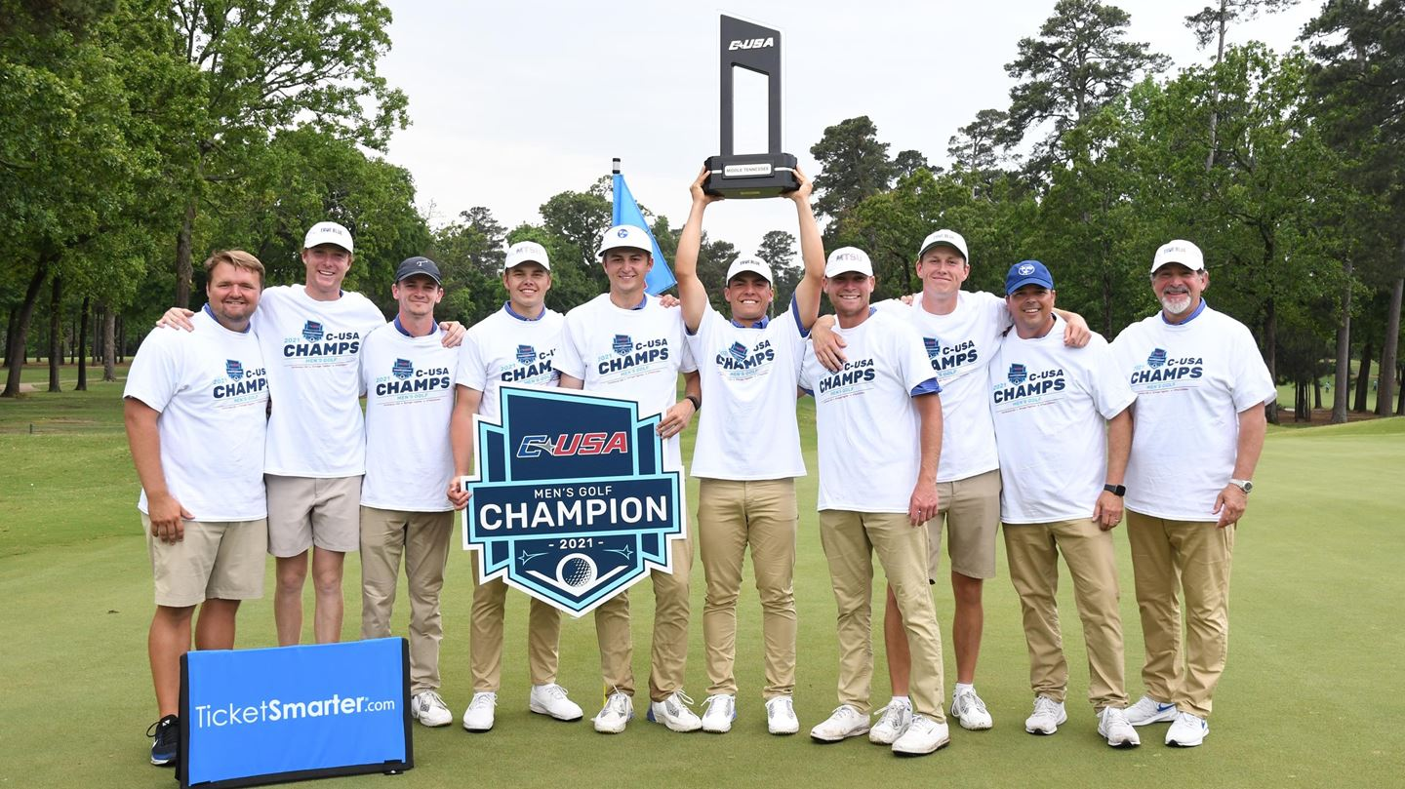
Athletic Success
C-USA Championships on with only Baseball Tournament remaining
MTSU 6 (5 championships, 1 divisional)
Charlotte 5 (3 championships, 2 divisional)
WKU 5 (2 championships, 3 divisional)
Rice 4 (1 championship, 3 divisional)

Slide 7
Tennessee Sports Hall of Fame Honorees

