Slide 1
MTSU fall 2021 new student enrollment

Slide 2
Who are our new students? Top 10 Counties (Freshmen enrolled fall 2021)

Slide 3
Who are our new students? Top 15 High Schools (Freshmen enrolled fall 2021)

Slide 4
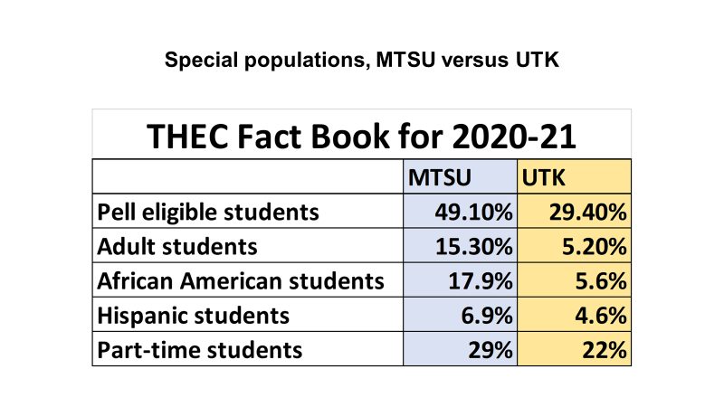

Slide 5
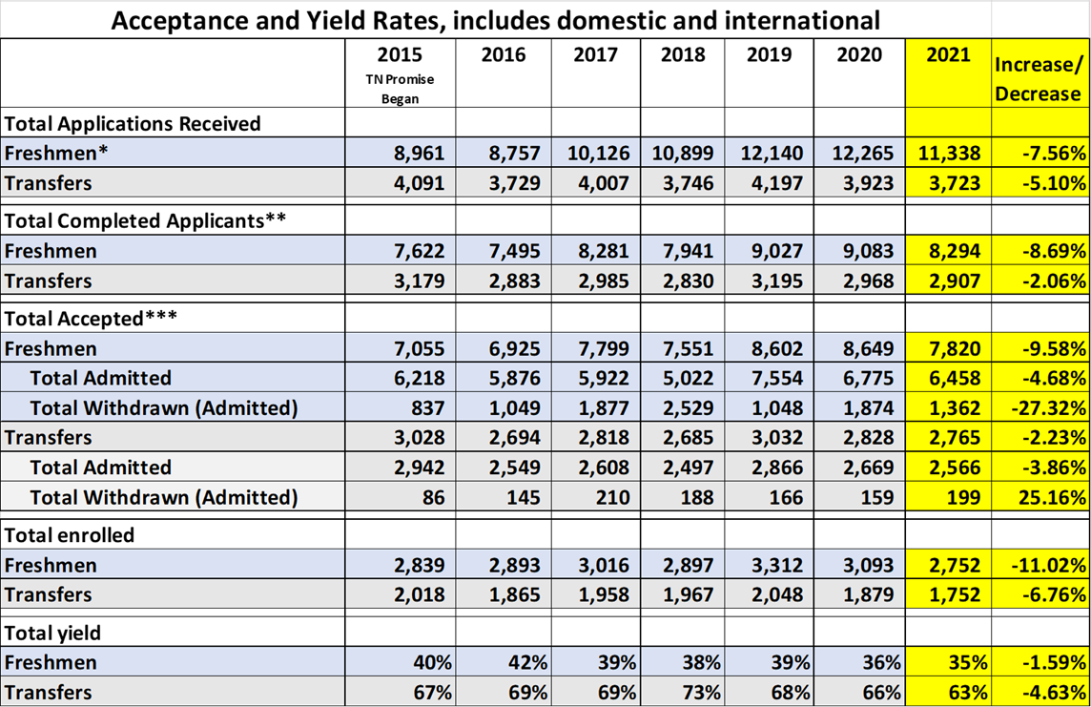
MTSU enrollment funnel
*Includes summer and fall freshmen
**Includes admitted, denied, and withdrawn who were admitted or denied
***Includes admitted and withdrawn who were admitted

Slide 6
How do we find prospects and solicit applications?
In an average year, we make more than 600 high school visits, participate in more than 100 fairs, make about 100 community college visits—traveling about 94,600 miles each year. That’s more than 3 times around the world!
True Blue Tour, True Blue Preview Days, and on-line activities.
Our campus tour program: 3 tours per day, plus most Saturdays. New this year: sponsored bus trips for high schools.

Slide 7
How does the Radius CRM fit in?
We contract with ACT to purchase approximately 60K names per year of students NOT already in our database.
We receive names from Tennessee and all eight Regional Scholars states, in ACT score bands: 30-36; 25-29; 22-24; 19-21
In addition, we purchase PSAT scores equal to an SAT score of 1100.
Loading the names into Radius triggers a series of up to about a dozen different personalized email messages and hard copy mailings, appropriate to where the student is in the funnel, including general campus information, invitations to events, follow up on missing application items, and so on.

Slide 8
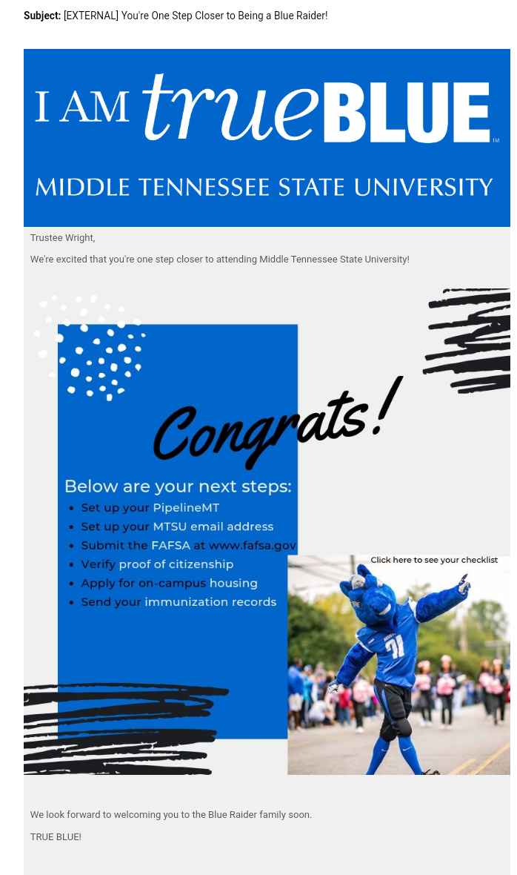
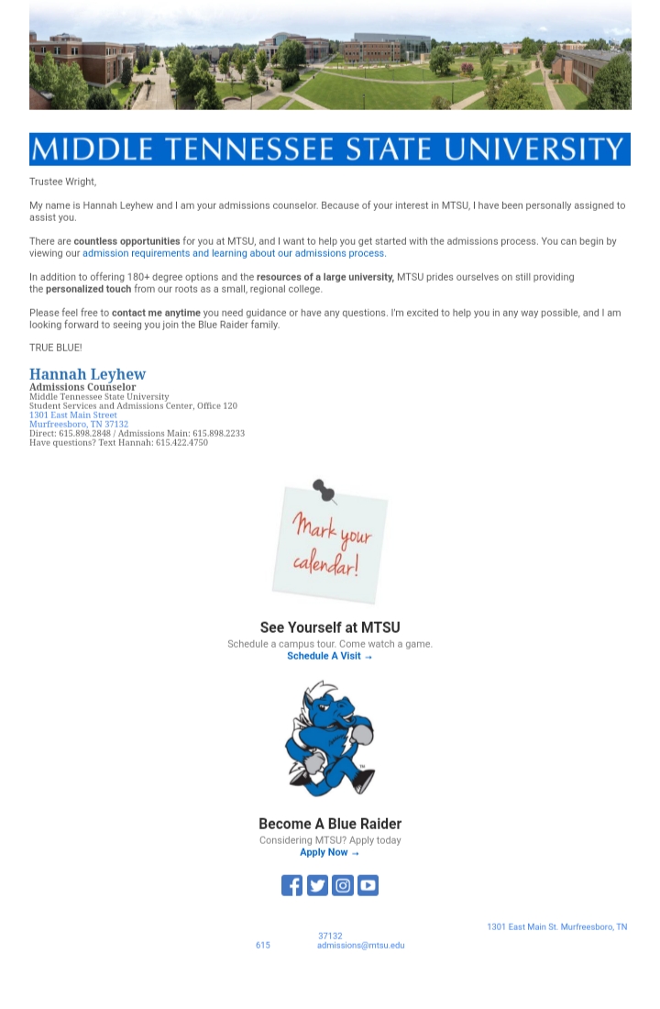
Example Radius messages

Slide 9
Strategic recruitment initiatives
Total of institutionally funded scholarships awarded 2021: $13M+
True Blue 100 program
Implementation of the MTSU Promise initiative with community colleges
Utilization of the Common Application and pilot of their Direct Admission program
Campaign to recapture non-matriculated scholarship admits by reinstating scholarship offers
Spanish language recruitment materials and targeted events
Expansion of completely on-line degree programs, with potentially 11 new by fall. Just received new recognition from Newsweek!
Expansion of corporate initiatives, including the McGuire/McDonalds program
Expansion of College yield activities

Slide 10
MTSU Blitz Campaign for November
We have purchased 175 30-second slots between Nov. 1 and Jan. 2 on Nashville’s four major television network affiliates
We are featuring our Telly Award-winning “MTSU in 30 Seconds” intermittently in November and exclusively in December
We have launched targeted digital ads on Facebook, Instagram, YouTube, and Spotify
We have placed 61 full-page ads in 18 daily and community newspapers throughout Middle Tennessee
We have new signage up at the Nashville airport
We have new images up on our digital signs and vinyl billboards
All of this driving students to the December 1 scholarship deadline

Slide 11
Where do we stand for fall 2022, as of November 1?

