Slide 1
Power Up Your Online and Blended Classes
November 8th 2019

Slide 2


Where is Charlie?
Name this place
Notes:
Can you name this place

Slide 3
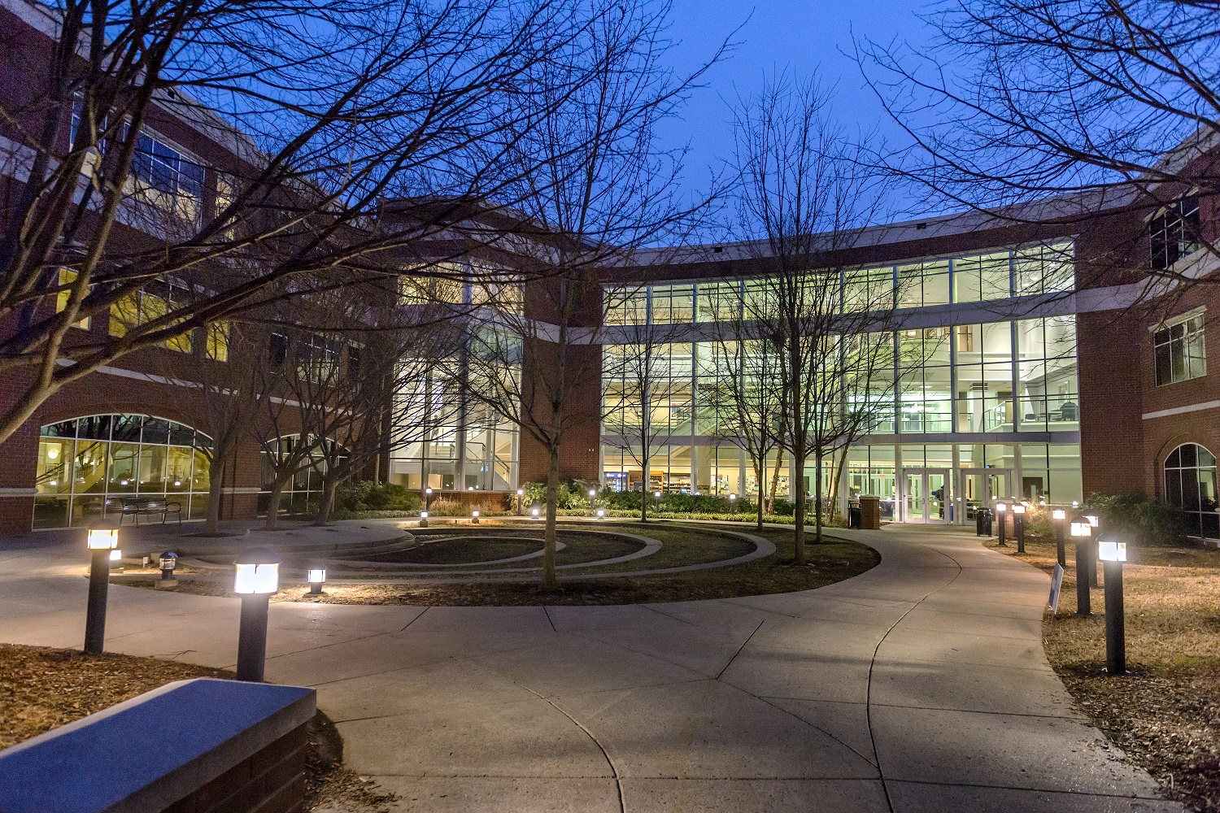

Welcome to
Power Up Your Online and Blended Classes
Notes:
We want you to Power Up your D2L classes. What do we mean by that?

Slide 4
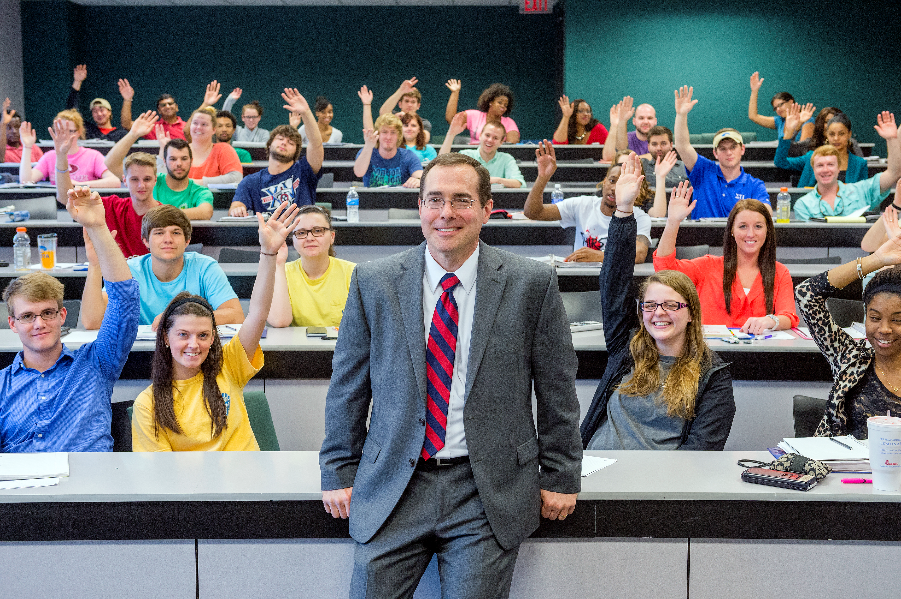
Set the Stage
Power Up
Engaging
Connects
Flows
Motivating
“… today’s college experience isn’t what it used to be.
Instructors in every discipline are rethinking both content and delivery, engaging students with new pedagogical strategies in modern learning spaces.
Yet, as institutions invest in classroom technology, adoptions doesn’t just happen. It requires institutional support, professional development and cross-campus collaboration.”
Wyle Wong, EdTechMagazine.com
Creating learning experiences that are efficient, effective and appealing.
Notes:
We all want our classes to have content that is easy to follow, engaging, and motivating to the students, helps them connect with the concepts and applies to their professional lives.
Today we will have the opportunity to learn about various D2L features and tools that you can apply to your classes. What is even better, will learn directly from faculty members who are already using these features in their classes.
What we learn today can be used in both online and blended classes!

Slide 5

Resources Available
JCB D2L Template
PowerPoint Template
Clickers
Top Hat
Panopto
Kubi
JCB Studio
One-Button Studio +
Apps.mtsu.edu
Qualtrics
LinkedIn Learning
Office 365
LMS (D2L)
MTSU Online:
  Zoom
  Examity
  Design Support
Developing Content
Notes:
Question:
What are you doing right now when creating your D2L content?
The good news is that we all can Power Up our D2L classes by using the resources we have available.
At the college level, we have several resources available. Today we will see how some of our faculty are using those resources.
At the university level, there are resources to help you design the content of your D2L classes. If you teach online courses, you can contact the University College
**** Segway to UC ****

Slide 6



Online Class Support
Notes:
* * * Segway to ID – Design Matters * * *

Slide 7

Design Matters
Notes:
* * * Segway to student engagement and D2L features * * *

Slide 8
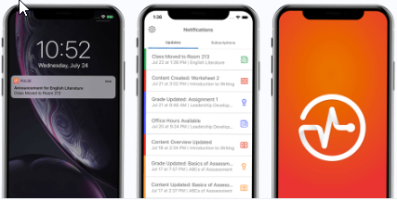
Keeping Students Engaged
D2L provides features:
  Intelligent Agents: Sends email reminders to students if they do not access your course in a “X” number of days.
  Notifications: Notifies students via MT mail, text or cell phone notifications (if Pulse installed) when new content is added or updated (news, content, discussions)
Brightspace Pulse
Notes:
D2L Features to increase participation and engagement
How-to: Intelligent Agents
Notifications
Brightspace Pulse (app)

Slide 9
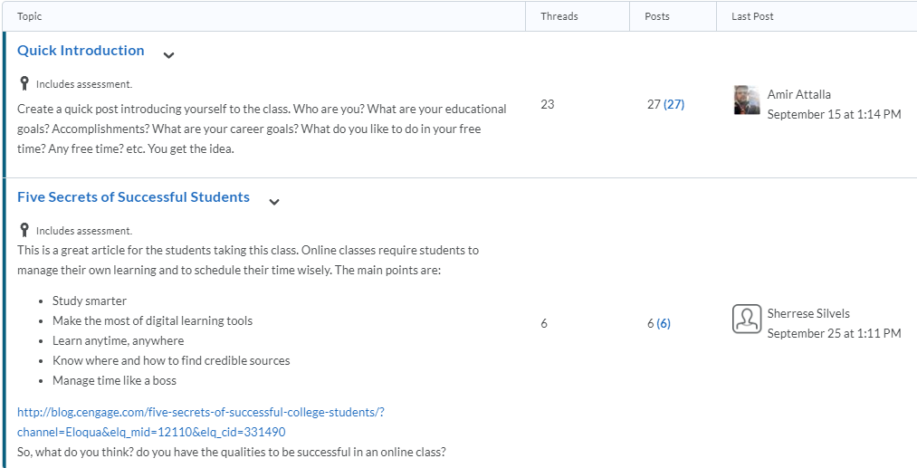
Let’s Discuss
D2L Discussions
Notes:
Show INFS-3200-D01 Discussions

Slide 10
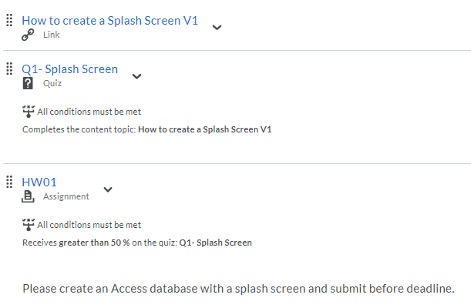
D2L – Release Conditions
Adaptive Learning
D2L Release Conditions are used to create learning paths that adapt to the student progress in class.
Notes:
Using Release Condition for Adaptive Learning Path
How-to: Conditions- examples for Quizzes/Dropbox

Slide 11
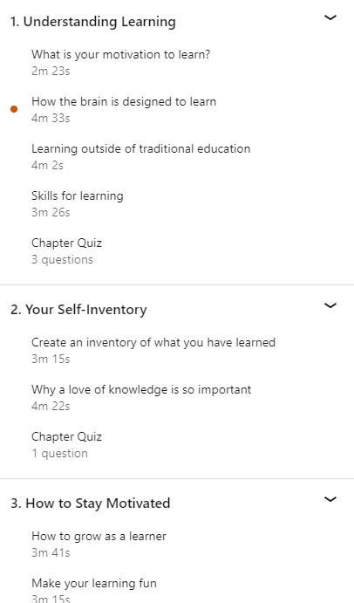
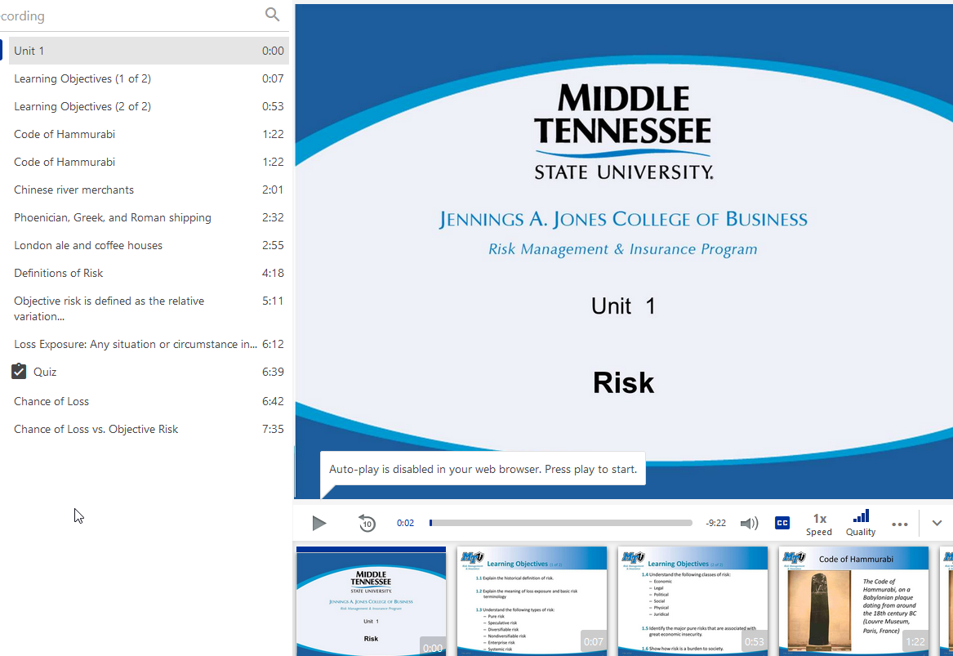
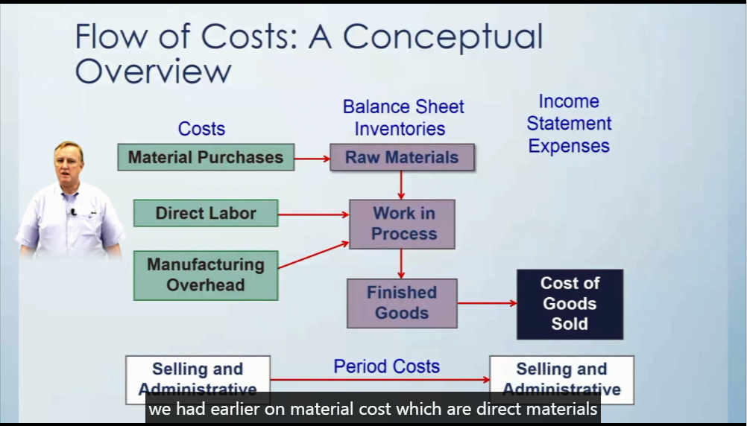
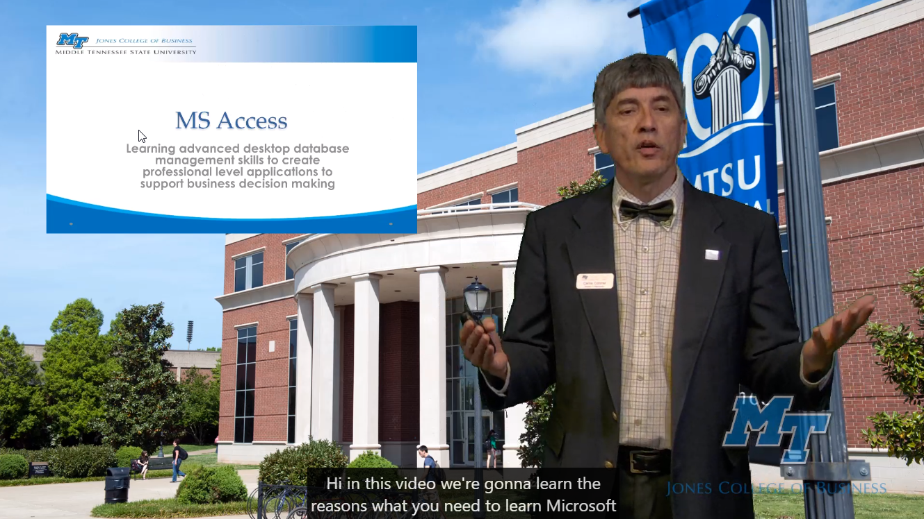
Micro-Lectures =
Content + Delivery
Have you noticed that most LinkedIn Learning videos are short?
Micro-Lectures
JCB Online Course Development Guidelines
Notes:
The reason is because of working memory, which is where we manipulate information, it holds a limited amount of information
Show welcome video for Excel or Access – INFS2200
One Button Studio +
1BS+ Tips Hand-out

Slide 12
Content Chunking
Strategy to break a concept into bite-size information pieces
  Identify learning objectives
  Create a hierarchy of learning objectives
  Organize from simple to complex
  Separate need-to-know vs nice-to-know
  One screen at a time – not too much information
  Presented in an orderly manner with a logical flow
  One chapter or topic per recording day
Notes:
most Lynda videos are short,
complete course is divided into many short videos, why?
The reason is because of working memory, which is where we manipulate information, it holds a limited amount of information at one time.
* * * * Segway to Other examples of video usage to support learning * * * *

Slide 13
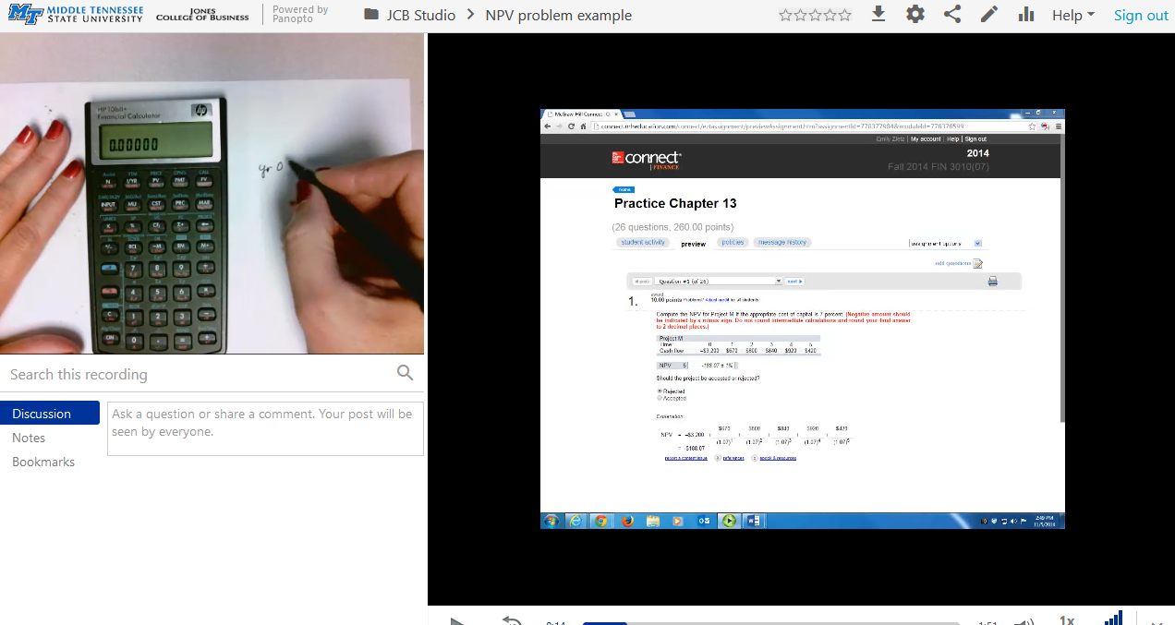
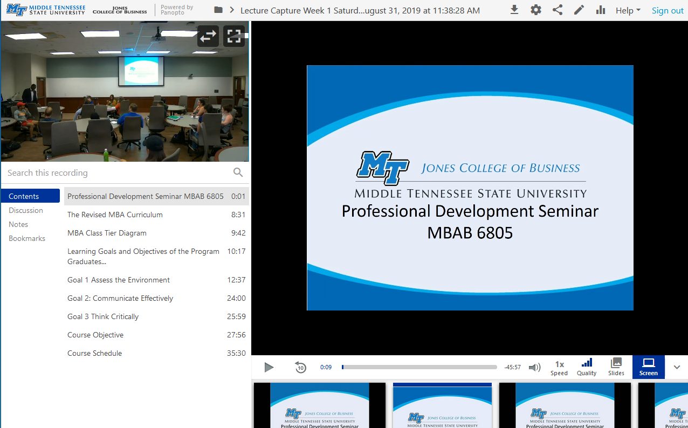
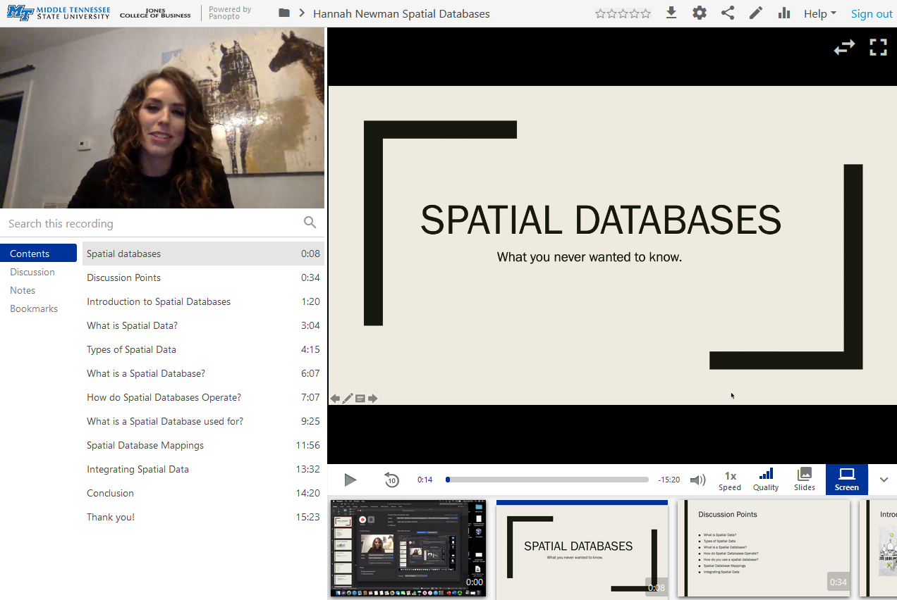
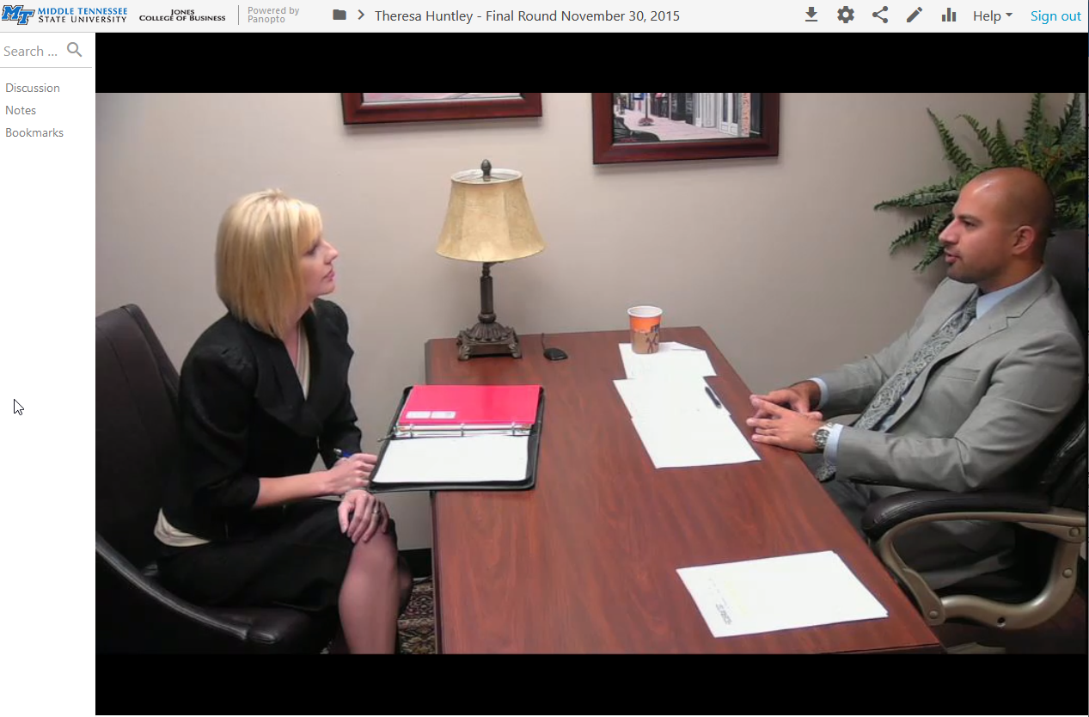
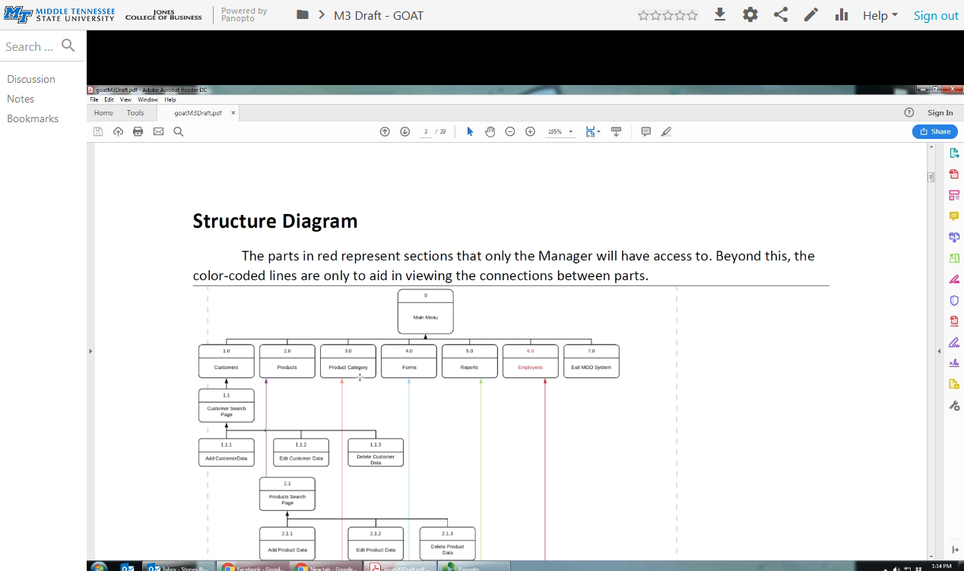
Content Delivery Examples
How-to Study Aid
Lecture Capture
Student
Presentations
Role Play
Grading Projects
“I learn more after class, watching the lecture video” Fathemeh I.
Notes:
One final example to use Videos in class is ….
* * * * Segway to Video Quiz * * * *

Slide 14
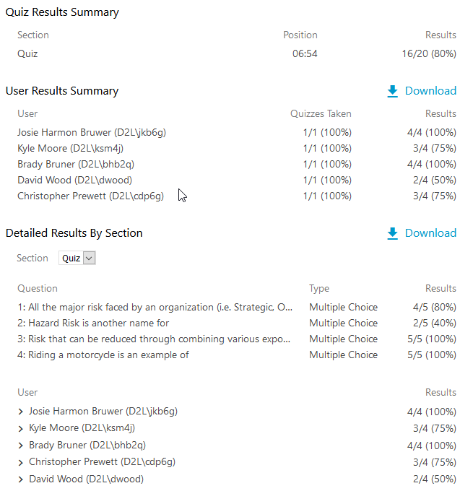
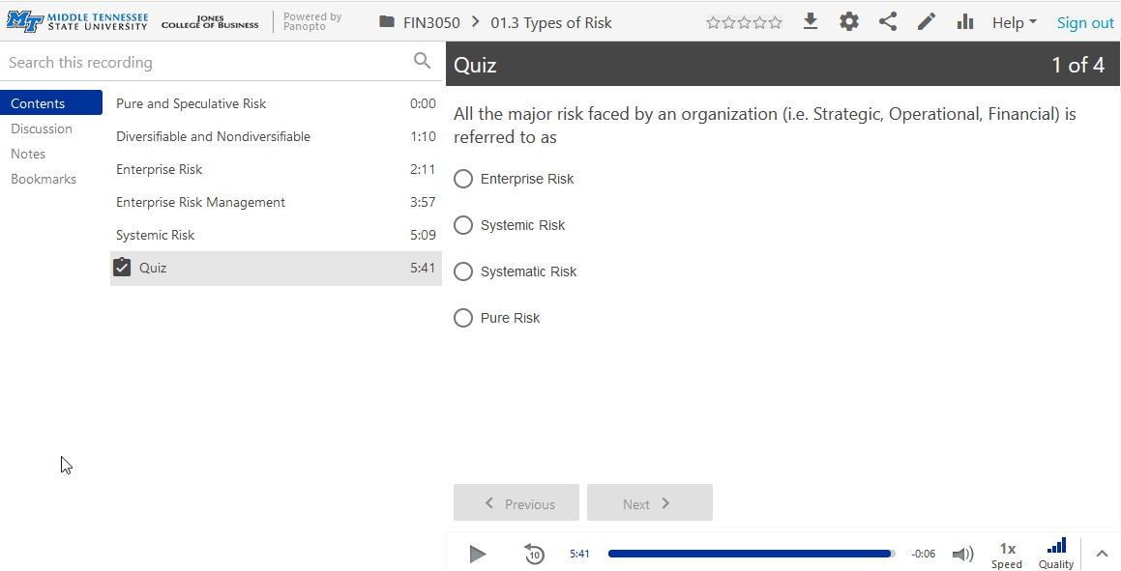
Video Quiz
Add a Quiz to a video lecture to get student feedback
Notes:
Show Panopto video and quiz
Fin 3050/01.3 Types of Risk
How to add a quiz to Video

Slide 15
Caption me?
Panopto comes with a caption editor that allows you to:
  Import Panopto auto-generated machine captions
  Edit captions
  Import third party caption scripts
YouTube machine generated captions are among the most accurate.
  You can generate captions for the Panopto videos and import the captions back into Panopto.
Notes:
How-to: YouTube captioning
Steps to create captions with youtube and upload to Panopto
* * * * Segway to Usage Stats * * * *

Slide 16
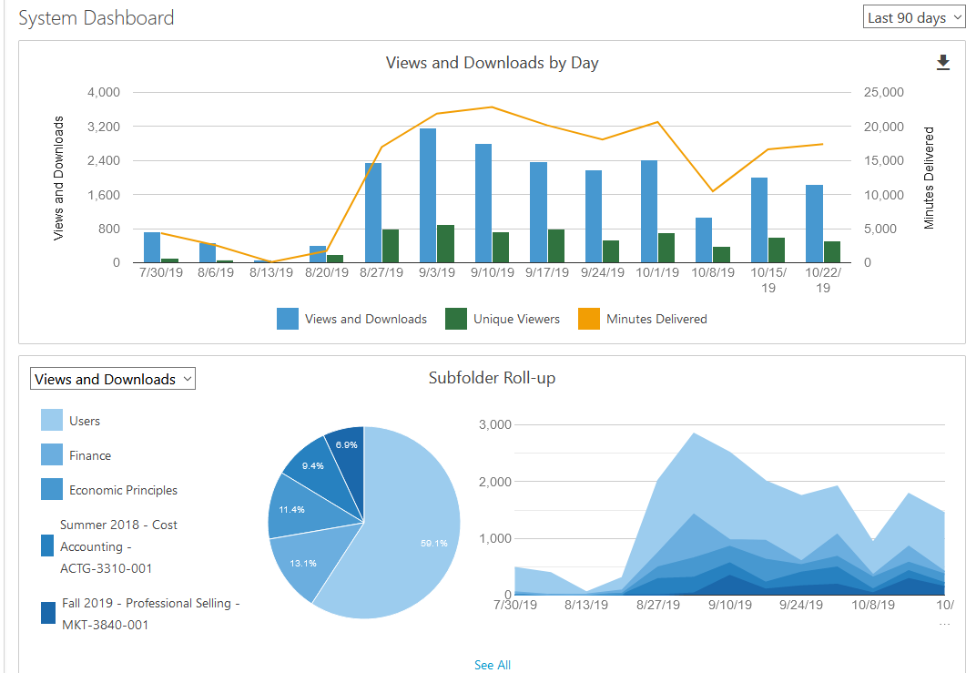
Build it and they’ll come
One of the advantages of using Panopto is the ability to get detailed usage statistics.
Notes:
Panopto - Everything – Stats icon – Last 30 days – 10/6
Change to Last 90 Days
System – point to minutes delivered
Economic Principles – Top Sessions – See All
Users- d2l\mkorzan – INFS4950
D2l\Lwdaniel – BLAW3400 – Deception

Slide 17

Q & A
Any questions?
Contact us for one-on-one training & support
Schedule you next content creation session

