Slide 1
Electronic Records Management
Records Management Secretary of State Tre Hargett
06.16.2021
Our mission is to exceed the expectations of our customers, the taxpayers, by operating at the highest levels of accuracy, cost-effectiveness, and accountability in a customer-centered environment.

Slide 2
This Training Will Cover:
Why Electronic Records Management is important
Guidelines for managing your records
Safeguarding records while working AWS
How to organize your agency’s shared drive to facilitate better records management
Maintaining and preserving your agency’s shared drive

Slide 3
Why Get Your Electronic Records Organized?
Fulfilling Legal Mandates/ Ensuring Compliance with State and Federal Laws
Facilitating Records Retrieval
Reduce agency costs from storing obsolete records
Ensure the creation and management of accurate, reliable records

Slide 4
Guidelines for Managing Electronic Records
Electronic Records should be reliably and securely maintained
No State records should ever be maintained on an employee’s hard drive or personal drive.
Your Electronic Record Storage system should include system controls and procedures for measuring the accuracy of your records.

Slide 5
Guidelines for Managing Electronic Records
Electronic Records should be retained and disposed of according to their Record Disposition Authorizations (RDAs)
Your business practices should support your electronic record keeping
Scan and verify incoming paper records as they are received
Have plans in place for record migration and destruction
The file format needs to meet your agency’s objectives for sharing and using records.
Ex. If the file format can only be read by specialized hardware and/or software, your ability to share, use, and manipulate the records is limited.

Slide 6
Guidelines for Managing Electronic Records
Electronic Records should be unaltered and secure
Protected from accidental or intentional alteration/destruction for as long as the record must be maintained
Access to records should be limited only to authorized and necessary personnel
Records should be accessed to the minimum amount needed to perform necessary business functions

Slide 7
Guidelines for Managing Electronic Records
Electronic records should be preserved without the loss of any vital information for as long as required by law.
Keep your electronic records with an eye towards the future
Electronic records should be accessible and retrievable in a timely manner throughout their retention period.
Electronic records need to be searchable and retrievable for reference purposes and in case of audit or litigation
Access to electronic records should be controlled through a well-defined criteria established by your agency.

Slide 8
Work From Home Guidelines
Do not download State Data onto a personal device.
Do not maintain official copies of records on your desktop.
Do not conduct state business via your personal email or messaging apps.

Slide 9
Work From Home Guidelines
An employee should get permission from their supervisor before bringing any records from their office to their AWS location.
These records should only be kept for a defined period of time.
The removal should be logged according to your agency’s AWS policy.
Any confidential or sensitive information needs to be safeguarded just as it would be in your agency.
Under no circumstances should confidential information be removed in a manner this is not consistent with your agency’s policies and guidelines.

Slide 10
Work From Home Guidelines
If you are currently under a litigation hold make sure that your general counsel has cleared the use of instant messaging apps before using them to conduct State business.
Remember: Any records that you bring home are still considered State records and any records that you create while working from home are also State records.
* For more information, please consult DoHR’s AWS guidelines, your agency’s AWS policy and STS’s AWS reference guide.

Slide 11
Setting up your Shared Drive

Slide 12
What is a Shared Drive?
A drive that is shared across all/or selected users on the network.
Typically used to store and share content such as:
Word Documents
PDFs
Spreadsheets
Databases
For the State, the drive letter H: is typically used for an Agency’s Shared Drive but any letter can be mapped
To be useful, agencies must spend time to develop and maintain a structure for their shared drives

Slide 13
Why utilize your Shared Drive?
More secure and reliable than storing records on your computer.
Records stored on a shared drive won’t be lost if an individual computer on the network crashes or is stolen
Records kept on your Shared Drive are backed up nightly
Files can be accessed in your shared folder whenever they are needed and allow multiple users to collaborate and access files simultaneously
Allows for one centralized copy of a record to avoid duplication of files
The cost to your agency is significantly less than utilizing an Enterprise Content Management (ECM) system such as SharePoint

Slide 14
Setting Up and Maintaining Your Shared Drive
Keys to success:
Conduct a Records Inventory
Determine ahead of time who needs access to view, edit, or delete folders within your shared drive and ensure that permissions are set accordingly
Utilize a standardized naming convention for your records
Arrange your records according to a hierarchical filing structure
Once you have set up your Shared Drive ensure that you continue to monitor and maintain the drive

Slide 15
Records Inventory
The first step in organizing your shared drive is to identify all of your agency’s electronic records. This can be accomplished by conducting a Records Inventory.
A Records Inventory is a fact-finding survey that identifies and describes the characteristics of records created, received, and maintained by an agency.
Without conducting a records inventory, you are likely to have a high amount of unstructured data. This will make it very difficult for you as an agency to follow your retention schedules.
Your records need to be categorized and organized in order to be useful

Slide 16
The Goal is to eliminate Unstructured Data
Structured Data:
Data that has been organized into a formatted repository
Unstructured Data:
Any information that has no identifiable organization of any kind

Slide 17
Records Inventory
Structured Data
Unstructured Data
Non Records

Slide 18
Records Inventory
Structured Data
Non Records

Slide 19
Steps to Conduct a Records Inventory
Every division should inspect all their files
Identify whether files are records, reference, personal documents, or non-records
Identify duplicate, fragmented, and related records
Determine which files your agency needs to keep and maintain
Match your files to your RDAs

Slide 20
Determine Access Levels & Permissions
Determine ahead of time who needs access to view, edit, or delete folders within your shared drive and ensure that permissions are set accordingly.
Remember: These protections exist for a reason and it is critical that your agency follow them.
Access and permissions should be reviewed routinely and updated as needed.

Slide 21
Why It Matters
In 2018 a Nashville Metro Department of Health employee wanted to share HIV/AIDs patient information with the department’s epidemiologist.
The epidemiologist was not one of three metro employees authorized to access the Department’s folder that contained the data.
The employee’s solution? To make a copy of the information and place it on the Department’s main drive.
The Result?
The protected health information for HIV/AIDs positive individuals living in 13 Tennessee counties sat unprotected on the agency’s server for 9 months
The agency was unable to determine if anyone accessed or copied the information
Numerous potential lawsuits against the department
A complaint being filed with the United States Department of Health and Human Services
The Metro Health employee at fault being forced to resign
Months of negative press coverage

Slide 22
Standardized Naming Conventions
The agency should agree upon a set naming convention for all agency records that will be kept on the shared drive
Naming conventions are a uniform set of rules agreed upon by an agency or division that document what folders/files are to be named on shared drives or other electronic storage

Slide 23
Standardized Naming Conventions
Do
Do Not
Use descriptive names to identify the purpose of the files
Include the date of creation or revision in your file name
Utilize consistent naming patterns for version control. Examples: Final, draft, Revision1, etc.;
Make sure your naming conventions work for your agency’s business needs
Avoid using spaces in any file names that may be accessed via web browsers. Instead, use hyphens or underscores between words
Avoid using special characters such as !@#$%^&*()
Avoid using personal names

Slide 24
How Not To Label Your Files

Slide 25
How To Label Your Files

Slide 26
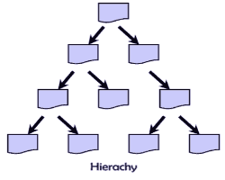
Hierarchical Filing Structures
We recommend that agencies utilize a hierarchical filing structure to organize their records.
Hierarchical folder structures start broadly and then become more specific as more sub folders are added.
A common structure is to organize by division and then by RDA or Record type.
For records utilized by multiple divisions it might make more sense for an agency to label their top level folders by RDA or record type instead.

Slide 27
Hierarchical Filing Structures
Folders should be named for Record Series title or Major function/activities. Ex. SW 12 Contracts or Audits.
Integrating RDA numbers into your folder names will help you organize your records and provide clear rules for the records retention.
Subfolders should reflect secondary activities. Ex. programs, grants, or projects
Remember: Folder names should be self-explanatory
Subsequent folders should be organized by calendar or fiscal years to facilitate the destruction or transfer of records to TSLA.

Slide 28
Sample Folder Layout
Records Management Division
Records
1768 RDA Files
1769 Record Center Files
Reference
T.C.A
Top Level Folder
Sub Folder
Subsequent Folders
Public Records Laws
2019
2018
2019
2018
Signed forms
Signed Forms
Archive

Slide 29
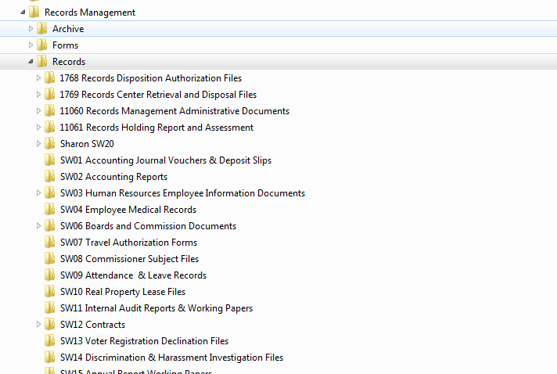
Hierarchical Filing Structures

Slide 30
Hierarchical Filing Structures
To get the most out of your filing structure:
Include a copy of your agency’s RDA or file plan in your top-level folders
Avoid Folder Creep
This can cause the records to become inaccessible
Adds unnecessary complexity and confusion.
Try to have no more than 4 pathways to access a record.

Slide 31
Controlling Folder Creep
STS
Agency Directors & Supervisors
End Users
Copyright RIMtech 2013

Slide 32
Maintenance and Preservation
Agencies should assign individuals or teams to periodically review their shared drives to ensure that records are being retained and disposed of in accordance with their RDAs.
Agencies should look for records that are duplications, redundant, obsolete, unwanted, or misfiled.
Agencies should ensure that all file names follow agency’s preferred naming conventions.
Work with STS to ensure plan is in place to dispose of records that reach the end of their retention.

Slide 33
Maintenance and Preservation
Your agency should continually review and update their RDAs as laws and business needs change.
Include copies of relevant RDAs/File Plans in all top level folders to help employees know proper retention and storage for your records.
Ensure that records are maintained and disposed of in accordance with your RDAs.
Agencies should make sure that digital records are regularly backed up to protect against accidental deletion or loss
Agencies should document destruction by filling out and submitting CRDs.

Slide 34
Maintenance and Preservation A Shared Drive That is Not Maintained
Subfolders are not labeled and do not reflect agency records or activities
File names do not follow any clear set naming conventions
The vacation photo is personal content and should never be kept on an agency drive
The Staples Purchase Order has been miscategorized and should not be filed under Certificates of Destruction

Slide 35
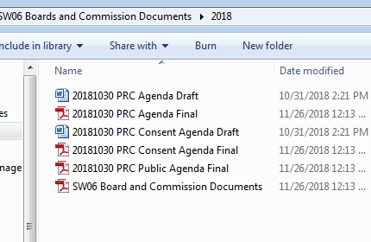
Maintenance and Preservation A Well Maintained Shared Drive
Versioning control
Set naming conventions
All files are related to their containing folder
A copy of the RDA is included in the folder to provide retention guidance
There are no duplicate copies of files or unnecessary drafts

Slide 36
Questions?

