Slide 1
Policy 90 Training
Compliance and Enterprise Risk Management

Slide 2
Objective
At the end of this training, understand what Policy 90 is and be familiar with the complaint process.

Slide 3
What is Policy 90?
Why should I care?

Slide 4
This policy is for you!
Policy 90 – Athletics Integrity and Conduct of Athletics Staff
  Provide instruction that is free from bullying, physical abuse, verbal abuse, and/or harassment
Statement of Athletic Values:
  Student athletic programs are an integral piece of MTSU’s mission and purpose
  Strive to provide opportunities for academic success, competitive excellence, personal and physical development, and involvement in the campus community
  Strive to reflect a commitment to the spirit of fair, honest, skillful, and civil competition.

Slide 5
Shared Responsibility
It’s a team sport!

Slide 6
Responsibilities
Laws, regulations, policies, and procedures for University
NCAA, C-USA, and other special requirements for Athletics
MTSU Statement on the Conduct of Athletics Staff
Student-Athlete Rights and Responsibilities

Slide 7
Student-Athlete Handbook (pg. 3-4)

Slide 8
Violations
Keep it in perspective.

Slide 9
Dos and Don’ts
Good coaching:
  Helps develop your skills
  Corrects you when you make a mistake
  Motivates you to perform at a higher level
  Holds you to a high, achievable standard
Bad coaching:
  Demeaning comments, racial slurs, vulgar or disparaging remarks
  Derogatory references to race, gender, sexual orientation, or gender identity
  Severe, pervasive, or objectively offensive behavior
  Violence of any kind

Slide 10
Complaint Process
What to do when things go wrong.

Slide 11
Student-Athlete Conflict Resolution Process
Step 1: Address complaint directly with the person/people involved
Step 2: Address complaint with Head Coach and/or the Sports Administrator
Step 3: Submit a written (formal) complaint to the Senior Associate Athletic Director or Director of Athletics
Step 4: Submit a written (formal) complaint to a Policy 90 investigator in CAERM office (https://www.mtsu.edu/caerm/athletics_complaint.php)

Slide 12
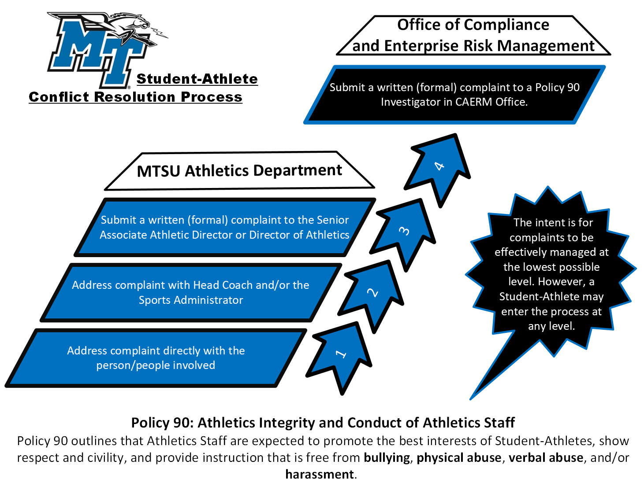

Slide 13
Resources
Student-Athlete Handbook: https://goblueraiders.com/documents/2022/3/24/2122_Student_Athlete_Handbook.pdf
Athletics Integrity and Student-Athlete Conflict Resolution page on CAERM site: https://www.mtsu.edu/caerm/Athletics_StudentAthlete.php

