Slide 1
Records Management Basics
Division of Records Management
Tre Hargett, Secretary of State

Slide 2
Why am I here? Why are you here?
The Public Records Commission
  Created by statute to determine and order the proper disposition of state records. TCA § 10-7-302
  Members include:
    Secretary of State
    Comptroller of the Treasury
    State Treasurer
    Director of Legal Services
    Commissioner of General Service
    Attorney General
    Executive Director of Historical Society
The PRC is authorized to direct the State Department to initiate, through the Records Management Division, any action it may consider necessary to accomplish more efficient control and regulation of records holding and management in any agency.
Tenn. Code Ann § 10-7-302.

Slide 3
What are the Records Officer’s responsibilities?
Create, revise, and retire RDA’s.
Compile and submit the Records Holding Report.
Approve records destruction reports.
Track agency records destruction.
Maintain R&R security access status for agency personnel.
Work with legal counsel and information services to advise division coordinators.

Slide 4
What is a Record?
“‘Public record or records’ or ‘state record or records’ means all documents, papers, letters, maps, books, photographs, microfilms, electronic data processing files and output, films, sound recordings, or other material, regardless of physical form or characteristics made or received pursuant to law or ordinance or in connection with the transaction of official business by any governmental agency.” T.C.A. § 10-7-301(6)
The test for determining whether a record is public is “whether it was made or received pursuant to law or ordinance or in connection with the transaction of official business by any governmental agency.” Griffin v. City of Knoxville, 821 S.W. 2d 921, 924 (Tenn. 1991).

Slide 5
Records
Non- Records
Budget Documents
Payroll Documents
Election Documents
Contracts
Revenue Reports
Investigation files
Audit reports
Personnel's files
Brochures
Reference Materials
Extra Copies
Drafts
Obsolete Catalogs
Bulletins
Trade Journals
Manuals

Slide 6
THESE ARE ALL RECORDS REGARDLESS OF FORMAT
Physical Records
Electronic Records
Paper
Microfilm
Microfiche
Videos
Photographs
Servers
Computer files
Documents on a collaborative workspace
CD/DVD

Slide 7
Confidential Record
Indicate whether any state or federal regulations restrict access to the records.
Records that are deemed confidential must be covered by statute and a copy of the statute must be attached.
Records that are not declared confidential by statute are classified as public.
While some Public Records may contain Confidential information the record itself is not confidential.

Slide 8
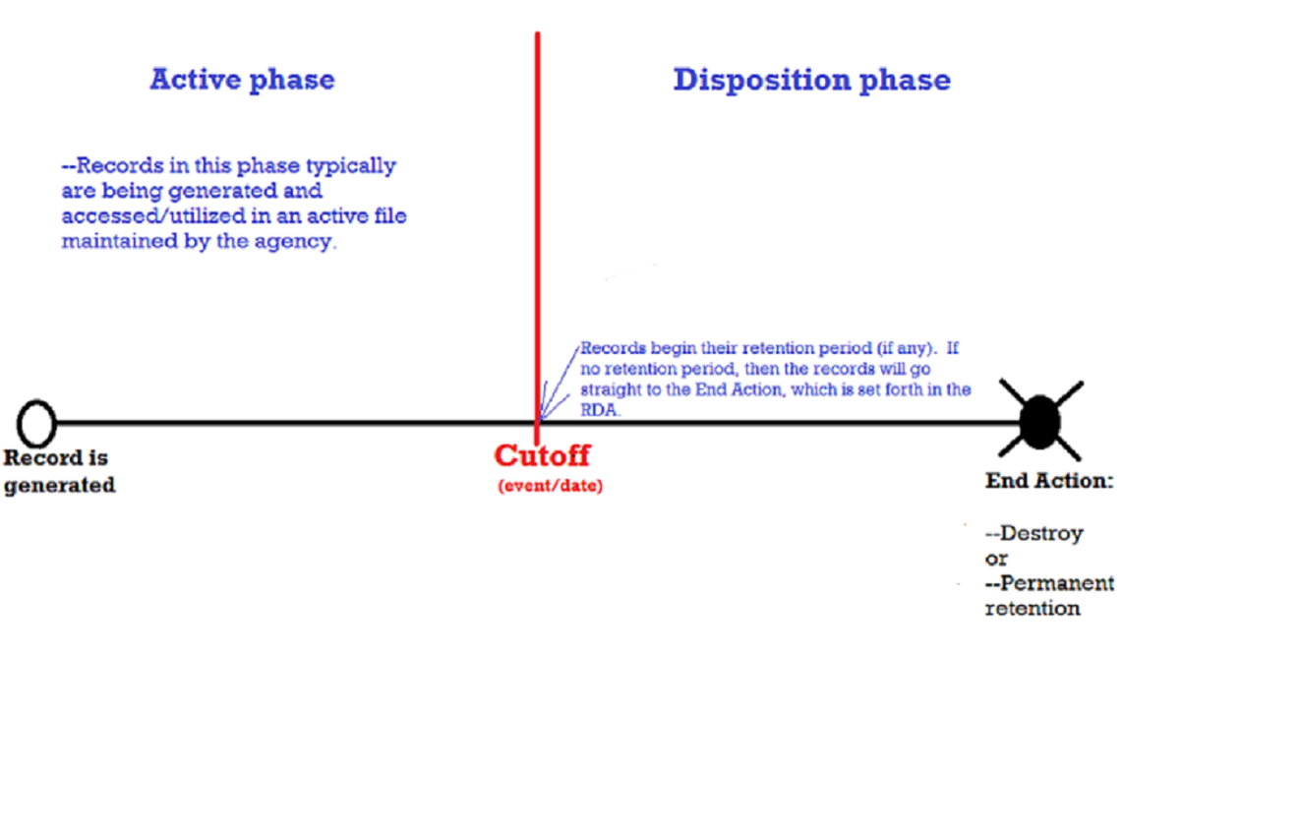
File Cutoff
The file cutoff date is a break or stop in the filing of a current records series, based on a predetermined event.

Slide 9
Destruction
The method of destruction depends on criteria described in the Records Disposition Authorization.
Those that are deemed confidential, private, or sensitive will be shredded for a fee by Richards & Richards to ensure that the information is protected.
Records not requiring confidential destruction may be recycled.
Any records may be confidentially destroyed on request.
Confidential records destruction services are also available for offices not using the Richards & Richards storage services.

Slide 10
Certificate of Record Destruction
When records are destroyed, a Certificate of Records Destruction form must be filled out and submitted to Records Management.
This form documents the destruction date, record series, RDA number, date range for the records, volume destroyed, and destruction method.
Records Management maintains all of the CRD’s and uses this information to monitor the record destruction process to ensure compliance with RDA requirements and statewide policies.

Slide 11
Parting Words
DO NOT DESTROY A RECORD WITHOUT AN RDA!!!
T.C.A. § 10-7-303
If you are unsure please contact us or your records officer.
We are here to assist you by advising on the development, utilization, retention, disposition, and destruction of records..

