Slide 1
Records Management Training
Compliance and Enterprise Risk Management

Slide 2
Objective
At the end of this training, understand how to use the records database.

Slide 3
Why are we doing this?
Tell me why!

Slide 4
Requirements
All state agencies must maintain an internal records management program (Rule 1210-01-.03(1)).
Must ensure that retention schedules are properly implemented and followed (Rule 1210-01-.02(5)).
MTSU Policy 129
Results in submission of a report to the Records Management Division, TN Secretary of State’s office.

Slide 5
Coordinator Responsibilities
Why am I here?

Slide 6
Responsibilities
Create record sets in Records Management Database.
Maintain / update record series.
Request destruction of record series.
Destroy record series as appropriate.
Confirm accuracy of records database periodically.

Slide 7
Terminology
Words mean things.

Slide 8
Terminology
Records
Record series
RDA – records disposition authorization
  Records cut off
  Retention period
  Retention action

Slide 9
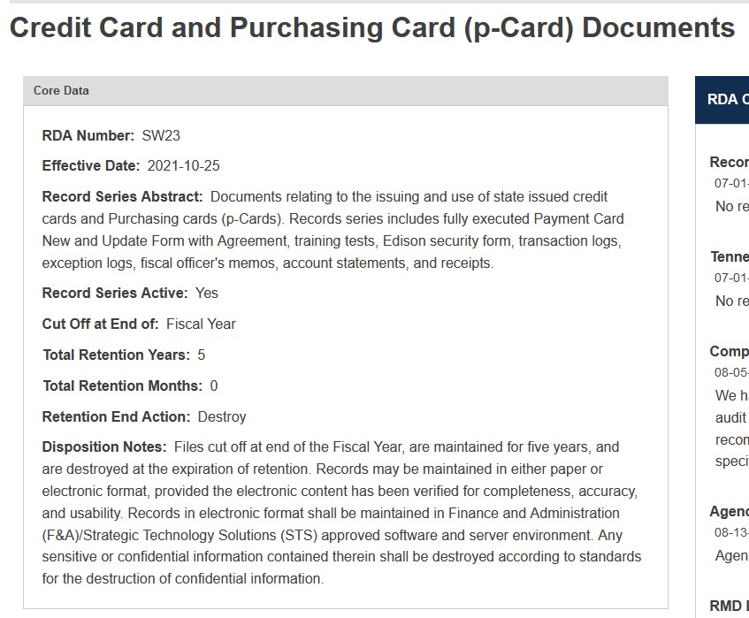
RDA Example

Slide 10
Creating New Record Series
Creating records … about records.

Slide 11
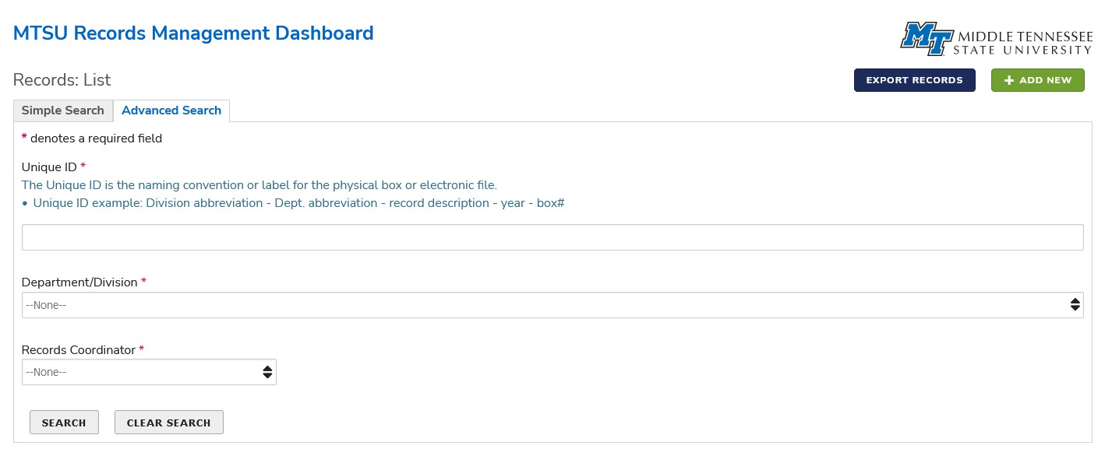
Creating a new record series

Slide 12
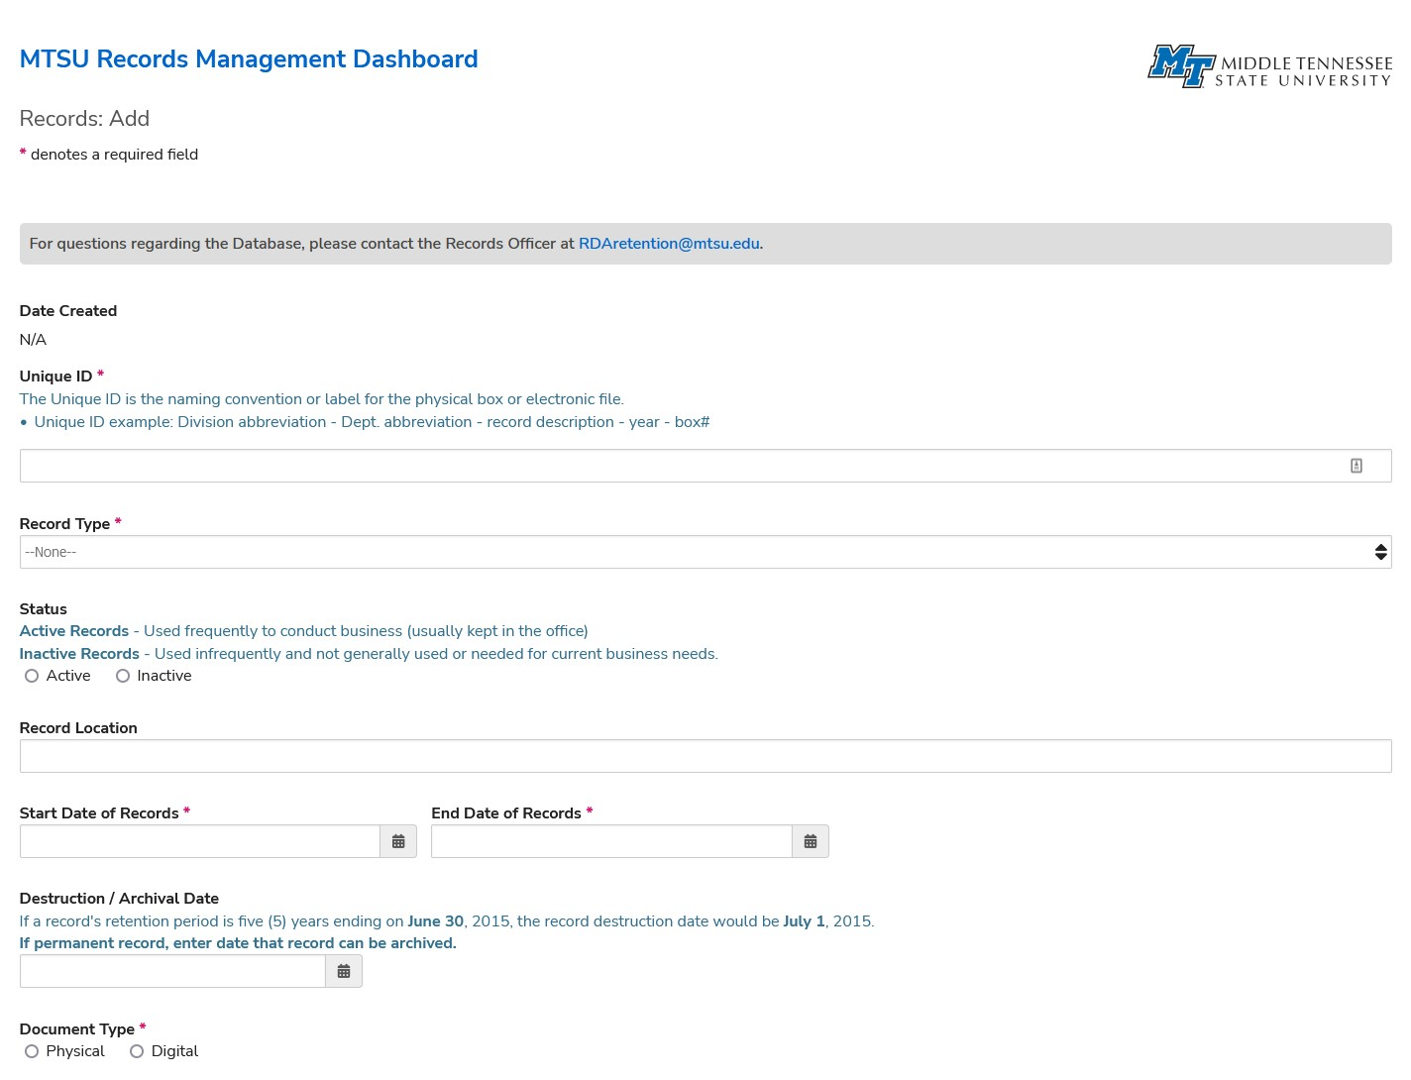
New records, page 1

Slide 13
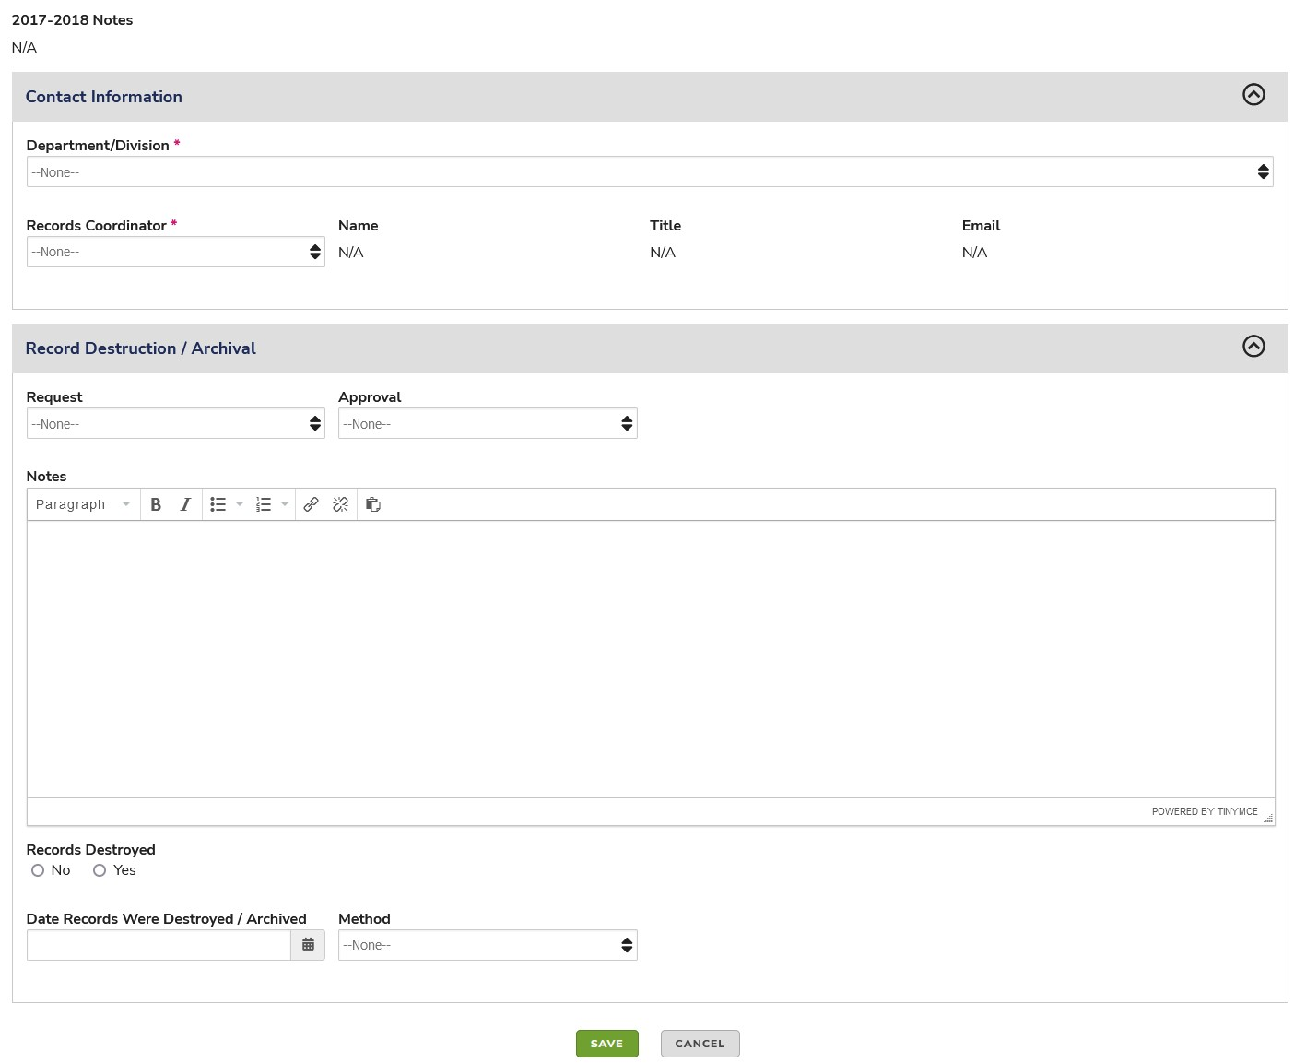
New records, page 2

Slide 14
New records tips
Start Date / End Date
  If you are going to be (or suspect you will be) adding records throughout the year, align to the timeline in the RDA.
  Simplifies storage and destruction.
Unique ID

Slide 15
New records examples
Student Records (SW-U06) – non-education record
  Cut Off: Academic Year
  Retention: 5 Years
  Disposition: Destroy
  Recommendation: set up a new record series for each academic year.
University Research Records (SW-U07)
  Cut Off: Completion, termination or suspension of research project
  Retention: 10 Years
  Disposition: Destroy
  Recommendation: set up a new record series for each research project.
Student Records (SW-U02) – education record
  Cut Off: Academic Year
  Retention: Permanent
  Disposition: None
  Recommendation: set up a new record series for each academic year.

Slide 16
Finding Existing Record Series
Hint: They are always in the last place you look.

Slide 17
Navigating to records, part 1

Slide 18
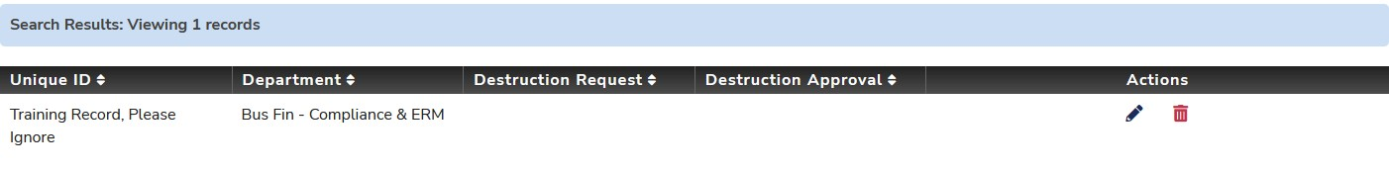
Navigating to records, part 2

Slide 19
Requesting Approval to Destroy Existing Record Series
It’s the final countdown.

Slide 20
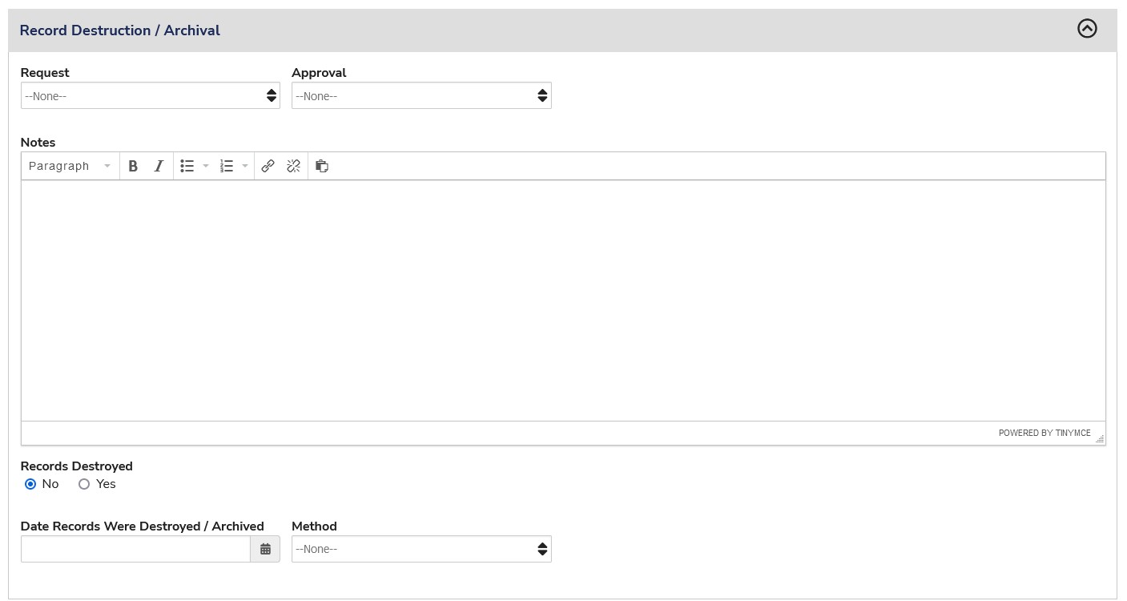
Requesting approval

Slide 21
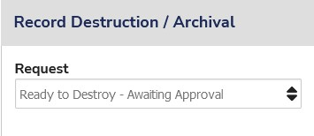
Requesting approval

Slide 22
Warning – Litigation Hold
Do not destroy documents that are on litigation hold.

Slide 23
Final Updates – Records are Destroyed
Gone in 60 seconds.

Slide 24
Confirmation

Slide 25
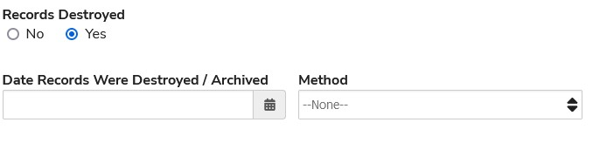
Confirmation

Slide 26
Process Map
No compass required.

Slide 27
Steps to Records Management
Create Record Set
Update and Maintain Record Set
Request Destruction of Record Set
Destroy Record Set
Confirm Destruction of Record Set

Slide 28
Confirming Accuracy
What is real?

Slide 29
Periodic Reviews
Annually
  CAERM will send each Records Coordinator a list of all record series for your area.
  Confirm all the data related to such record series is accurate.
    Quantity
    Location
    Record Start / End Date
    Destruction Date
  Will typically occur in March - April
As Needed
  CAERM will follow up on specific record series if it appears something is amiss.
    Retention period expired
    Location doesn’t exist
    Quantity is an imaginary number.

Slide 30
Records Holding Report
CAERM compiles the Records Holding Report for submission to the Tennessee Secretary of State’s Office
Includes:
  Number of active records.
  Records created.
  Records destroyed.

Slide 31
Records Audits
Secretary of State’s office performs periodic audits of our records management practices.
Includes on-site visits.

Slide 32
Helpful Hints and Information
Everything is Awesome.

Slide 33
Duplicates
Duplicates aren’t records.
Things that aren’t records do not have to be entered into the database.

Slide 34
Picking an RDA
Do your best and look for best fit.
Be consistent.

Slide 35
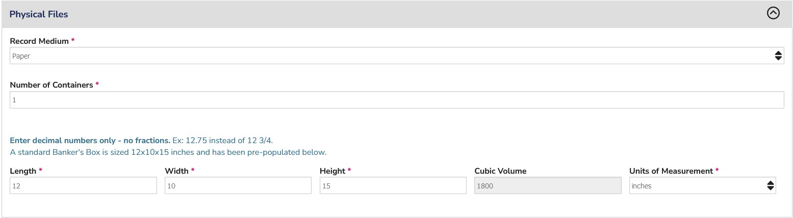
Multiple Boxes or Drawers of Information

Slide 36
Resources
CAERM site: https://www.mtsu.edu/caerm/records_management_retention.php
Tennessee Secretary of State records site: https://sos.tn.gov/rmd
Email CAERM at recordsretention@mtsu.edu

Slide 37
Questions?
Was I in the right training?

