Slide 1

3D Body Scanning
Current and future research opportunities

Slide 2
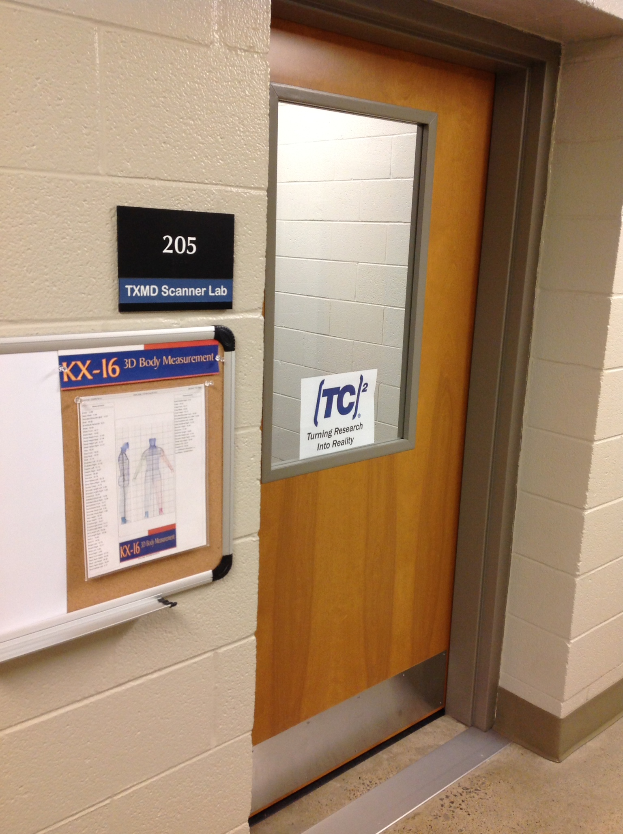
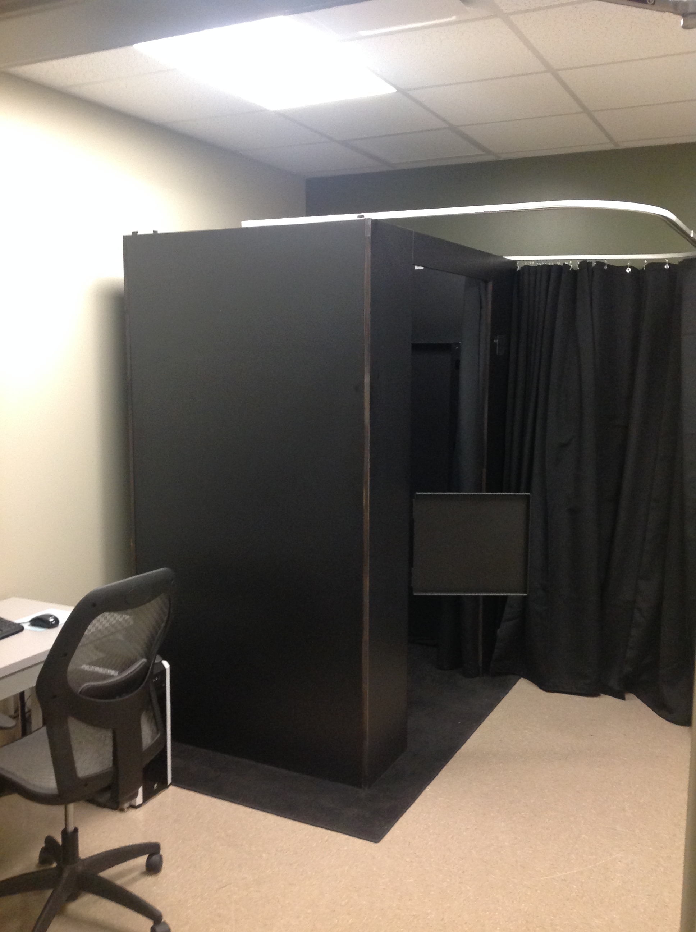
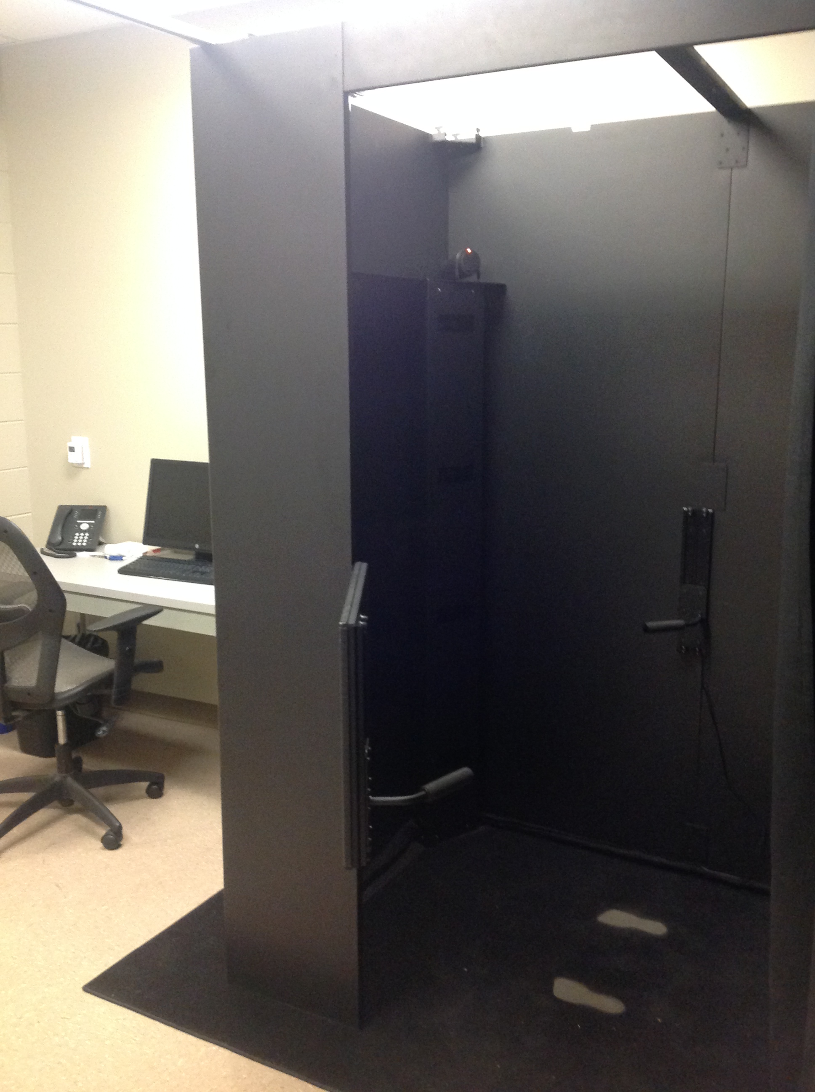

Slide 3
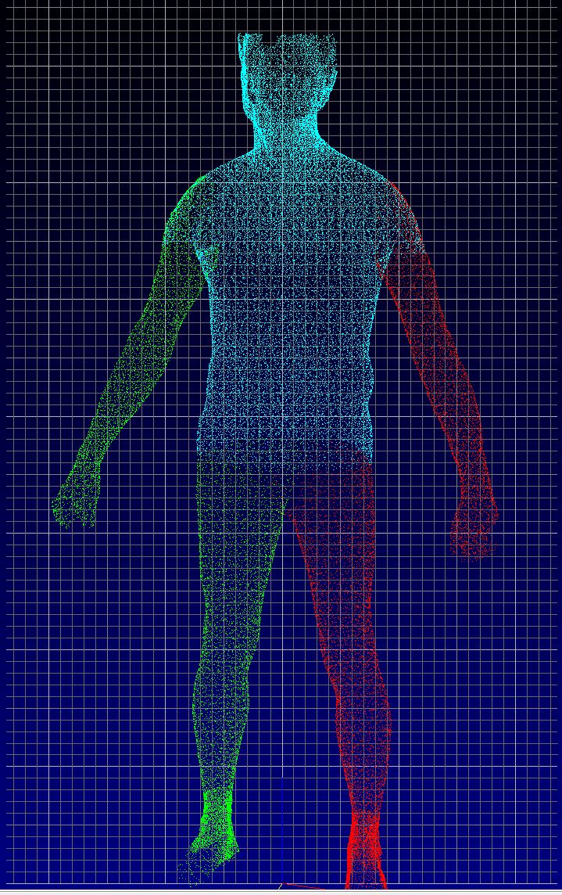
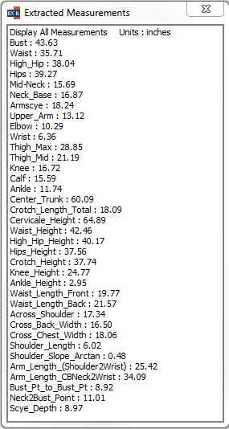
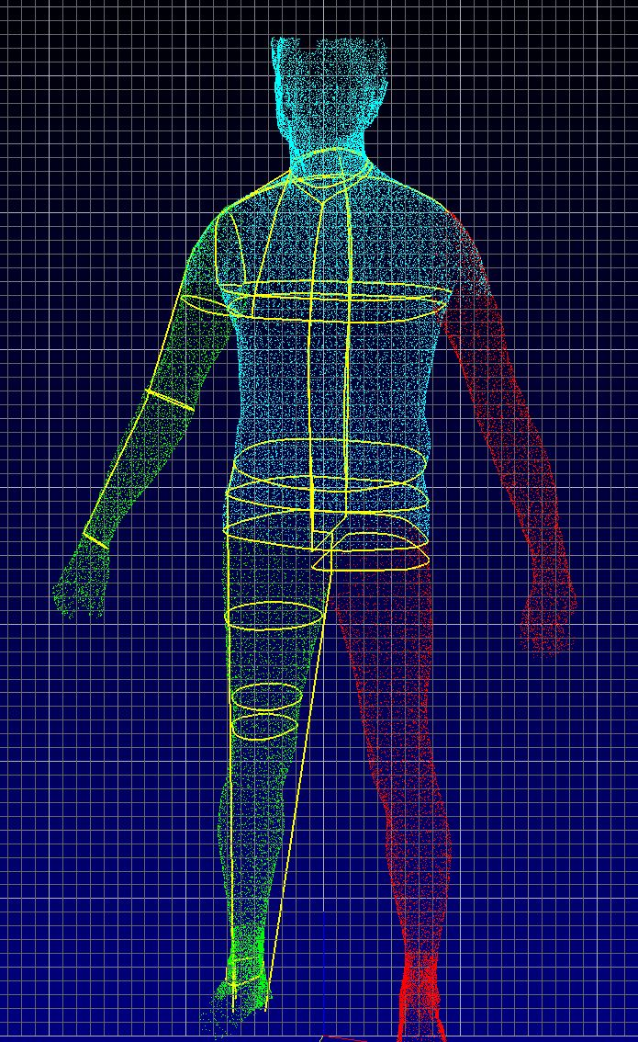

Slide 4
My Current Research Stream…
Clarification of Constructs that Describe the Human Body:
Clustering of Human Body Form:

Slide 5
Body Measurement Constructs

Slide 6
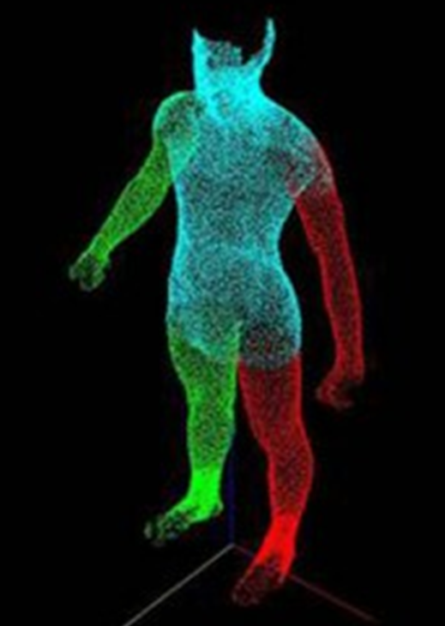
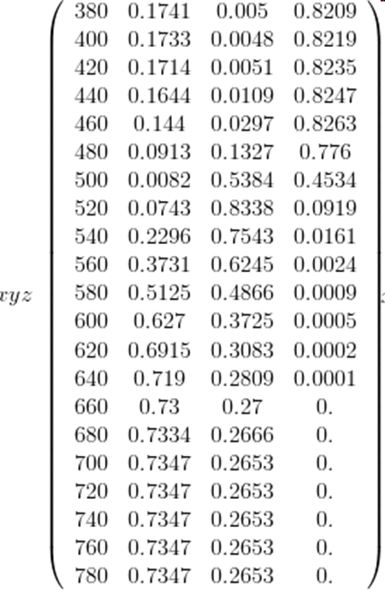
What the 3D Body Scanner Provides…

Slide 7
What Does the 3D Point Cloud Mean?
FORM?

Slide 8
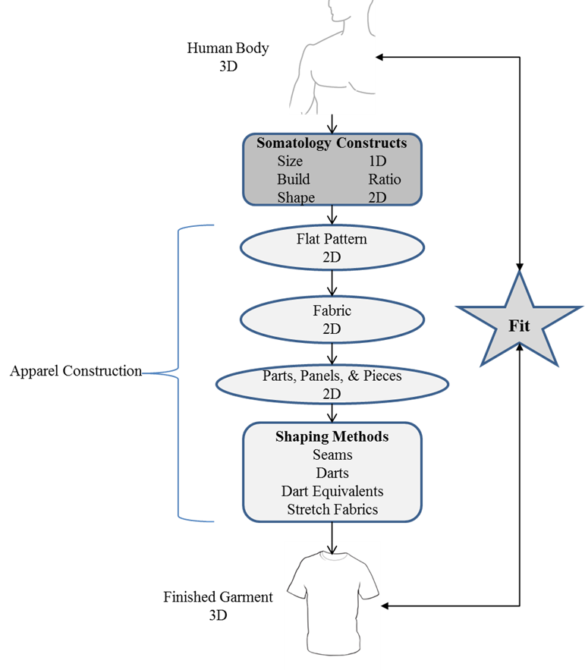
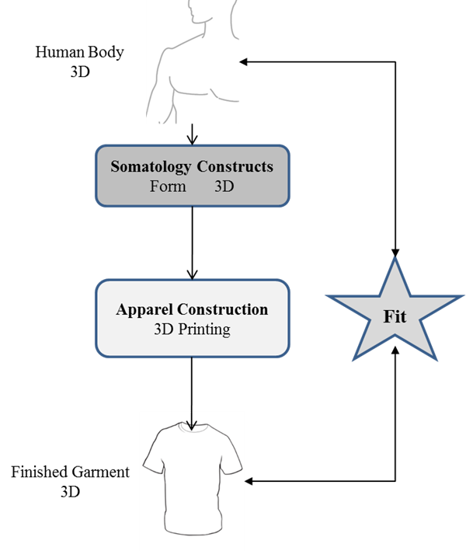
Industry Contribution

Slide 9
COLLABORATION !!!!

