Slide 1
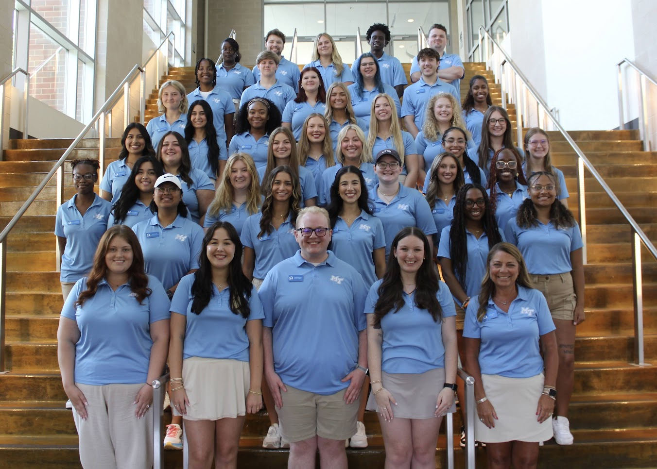
Be an MT Influencer… Apply to be an SOA

Slide 2
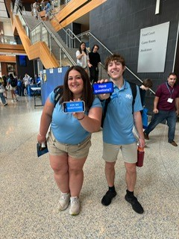
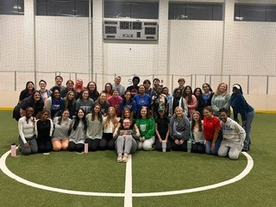
Student Orientation Assistant
Be a Mentor and Role Model to new students during orientation
Be a Leader
Be Punctual
Be a Representative of MTSU at all times
Be Positive and make an impact
Be a member of our diverse team

Slide 3
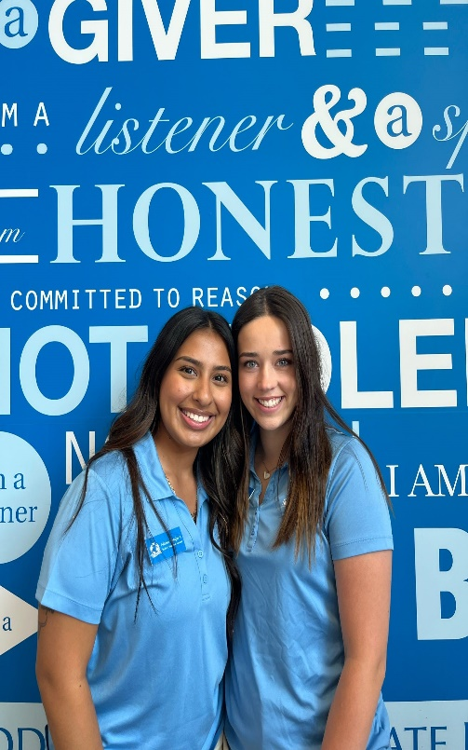
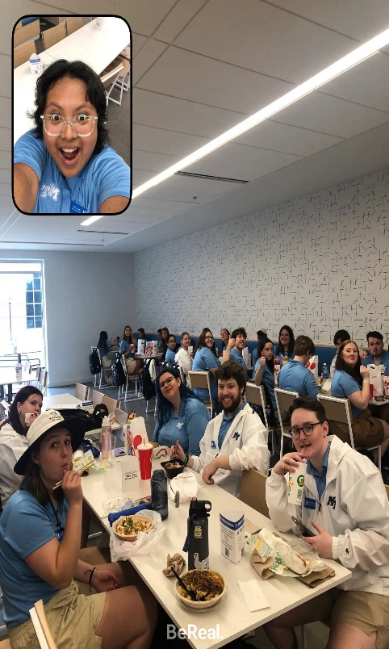
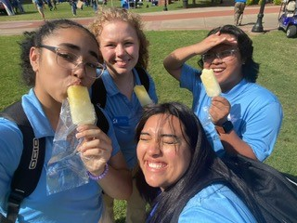
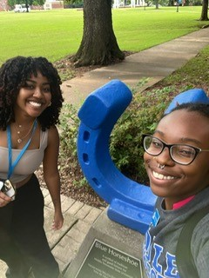
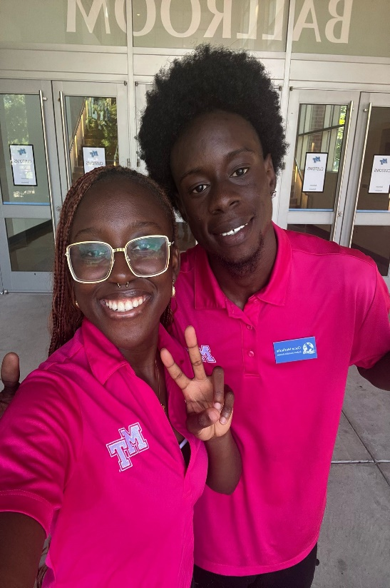
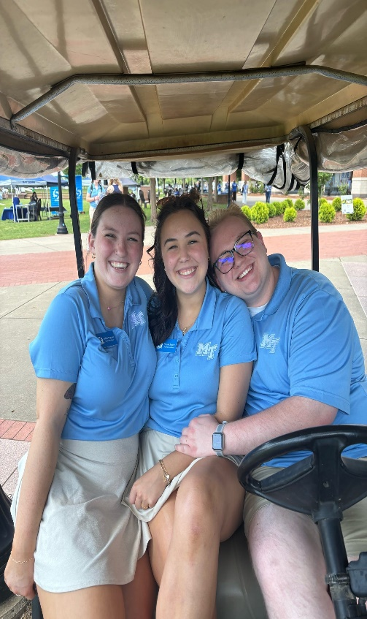
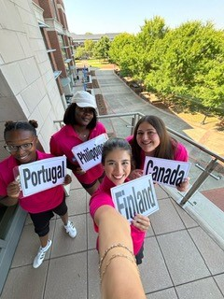
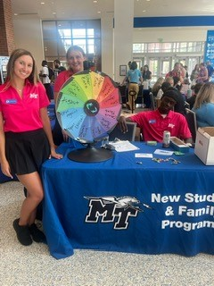
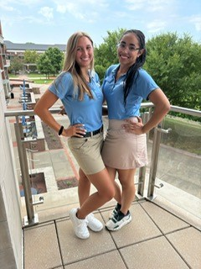
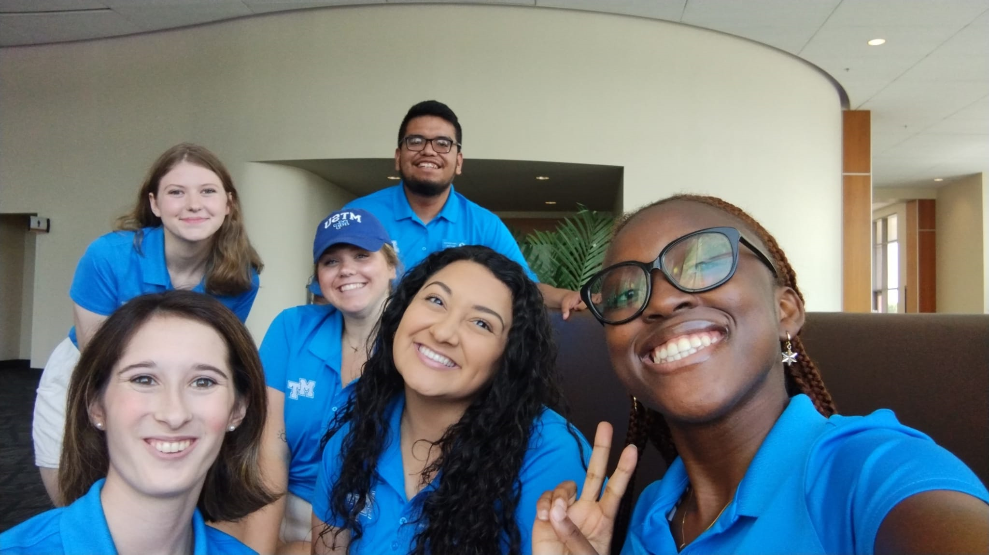
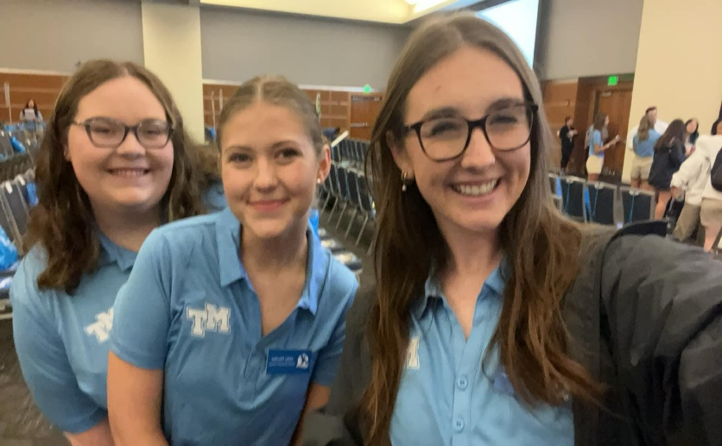

Slide 4
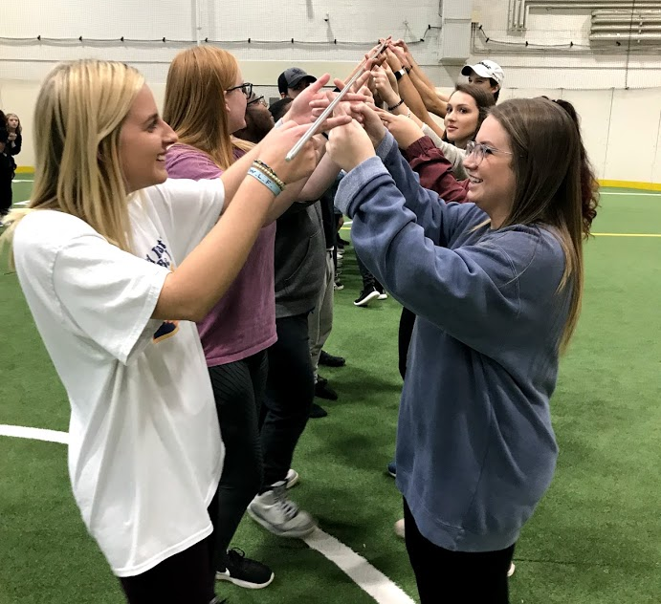
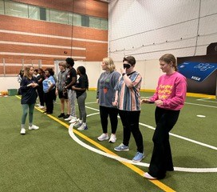
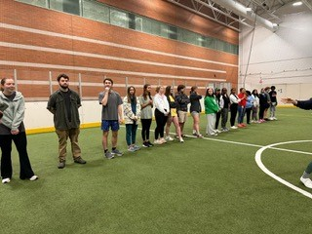
Student Orientation Assistant
Attend weekly trainings Wednesdays
Will have additional training based around your schedule
1.5-3 hour commitment per week in spring 2024

Slide 5
Student Orientation Assistant
Attend team building
February 7, 2024*
Attend SOA Retreat
March 21 & 22, 2024*
Attend All-Day Training
May 12,2024*
* Dates subject to change

Slide 6
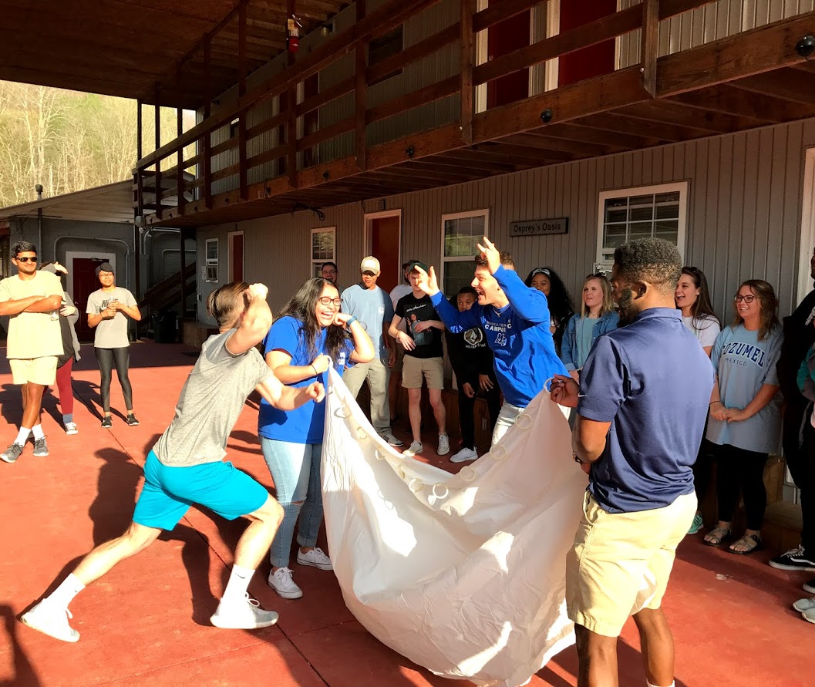
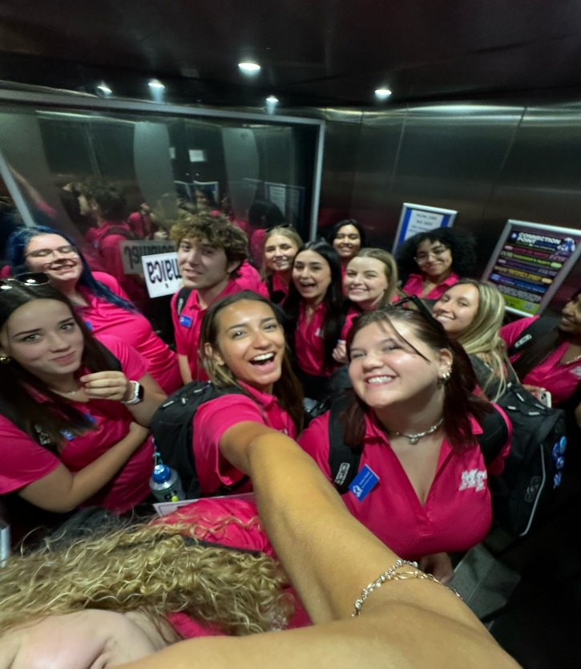
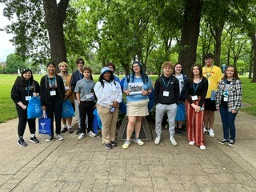
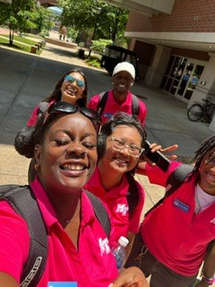
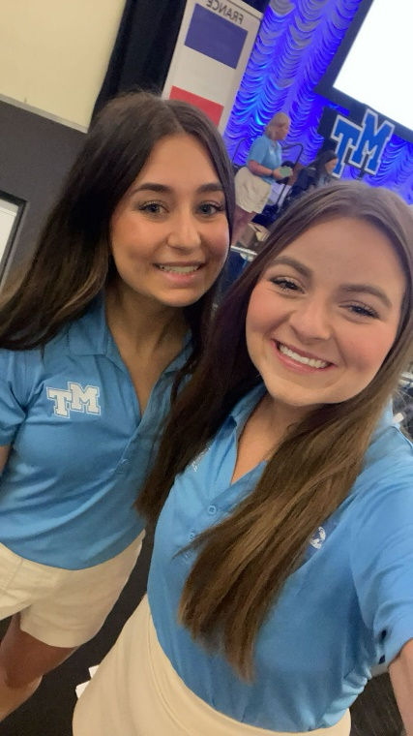
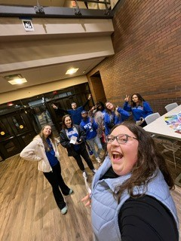
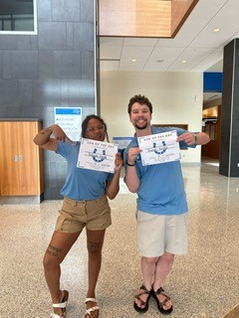

Slide 7
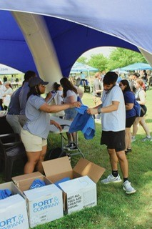
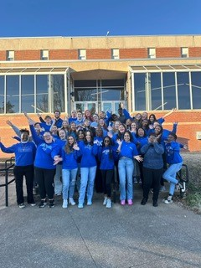
Freshmen Sessions (Mandatory)
Freshmen sessions are ONE FULL DAY starting in mid- May through July
Dates are being determined at this time and will released soon
Will likely be around 15 total dates

Slide 8
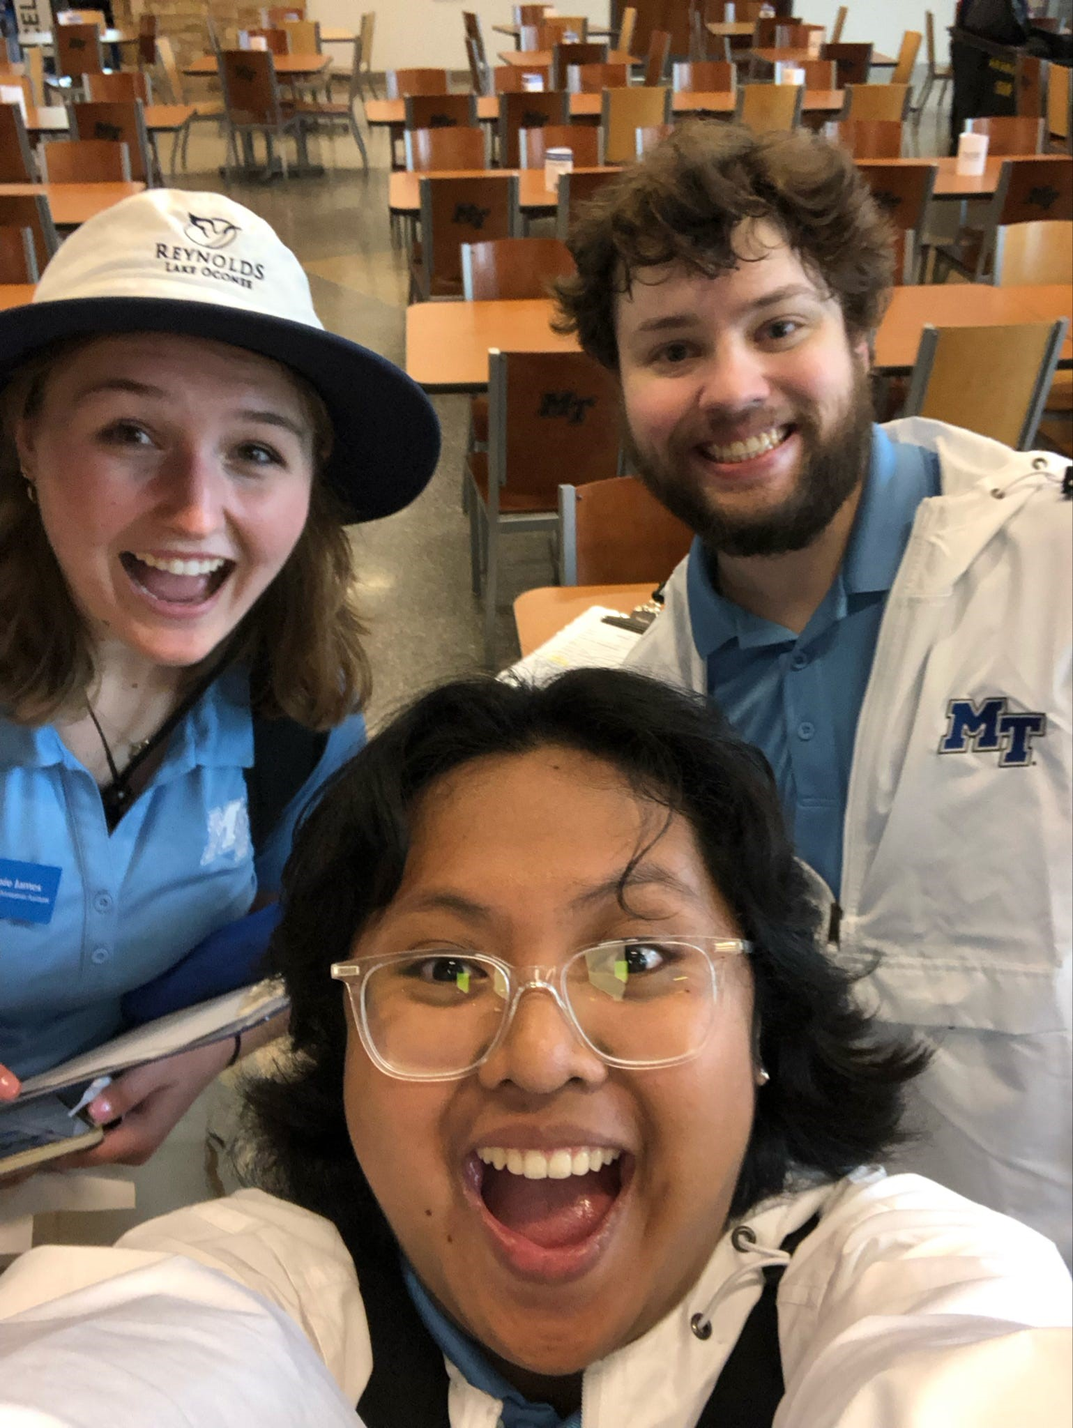
Transfer Sessions
Transfer sessions will be offered in person and virtually this summer.
SOAs will work the on campus in person sessions.
Dates are still being approved at this time. There will likely be 3 sessions on campus

Slide 9
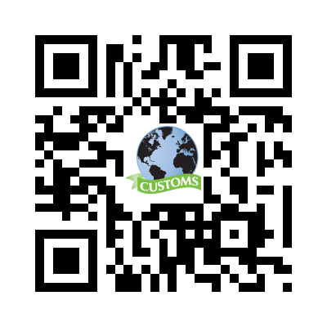
Apply Today! mtsu.edu/customs For more details Due: November 25, 2025

