Slide 1
College of Education
Elementary & Special Education

Slide 2
WELCOME
Students
Future Teacher Bag
Your Advising Folder
College of Education
Student Handbook (pink star)
Student Information
Your PERSONAL documents
Candidacy
Items needed for Admission to the Teacher Education Program
Licensure
Misc.
Blank paper for notetaking
Other helpful resources
Guests
Jump Drive
Handout
Notepad and writing utensil
Follow along with your folder

Slide 3
Agenda
This session (1:00 P.M. – 1:30 P.M.)
College of Education Overview
College Leadership
Majors
State Benchmarks for licensure
College & University Supports
Next session (1:30 P.M. – 4:00 P.M.)
Students
Advising for fall classes, COE 160
Guests
Meeting with Dr. Deb Sells, Student Union Building

Slide 4
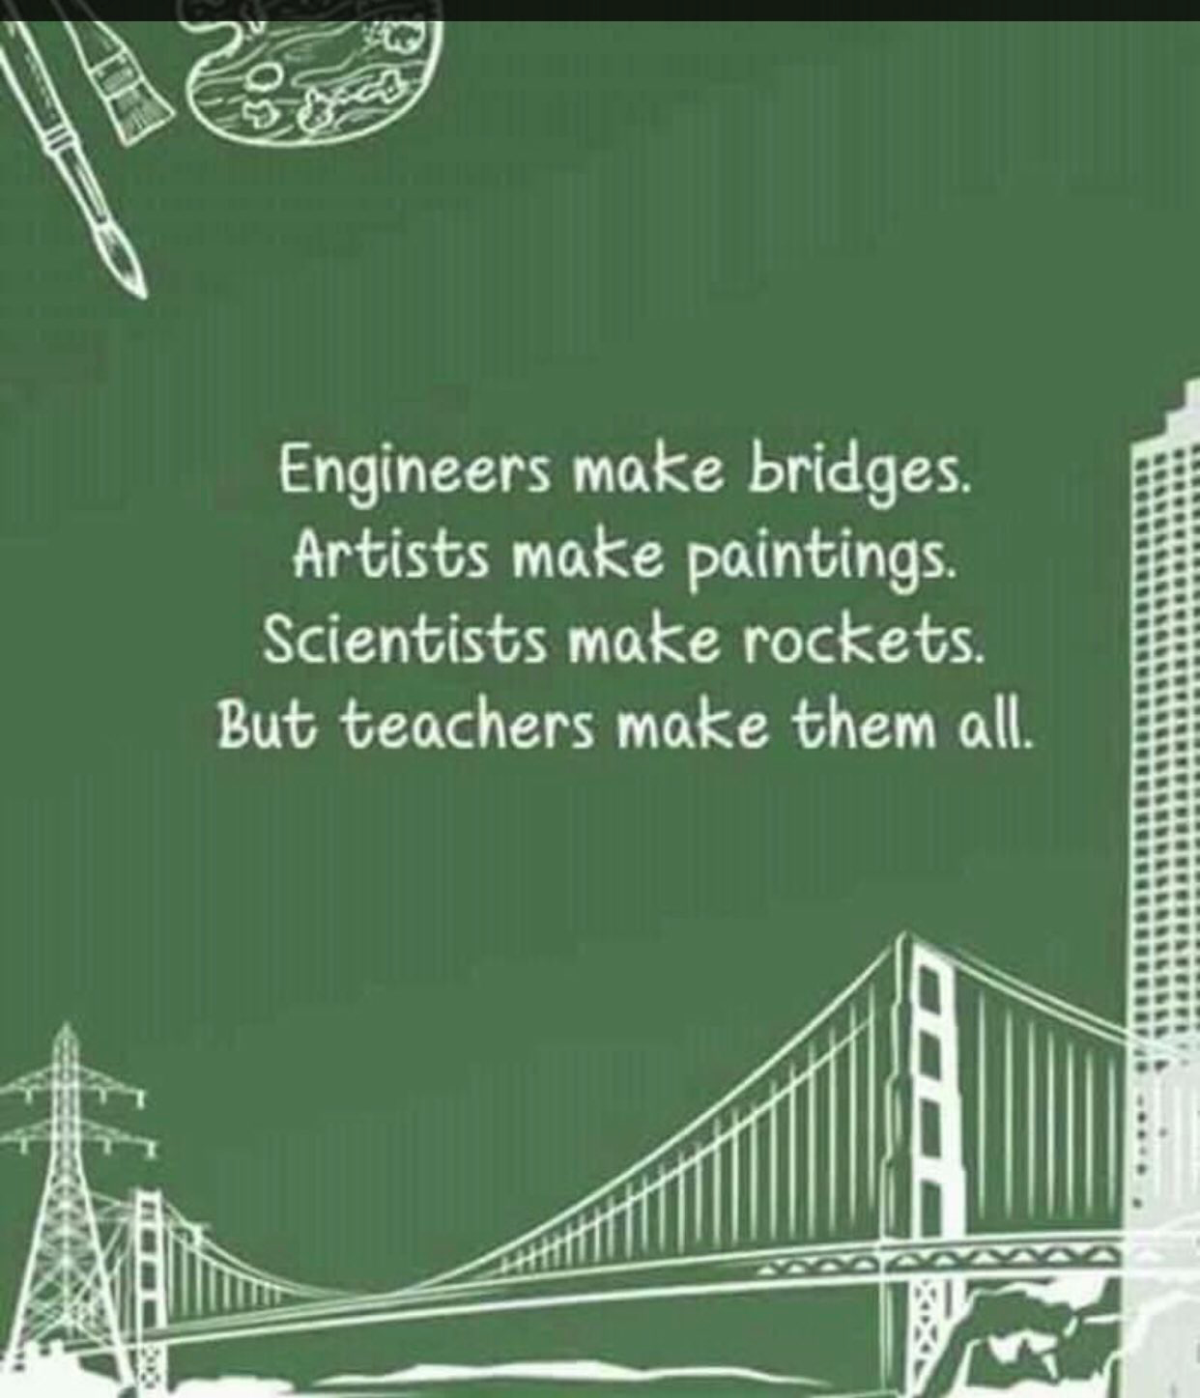
College of Education Leadership Roles
Dr. Rick Vanosdall
Interim Dean
Dr. Robyn Ridgley
Associate Dean
Dr. Tiffany Dellard
Executive Director, Professional Laboratory Experiences
Dr. Eric Oslund
Department Chair, Elementary & Special Education
Dr. Donald Snead
Department Chair, Educational Leadership
Ms. Alicia Abney
Advising Manager

Slide 5
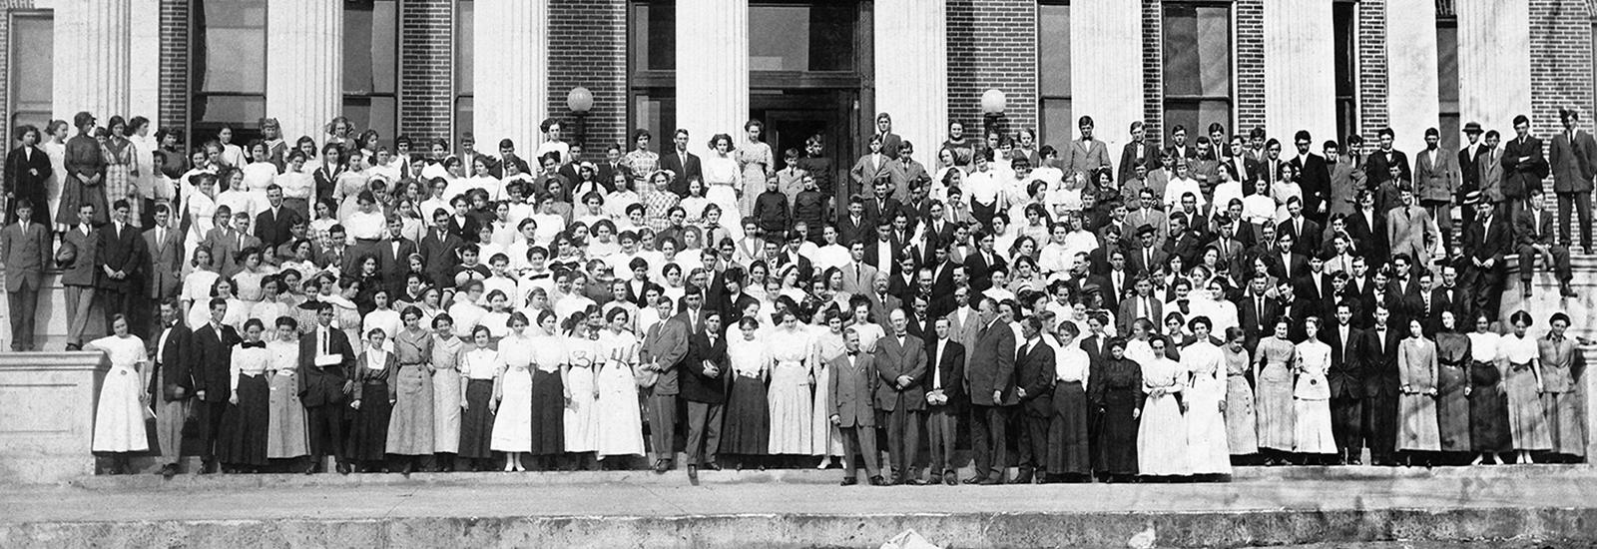
Primary Goal & Mission of MTSU the education and preparation of excellent teachers
Sept. 11, 1911 – Middle Tennessee State Normal School
President R. L. Jones
18 faculty members
125 students
1 building
Source: Clark, S. M. (n.d.). A short history of MTSU. www.mtsu.edu/about/history-more.php
Notes:
1911 – Middle Tennessee State Normal School
Normal schools were expected to establish teaching standards or “norms.”
President R. L. Jones and 18 faculty members were joined by 125 students on September 11, 1911 in a single building that housed all classrooms, offices, meeting rooms, and the library.

Slide 6
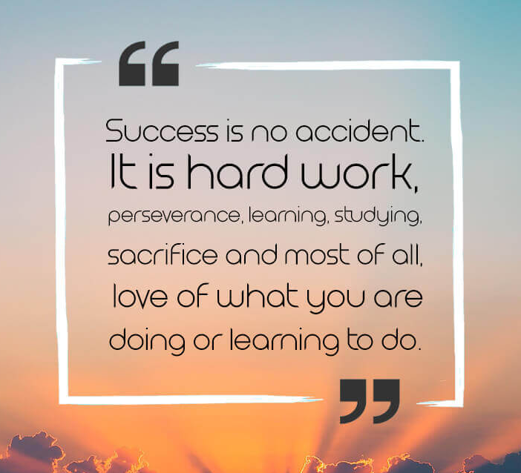
Five Cs in the
College of Education:
Caring
Competent
Collegial
Curious
Creative

Slide 7
2020 State EPP Report Card graduates from 2016-2017, 2017-2018, & 2018-2019
MTSU Exceeds State Average in Employment
Year 1 Employment rate (in-state)
89.3%
(TN average 76.8%)

Slide 8
2020 State EPP Report Card graduates from 2017-18, & 2018-19, & 2019-20
MTSU College of Education Leads the State
MTSU 1st in Educators Highest TEAM Scores (4+)
MTSU 556, UT-Martin 528, TTU 480
MTSU 1st in Educators Highest Student Growth Scores (4+)
MTSU 51, UT-Martin 30, TTU 29
MTSU 1st in Educators Highest Overall LoE Scores (4+)
MTSU 568, TTU 534, UT-Martin 482

Slide 9
Required by State Board for Teacher Licensure MTSU average 44+ in the most recent of the total 18 semesters (required score (2019) = 38; required score (2020 to present) = 40; max score 75)
Spring 2022 | 45.83 | (n 170) | 31 at 50+ | Highest 63
Fall 2021 | 46.11 | (n 67) | 12 at 50+ | Highest 64
Spring 2021 | 44.86 | (n 170) | 23 at 50+ | Highest 61
Fall 2020 (COVID-19 Full Semester) | 44.1 | (n 76) | 6 at 50+ | Highest 52
Spring 2020 (COVID-19 Partial Semester) | 46.0 | (n 154) | 47 at 50+ | Highest 62
Fall 2019 | 45.4 | (n 81) | 23 at 50+ | Highest 64
Spring 2019 | 46.64 | (n 127)
Fall 2018 | 45 | (n 66)
Spring 2018 | 46.58 | (n 146)
Fall 2017 | 45.8 | (n 70)
Spring 2017 | 46 | (n 168)
Fall 2016 | 44 | (n 98)
Spring 2016 | 45.56 | (n 136)
Fall 2015 | 45.88 | (n 99)
Spring 2015 | 42.93 | (n 171)
Fall 2014 | 41.27 | (n 130)
Spring 2014 | 40.4 | (n 93)
Fall 2013 | 37 | (n 225)
edTPA

Slide 10
Future Teachers!

Slide 11
College of Education
Early Childhood Education
PreK-3
Elementary Education
K-5
Middle Level Education
Grades 6-8
Special Education
Interventionist, Grades K-8 or 6-12
Comprehensive, Grades K-12
Pg.19
*Secondary Education (6-12/K-12): Major in content area, minor in secondary education

Slide 12
How do I become a teacher?
Degree Requirements
State Licensure Requirements
Admission to the Teacher Education
EdTPA
Praxis Licensure Exams
Pg.19-23
Notes:
Degree Requirements – major requirements, classes, etc.
State Teaching License Requirements – Admission to Teacher Education, EdTPA, Praxis Licensure tests

Slide 13
Requirements
Degree Requirements
State Requirements
General Education
Content Major Courses
Grades = As, Bs, or Cs
Professional Education Courses
Begin first year
EESE 2010/2011 – Introduction to Education
Grade = A or B
Admission to Teacher Education
2.750 Inclusive GPA
45 Earned credit hours
Test Scores
22 ACT, 1080 SAT, or pass Praxis Core Academic Skills for Educators
Grade of B or higher in EESE 2010/11
EdTPA
Praxis Licensure Exams
Pg.19-23
& Candidacy Tab, Checklist
Pg.24-26

Slide 14
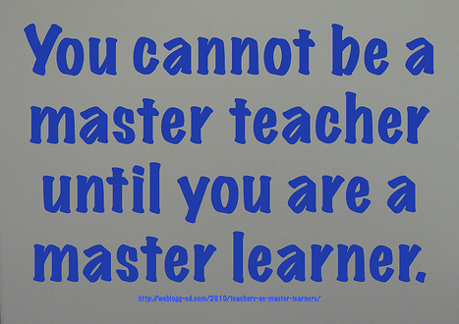
Pre-Residency Program
Pre-Residency Coursework
Coursework with Field Placements
Enrolled in classes on campus

Slide 15
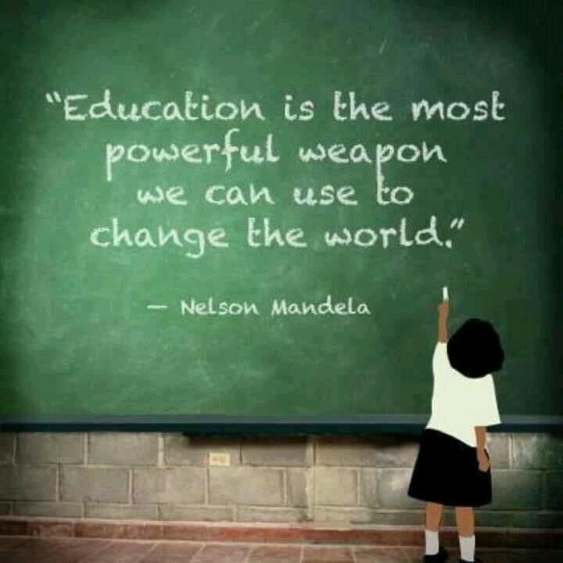
Residency
Residency One
Residency Two
Placed in a local school approximately 2 days a week
Enrolled in classes on campus
Five days a week in field placement

Slide 16
A few degree related notes….
Not all majors are created equal…
College of Education majors are different from other colleges on campus.
Graduate in 4?
120-124 credit hours
Recommended 5 classes (15 hours) each semester
Follow program of study/map recommendations
Minors are not required.
Course Program of Study (CPoS)
Federal/State Financial Aid limitations.
Pg.14
Notes:
Not all majors are created equal…
College of Education majors follow a very specific program of study to meet state education requirements
Graduate in 4?
Majors have a minimum of 120 credit hours
Recommended average 5 classes (15 hours) each semester
Follow program of study/map recommendations, there is no room for electives
Minors are not required.
Course Program of Study (CPoS)
Federal/State Financial Aid will only cover courses required for the student’s major.

Slide 17
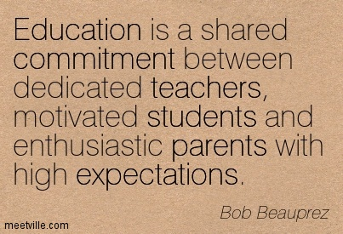
University & College Supports
Pg.13

Slide 18
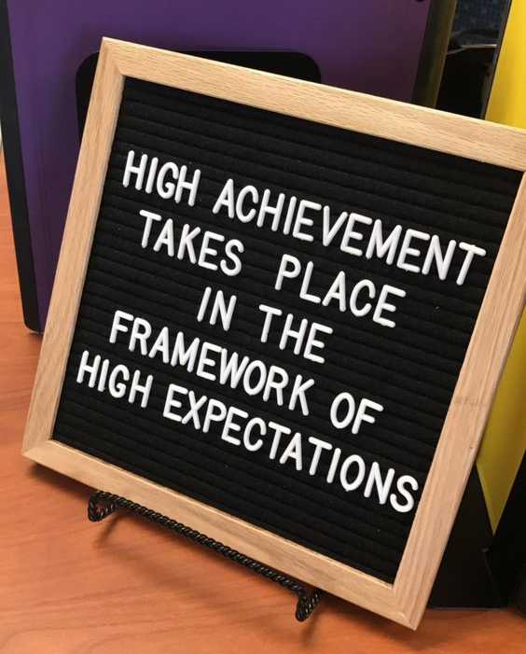
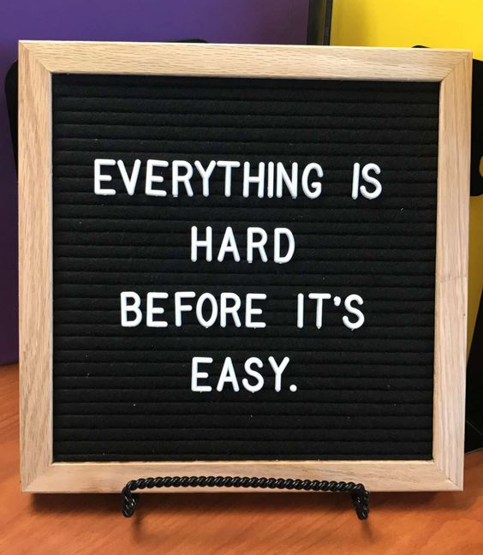
Student Success
Free Tutoring
Writing Center
Success Resources
Early Arrival Programs
Pg. 30

Slide 19
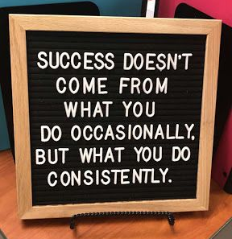
Tutoring & Writing Center
Tutoring Spot
(www.mtsu.edu/studentsuccess/tutoring.php)
FREE Tutoring is available in over 200 courses
Successful student sessions
Margaret H. Ordoubadian University Writing Center
(www.mtsu.edu/writing-center/index.php)
Individual and online appointments, document drop sessions
Tutoring
Online resources
Workshops and writing groups
Pg. 30 & Misc. Tab
Notes:
Tutoring Spot (www.mtsu.edu/studentsuccess/tutoring.php)
FREE Tutoring is available in over 200 courses in subjects such as biology, history, math, economics, and so many more.
Sessions on how to be a successful student!
Study skills, learning strategies, note taking, time management, etc.
Margaret H. Ordoubadian University Writing Center (www.mtsu.edu/writing-center/index.php)
Individual and online appointments, document drop sessions
Tutoring
Online resources
Workshops and writing groups

Slide 20
Early Arrival Programs
Scholars Academy
Two-week early arrival program for incoming first-time freshmen
Student Transition and Academic Readiness (S.T.A.R.) Program
One-week early arrival program for incoming freshmen and transfer students
Contact Ms. Brelinda Johnson at Brelinda.Johnson@mtsu.edu for more information
Pg.30
Notes:
Scholars Academy
Two-week early arrival program for incoming first-time freshmen that begins two weeks prior to the first day of school in August.
Scholars Academy
Academic Benefits
Better preparation for college-level general education courses
Support of academic advising and course selection
Completion of Scholars Academy University Seminar course with unique curriculum and experiences
Social Benefits
Heightened sensitivity to the benefits and challenges of independence
Greater awareness of interpersonal strengths and challenges
Increased opportunities to engage students in conversations about college and success
Involvement in Scholars Academy student organization
Long-term Benefits
Increased retention and graduation rates of participants
Earlier identification of major/career options and subsequent educational adjustments
Peer mentor opportunities
STAR
Benefits
Head start on college
Positive academic, social, and long term impact
Enhanced preparation for college-level general education courses
Leadership training, service learning and team building opportunities
Early move-in to housing
TALKING POINTS FOR DEANS & ADVISING MANAGERS
Scholars Academy is designed to serve all students with a focus on the needs of first generation, Pell Eligible, and students who face barriers in obtaining a quality education.
Scholars Academy provides students a head start to the university and prepares them in critical areas of time-management, studying, test taking, college reading, math, and much more through a two-week Freshmen Summer Institute.
Scholars Academy allows students to build a strong support system with administration, faculty, peer mentors, and fellow participants.
Scholars Academy participants maintain a higher retention rate than those students who do not join the Academy.
Stop by the Scholars Academy table at the picnic this afternoon.

Slide 21
Accelerated Mentoring Program
Who can participate?
Anyone!
Highly encourage the following to participate
First-generation students
Minority students
Incoming freshmen students
Incoming transfer students
What is the Accelerated Mentoring Program?
A program to eliminate the achievement gap
Through components of peer mentoring, tutoring, student success coaching, family education, and financial assistance, underserved students are afforded a more level playing field to aid them toward obtaining a Bachelor’s Degree.
Contact Ms. Brelinda Johnson at Brelinda.Johnson@mtsu.edu for more information

Slide 22
Other Success Resources
Supplemental Instruction (SI)
Peer-assisted, group study and discussion
Office of Student Success Resources (www.mtsu.edu/studentsuccess/)
Student Success Center (www.mtsu.edu/studentsuccess/students.php)
Best Practices for Student Success (www.mtsu.edu/studentsuccess/best-practices.php)
Ready Reference Guide (page 31 in folder!)
Pg.30-31
Notes:
Supplemental Instruction
Supplemental Instruction (SI)
Peer-assisted, group study and discussion methodology that uses regularly scheduled, informal SI sessions to help students develop greater understanding of challenging content, refine study skills, and better integrate course material into their work and lives
SI targets historically challenging courses, and SI leaders coordinate sessions in which students work together to immerse themselves in lecture material and content at a level over and above what is possible in traditional class meetings. These sessions are great ways for students to explore challenging concepts or ideas; review and analyze class notes; deconstruct and discuss difficult reading assignments; learn test-taking strategies; and review for exams. SI leaders are embedded in the courses in which they are responsible for leading group study sessions, and have typically performed at a very high level in those courses. In short, SI leaders are in many ways just like you. They have already completed your course and are eager to share their experiences and expertise with you!
Why should you attend Supplemental Instruction sessions?
First and foremost, because they work! It is not uncommon for SI participants to score a half to full letter grade higher than non-participants, depending on their attendance and on the course.
Through informal seminars, SI not only helps students with course material. It also helps students develop the skills that they need to further their work at MTSU as successful and self-sufficient students.
SI gives you exclusive access to professionally trained SI leaders in group discussion and review sessions, where you can enhance your understanding of assigned material, practice course content, and develop skill-sets to support your long-term success at MTSU.
There is no long-term commitment or special forms required! Attend as many or as few sessions as you wish, or as you need them. Regular attendance is encouraged since what you get out of SI tends to correlate with the time and effort that you put into your participation. So attend weekly, or just attend as your exams approach!
SI is voluntary and offered by the Office of Student Success FREE of charge to students enrolled in Supplemental Instruction courses. All that is required of you is your time, effort, enthusiasm, and participation.
Benefits of Attending SI
Typically higher course grades and better long-term student success, according to data from partner universities and the International Center for Supplemental Instruction, and various other research studies.
Meet new and interesting people, and increase your involvement in and connection to the MTSU campus (another important element of student success, more generally).
Learn and embrace valuable learning and analytical skills through directed exercises and discussions with your professional SI leader and your classmates.
Enjoy and immerse yourself in the learning process, the lifeblood of the university.

Slide 23
Other Success Resources (cont.)
Study Abroad
Numerous options for General Education courses
Consortium for Overseas Student Teaching (COST)
Opportunity to complete part of Residency abroad
Financial aid and scholarships may be available for funding
Meet with your advisor EARLY to start planning
Past College of Education Study Abroad Opportunities
Singapore

Slide 24
Academic Advising
Mission: Provide a quality, student-centered environment that promotes intellectual growth.
Fostering a collaborative and mentoring relationship among advisors, students and the university community.
Pg.7-12
Notes:
The mission of the MTSU academic advising process is to provide a quality, student-centered environment that promotes intellectual growth. This process is dedicated to fostering a collaborative and mentoring relationship among advisors, students and the university community. Students are encouraged to think logically, critically, and creatively in order to assume ownership of their lifelong educational goals. Advisors guide students through a variety of support services that enable them to make a successful and holistic transition in the MTSU and global community.
“Academic advising is the only structured service on the campus in which all students have the opportunity for on-going, one-to-one contact with a concerned representative of the institution.” Habley, W. R. (1994).
Pgs. 7-10 in student folder

Slide 25
COE Advising Team
Alicia Abney, Advising Manager
Early Childhood Education that have earned their Associate of Science in Teaching (A.S.T.) degree.
Future Teachers that may be struggling
Bryanna Licciardi
Middle Level Education
Elementary Education and Early Childhood Education that have transferred to MTSU.
Gerard McQueen
Special Education
Elementary Education and Early Childhood Education that have NOT transferred to MTSU.
June Adams
Elementary Education majors that have earned their Associate of Science in Teaching (A.S.T.) degree.
Graduation Analyst
Pg.7-12

Slide 26
VIDEO 1 (4:45)
VIDEO 2 (3:00)
MTSU Teachers are Difference Makers(2:15)
Difference Makers – Dr. Schrodt (1:26)
Difference Makers – Kira Dillard (2:23)
Difference Makers – Lori Chew, MCS (1:23)
Difference Makers – Lee Ramsey, RCS (2:31)
“Teaching True Blue” (1:45)
Focused on Student Success (1:42)
High Quality Faculty (2:17)

