Slide 1
The Last Weeks of Class
And then there are exams

Slide 2
Note
This is the last section of a set of slides designed to give new students an overview of what to expect during the first semester.
In addition to the appendix, the other sections are
Introduction
The First Day of Class
The First Six Weeks
The Second Six Weeks
The whole set is posted as one presentation in the “For Students” section of the English Department under the title “Tips for New Students.”

Slide 3
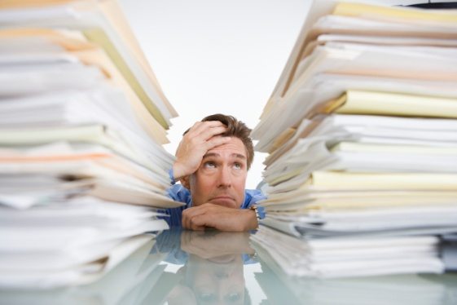
The Last Few Weeks
During the last few weeks of the semester, you may be torn between wanting the semester to end right away so you can rest and wanting the semester to last longer so you can finish all your work.
During the fall semester, Thanksgiving may feel like the end of the semester, but it isn’t.
In the spring, the sunshine may beckon, but you have to keep studying.
But then, after exams, you will have a break.
Hang in there!

Slide 4
Final Essays and other Projects
IMPORTANT: Most final assignments will be due around the same date.
Plan ahead so that if three or four things are due in the same week, you can do your best work for each of them. Sometimes it helps to set deadlines for yourself, that are earlier than assignment deadlines.
Just because you did well in a subject before the midterm, don’t slack off on that subject to concentrate on others.
Make sure you get enough sleep and that you eat adequately. You will do better work if your energy levels are at their peak.

Slide 5
Studying for the Final Exam
Find out if the exam is cumulative or if it covers only the work since the last exam.
Put together some method for review.
For most English classes, memorization will not be the best way to study.
When preparing for an essay exam, asking yourself questions and taking time to write out answers is a great way to review.
Study/review a little every day.

Slide 6
Exam Week
Confirm all your exam dates and times at least a month in advance. Put them on your personal planner.
Note that final exams last two hours.
Note that your exam may not be at the same time as the beginning of your class.
Make sure you have whatever you need to bring to the exam.
Plan ahead for parking. If you are late to the exam, you don’t get extra time.
Get enough rest and food so you can concentrate on the exam.

Slide 7
How Did You Do?
You survived finals.
You completed at least 12 hours with a C average or better.
You are not in danger of losing your scholarship.
You missed more classes than you should have or otherwise “blew” a class.
You made a lot of mistakes.
You are preregistered for next semester.
Terrific!
Not bad!
Wonderful.
Next semester you won’t.
And learned from them.
You’re doing just fine.
Guess what?
You had a normal first year.

Slide 8
Looking Ahead
If you are preregistered for next semester, don’t forget to pay your bills on time and confirm your registration so you don’t lose your classes.
If you are not preregistered, why not?
If you didn’t do as well this semester as you’d hoped, ask yourself why so that you can plan to do better.
If you did as well as or better than you hoped, be happy.
There is only one first semester of college in everyone’s life.
Are you ready for the next one?

