Slide 1
Middle Tennessee State University Rental Program

Slide 2
Agenda
Middle Tennessee State University Program Overview
State webpage (eLink)
Trip Optimizer
Enterprise Reservations
National Reservations
  Emerald Club Benefits
Personal Use
Q&A

Slide 3
Program Overview and Main Webpage

Slide 4

MTSU– Program Overview
Enterprise Rent-A-Car
  127 office within Tennessee
  Statewide travel directed to the closest rental location
National Car Rental
  Airport Travel
  Emerald Club
Q&A
Agency Billing included for Enterprise & National

Slide 5
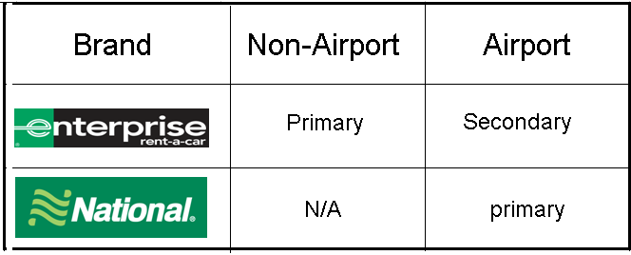
What Brand Do I Use?

Slide 6
Trip Optimizer

Slide 7
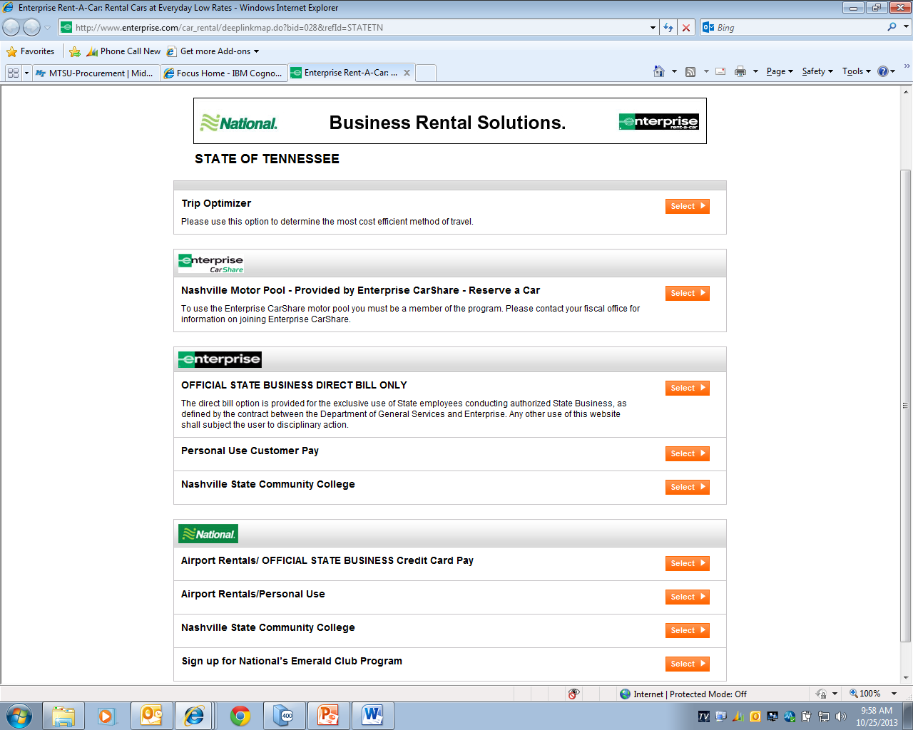
http://www.enterprise.com/car_rental/deeplinkmap.do?bid=028&refId=STATETN

Slide 8
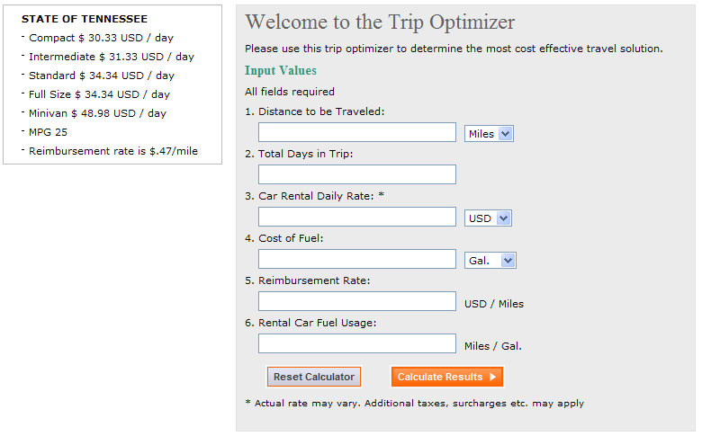
http://www.enterprise.com/car_rental/deeplinkmap.do?bid=028&refId=STATETN

Slide 9
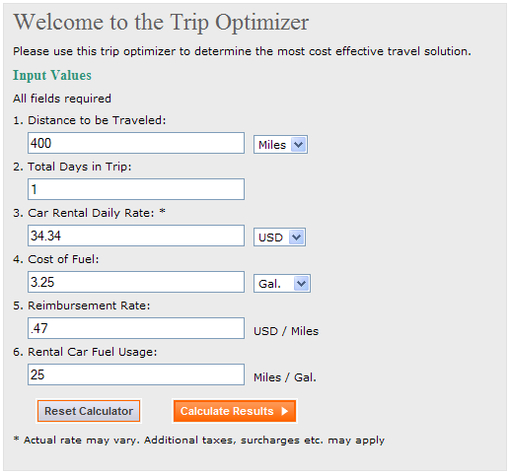
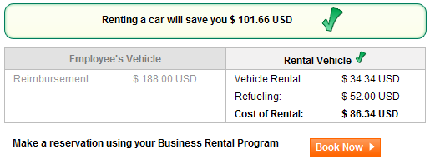
Roundtrip – One Day trip to Knoxville
Trip Savings $101.66

Slide 10
Reserve at Enterprise Rent-A-Car

Slide 11
http://www.enterprise.com/car_rental/deeplinkmap.do?bid=028&refId=STATETN

Slide 12
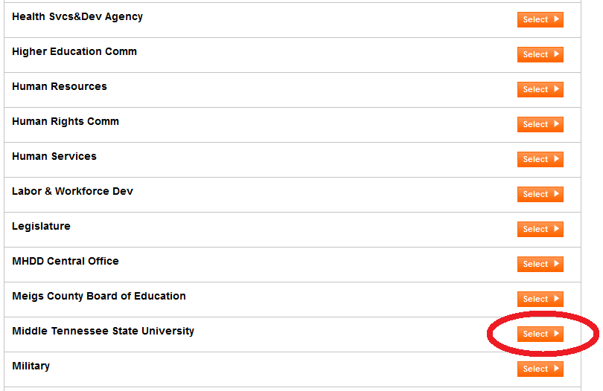
Enterprise Reservations – Middle Tennessee State University

Slide 13
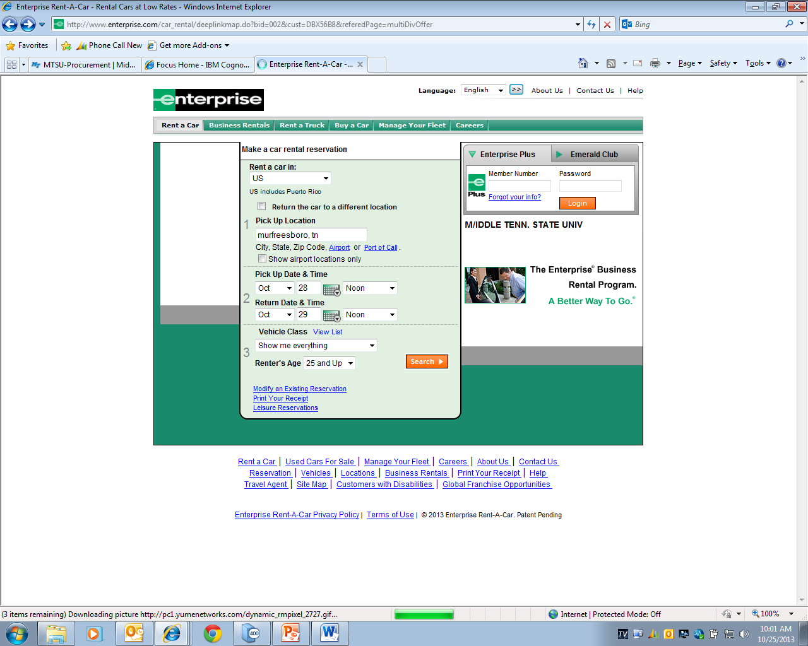
Enterprise Reservations – Enter City, Select Date / Time, and Vehicle Class

Slide 14
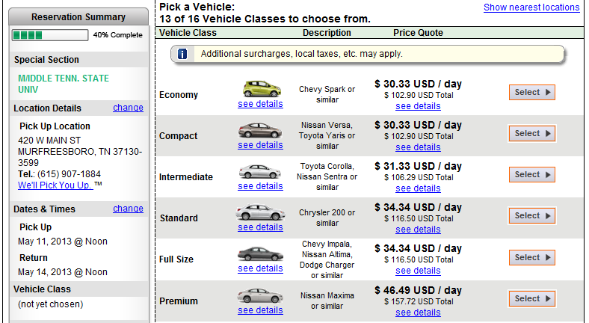
Enterprise Reservations – Select Vehicle

Slide 15
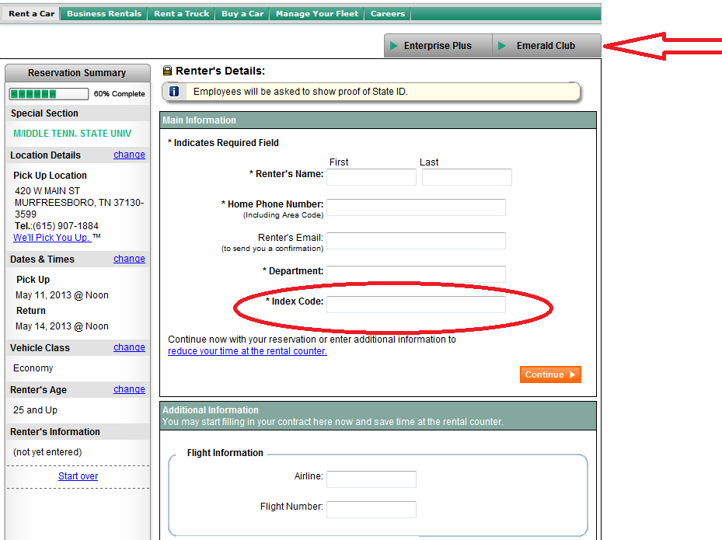
Enterprise Reservation – Enter Information

Slide 16
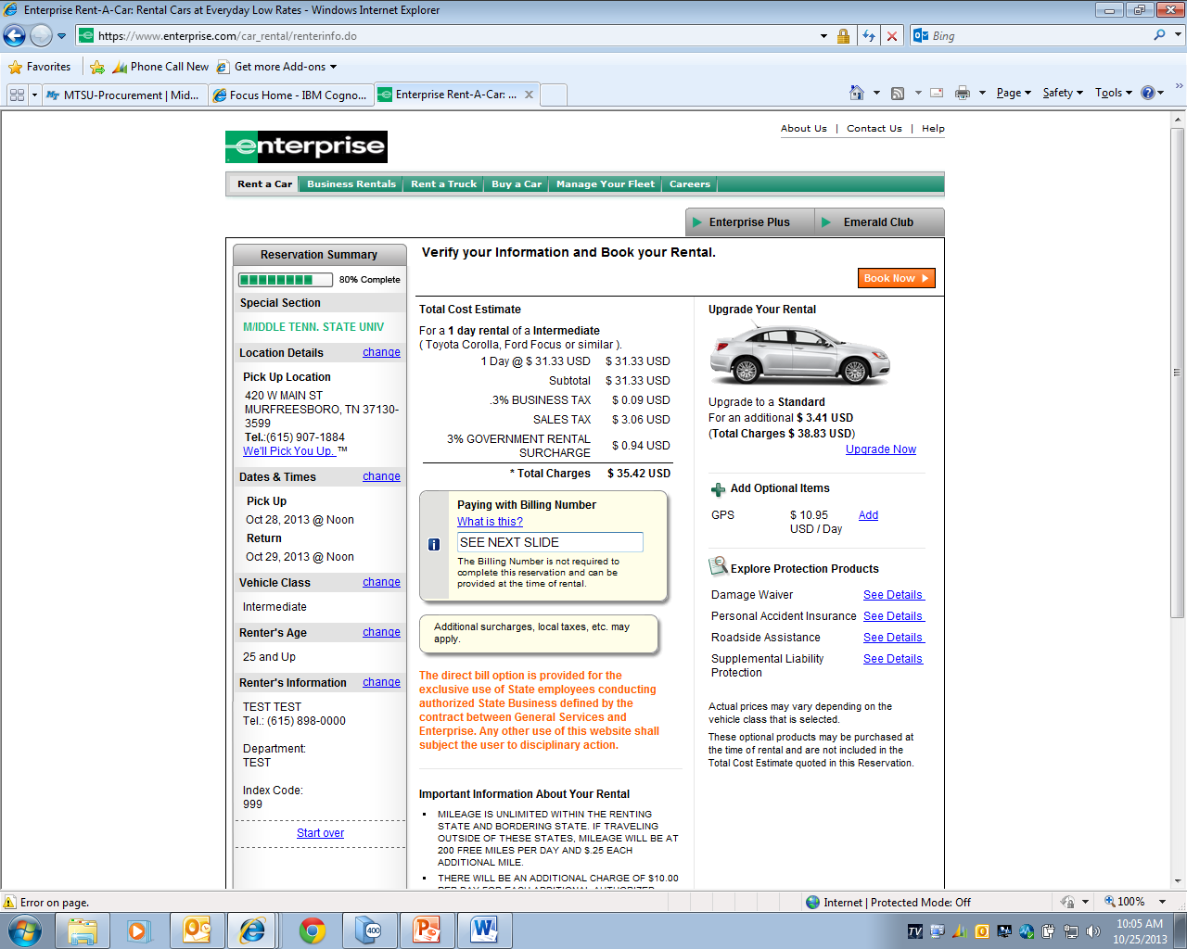
Billing Number Required ?

Slide 17
Billing Number Required
MTSU has a secure billing number
  Must be obtained from authorized personnel
  Must be provided at time of reservation
  Without billing number, you must pay with credit card
  The Enterprise branch does not have access to MTSU’s secured billing number

Slide 18
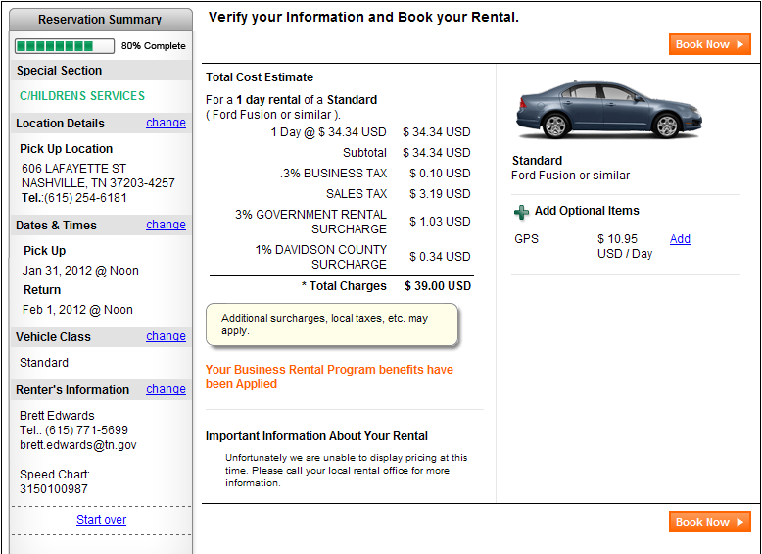
Enterprise Reservation – Details
Note: The State of Tennessee is tax exempt and the taxes will be removed at the time of rental!!

Slide 19
Airport Reservations at National Car Rental

Slide 20
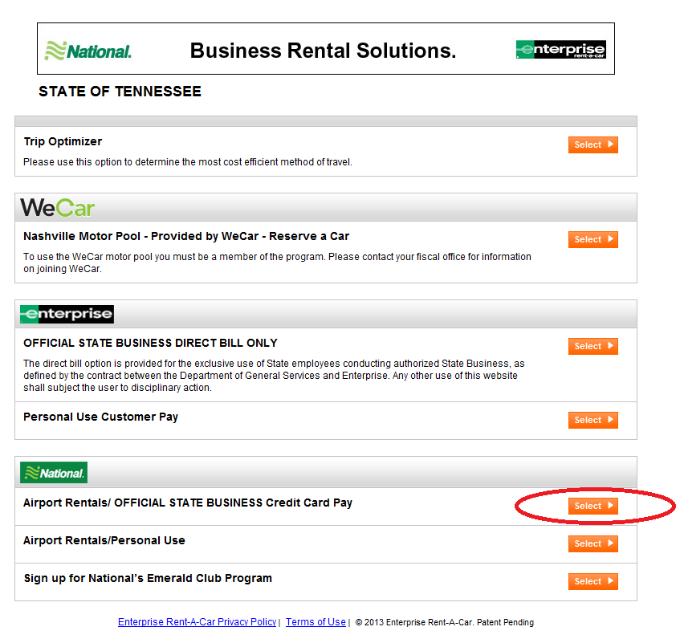
http://www.enterprise.com/car_rental/deeplinkmap.do?bid=028&refId=STATETN

Slide 21
National Car Rental - Reservations

Slide 22
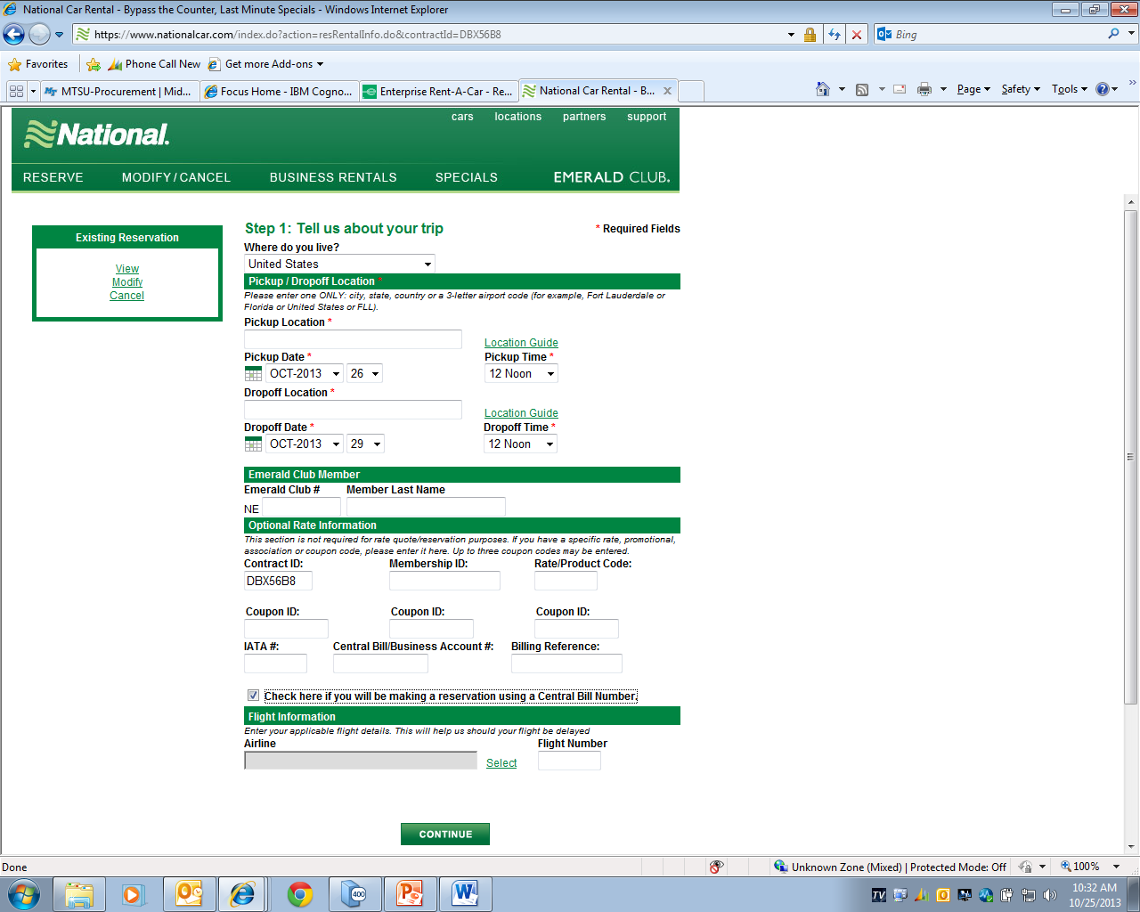
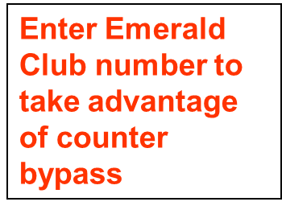
National Car Rental – Enter Trip Data

Slide 23
Billing number required?
MTSU has a secure billing number
  Must be obtained from authorized personnel
  Must be provided at time of reservation
  Without billing number, you must pay with credit card
  The Enterprise branch does not have access to MTSU’s secured billing number

Slide 24
Personal Use

Slide 25
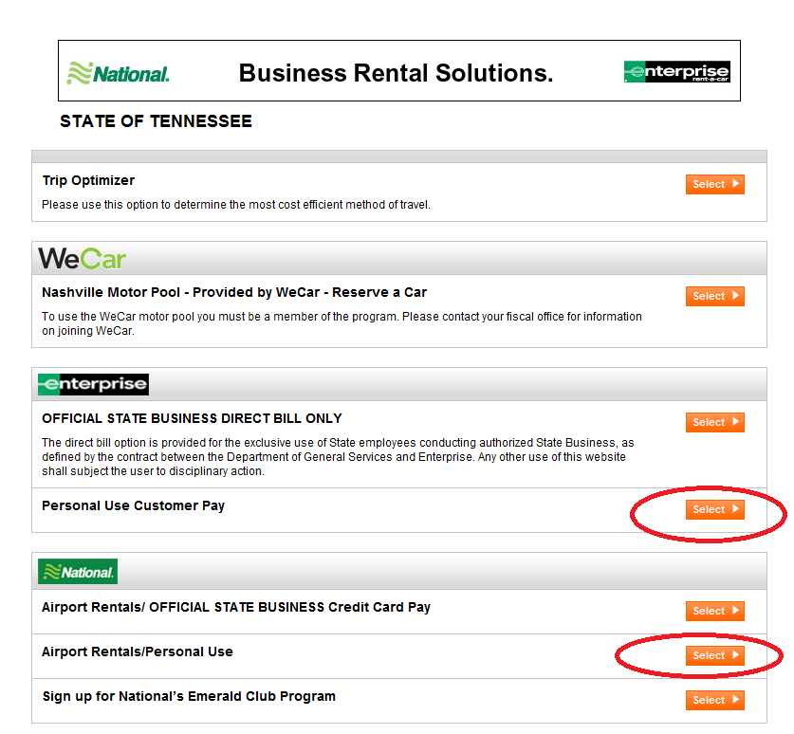
http://www.enterprise.com/car_rental/deeplinkmap.do?bid=028&refId=STATETN

Slide 26
Q & A

