Slide 1
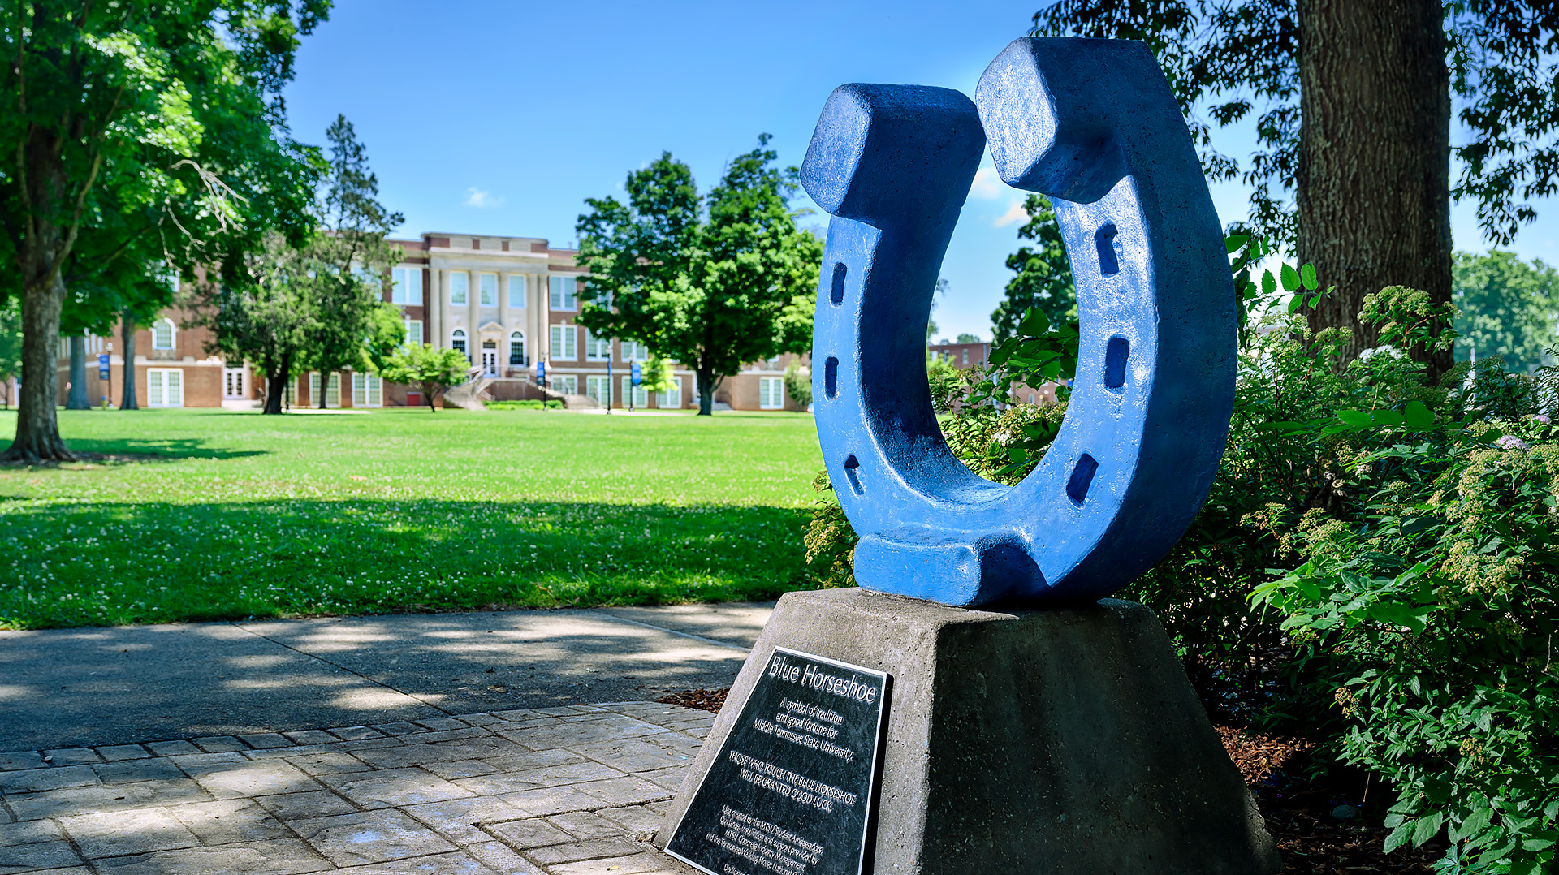
DEPARTMENT TRAINING – Scheduling and Registration

Slide 2
Registrar’s Office
Registrar and Assistant Vice Provost – Dr. Tyler Henson
Associate Registrar, Curriculum and Graduation – Cindy Johnson
Associate Registrar, Scheduling, Registrar and Records – Anne Ford
Scheduling Manager – Tammy Maples
Academic Course Schedulers – Christy Weir, Cyndi Smith
Registration Coordinator – Kimberly Primas

Slide 3
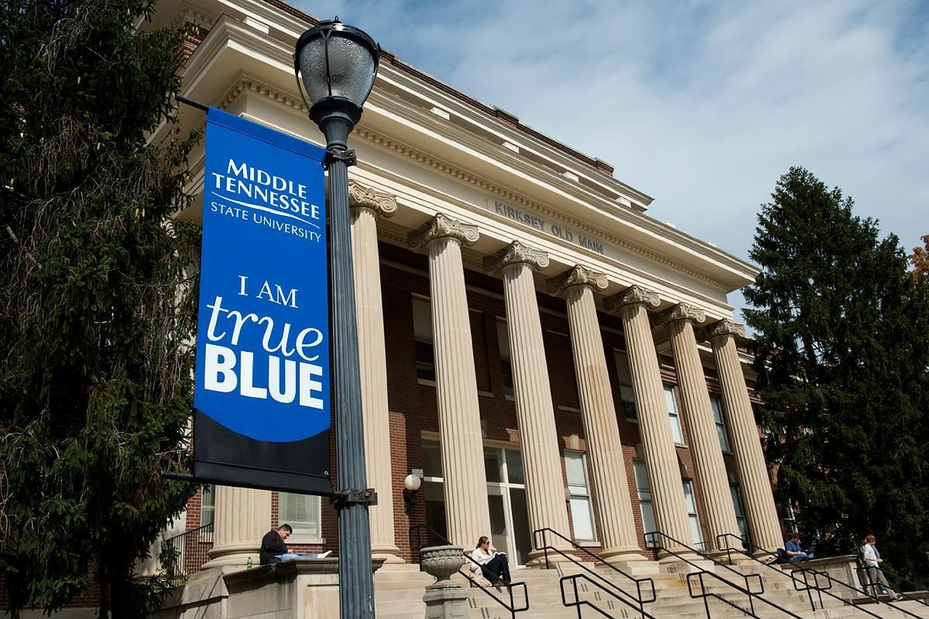
ONLINE RESOURCES
Registration Forms - https://www.mtsu.edu/one-stop/forms.php
Add/Drop Forms and instructions, UG Repeat forms
Registration Guide - Course Type Information, Waitlist, Pipeline navigation, Winter Information - https://www.mtsu.edu/registration/registration-guide.php
Dates and deadlines for each semester, also includes purge dates
Scheduling Information – https://mtsu.edu/resources/staff/class-schedule-production.php
Scheduling Timeline, Standard Times, Instructional Space Use Procedures, Schedule Production Guidelines

Slide 4
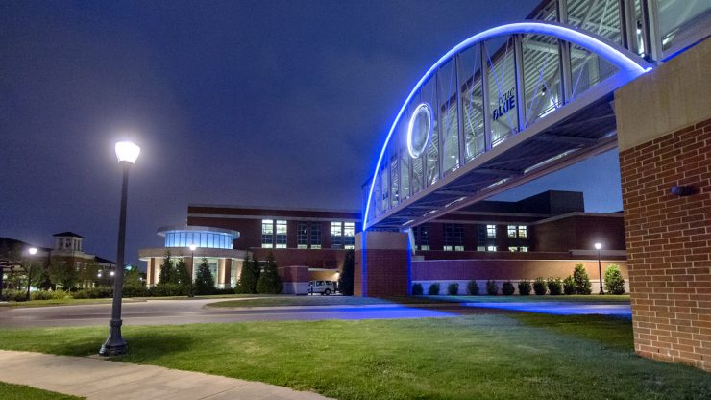
ACADEMIC COURSE SCHEDULING

Slide 5
Academic Course Scheduling
Scheduling rolls the courses from the previous like term to create the new term. For example, Summer 2023 is rolled to create Summer 2024.
Scheduling “cleans up” the data by removing previous dates and times from the schedule, removing non-first priority space and deleting cancelled courses.
Our office is not always notified of prefix or number changes. Please make sure you let us know if you have a prefix or number change and include the course information so that we can get it added to your schedule.
Scheduling then sends the schedule out to the departments with a memo explaining what we have done including the timeline of dates and deadlines for the schedule.

Slide 6
Academic Course Scheduling
Schedules are sent to the departments. Departments have approximately 6-8 weeks to make any schedule changes depending on the semester.
Scheduling then has approximately 6 weeks to make all schedule changes. Please keep in mind that each Academic Scheduler manages around 3000 courses for each semester.
All changes should be made on the Excel Spreadsheet.
Please do not delete any lines or columns on the spreadsheet.
All changes should be highlighted.

Slide 7
Academic Course Scheduling
Per SACSCOC, course must meet on campus 750 minutes per credit hours. A three-hour course must meet 2250 minutes.
Most courses are 3 credit/3 contact hours.
We schedule courses based on the contact hours listed in Banner.
The course description does not control how long a course meets.
If the description says the course should meet for a 2-hour lecture and a 2-hour lab, the course must be listed at 4 contact hours in Banner.

Slide 8
Academic Course Scheduling
Standard meeting times
All courses that are 3 credit/3 contact hours must meet on a standard meeting time.
Courses that are not 3 credit/3 contact hours must begin, end or meet during a standard time.
Courses meeting any other time must have non-standard time approval, even if they have met this way in the past.
All courses approved to meet at a non-standard time, must meet in their own restricted or first priority space.
Standard Meeting times can be found online. https://mtsu.edu/resources/staff/class-schedule-production.php

Slide 9
Academic Course Scheduling
Space
Courses should be placed in your first priority space.
Departments should make every effort to pre-assign all courses before the automatic scheduler runs. The more space you pre-assign, the more chance your courses will be in spaces they can use.
Departments have use of their first priority space until the automatic scheduler runs.
After the automatic scheduler runs, only restricted space is reserved for your department. No other department can use restricted space without your permission.

Slide 10
Academic Course Scheduling
Space
Courses capacity should be set as close to the room capacity as possible.
Course should follow the 67% fill rate guideline.
For example, we should not place a course with enrollment of 30 in a room that holds 400 people.
First-priority space- the department can use this space for their courses until the automatic scheduler runs. After the automatic scheduler runs, first-priority space can be used by any department.
Restricted space – this space is always reserved for the department. Nothing can be placed in this space without the department's permission.

Slide 11
Space limitations
Beginning Summer 2024, KOM will be offline for at least 2 years.
All courses will be scheduled in other open spaces during the time this building is offline.
How does this impact your department if you don’t schedule in KOM?
We will be using every available space to place courses that would normally meet in the KOM.
This means, there will be little to no space available if you need to move a course.
We ask that all restricted and first priority space be used by your department before you use space outside your area.

Slide 12
Crosslisting Course
Crosslisting a course for Scheduling purposes is only done to share space.
The courses with the meeting patterns listed below will not be crosslisted:
TBA meeting pattern.
Courses with different Instructors (only if they share physical campus space).
Courses with different meeting patterns (unless they share space).
Online courses that are not dual listed or curricular equivalents. Dual Listed course are defined as Undergraduate/Graduate equivalents and 6000/7000 levels. Any question regarding dual listed can be sent to the Associate Registrar. Curricular equivalent examples would be EMC/JOUR/RIM 1020 or ECON 2110/FIN 2010.

Slide 13
Crosslisting Course
Circumstance outside of the list provided by Scheduling should be reviewed by the Associate Registrar.
If the Associate Registrar can’t approve, the department can request ITD to crosslist in D2L only. The courses must meet the guidelines set forth by ITD.
Two or more online sections of the same course taught by the same instructor.
Two or more sections of the same on-campus or blended course that meet in the same location at the same time.
A combination of online, blended, and on-campus sections of the same course taught by the same instructor. (On-campus and blended courses must meet at the same time in the same location.)
Cross-listed courses that combine graduate and undergraduate sections that are taught by the same instructor at the same time in the same location or are online sections.
Cross-listed courses that combine interdisciplinary courses taught by the same instructor at the same time in the same location or are online sections.
www.mtsu.edu/ait/D2L/Forms/crosslisting.php
If the course does not fit one of these parameters listed, the department can appeal to the Registrar.

Slide 14
Academic Course Scheduling
Course Types
Conventional – Traditional, on ground meetings at a standard time.
Blended – a blend of on ground and online meetings.
Synchronous – courses with a standard meeting pattern, but meets online.
Online – courses that take place only online. These courses cannot have any required meetings on ground or online.
Detailed information on course types can be found online. https://mtsu.edu/registration/coursetypes.php
Distance Education courses are determined by how much time the course meets on ground and online.
Any course meeting 50% or more of the required time is considered on ground.
Courses meeting less than 50% of the required time is considered online.

Slide 15
STUDENT
REGISTRATION
PROCESS

Slide 16
Registration
Students can register online from their assigned registration time through the seventh day of courses for a full-term course.
All dates and deadlines for dropping and adding can be found in the Registration Guide. https://www.mtsu.edu/registration/registration-guide.php
Once forms are required, the student should obtain signatures from the professor and the department and bring the form to the One Stop to be processed.
We ask that forms be brought by the student to the One Stop as most students will need to prepay for the course before it can be added.

Slide 17
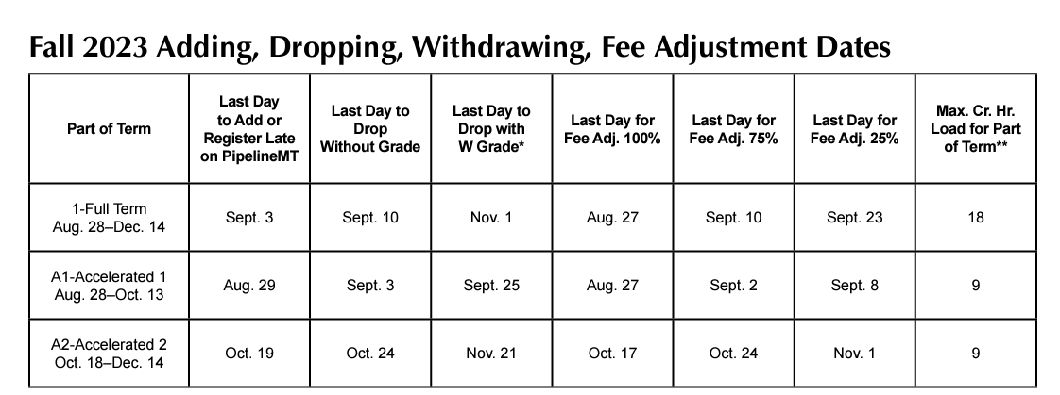

Slide 18
Registration
When Add/Drop forms are required, the One Stop will process the form with the Department Signature. We do not require the Instructor’s signature.
It is at the discretion of the department if the Instructor signature is required.
A Signature Authorization list that is maintained in our area and includes the name and copy of a signature for every person authorized to sign add/drop forms.
If someone signs an add/drop form that is not on the list or we can’t recognize the signatures, the One Stop will contact the department for verification before processing the form.

Slide 19
Registration
When signing an add/drop form, the department should review the course to ensure there are open seats.
The department should also enter all permits before the student brings the add/drop form to the One Stop to be processed.
The add/drop only gives us permission to late add the student. It does not give us permission to override any registration errors.
The One Stop processes the form. If they receive registration errors, they will contact the department to assist in resolving these errors.
The One Stop does not enter permits. If no one is available in your office to enter permits, the Chair should email Anne Ford for assistance.

Slide 20
Registration
Registration forms can be emailed to register@mtsu.edu only if the student is only registered in online courses.
We only have one staff member that monitors this email account.
Late registrations through email can take days to process depending on how fast each area responds to a request or how long the student takes to pay the fees.

Slide 21
PERMITS
If a course has registration restrictions (prerequisites, corequisites or program restrictions) the student must meet all of the registration restrictions that are specifically listed in Banner.
If the student does not meet all of the registration restrictions the department can determine if the student should receive a registration permit to allow the student to register.
Registration permits are specific to the registration error the student is receiving.
There is not a blanket permit that overrides all errors.

Slide 22
PERMITS
Permits should be entered by the department in Banner.
Permits are entered on SFASRPO.
The Students M Number and the term should be entered on the first screen.
After pressing the permit can be entered at the top of the screen.
Please note the permits should be entered with a CRN.
Not entering a CRN allows students to override the error for every section.
When entering a PREQ permit, this will allow students to register in every section, this includes Prescribed, Honors and Dual Enrollment courses.

Slide 23
PERMITS

Slide 24
PERMITS
Best Practices
Before ENRL permits are entered, you should check the room capacity to ensure that the room will hold extra students.
All permits should be entered with a CRN.
CREQ (Corequisite) permits should be entered for the course the student is registering in.
There are no permits for Repeat restrictions. If a student receives any repeat error, the student must complete a repeat form. This is the only way they can register for a course.
There are no permits for Duplicate Course errors. The student should email register@mtsu.edu and we will register them manually.
If a course is Department Permission, a PREQ permit should never be entered, only the SPEC permit.
When we add Department Permission to a course, we remove all prerequisites and restrictions.

Slide 25
PERMITS
Best Practices
If you are not sure what permit to enter, please contact Anne or Kimberly and we can help you.
If you feel as though the prerequisite is incorrect or there’s a problem, please reach out to Anne Ford.
There are times that things get lost in translation between the Curriculog request form and processing the change. We can correct issues when a prerequisite is set up incorrectly.
If you find yourself entering multiple permits for the same course, please reach out to Anne Ford. We can look at the prerequisite to see if there’s an issue.

Slide 26
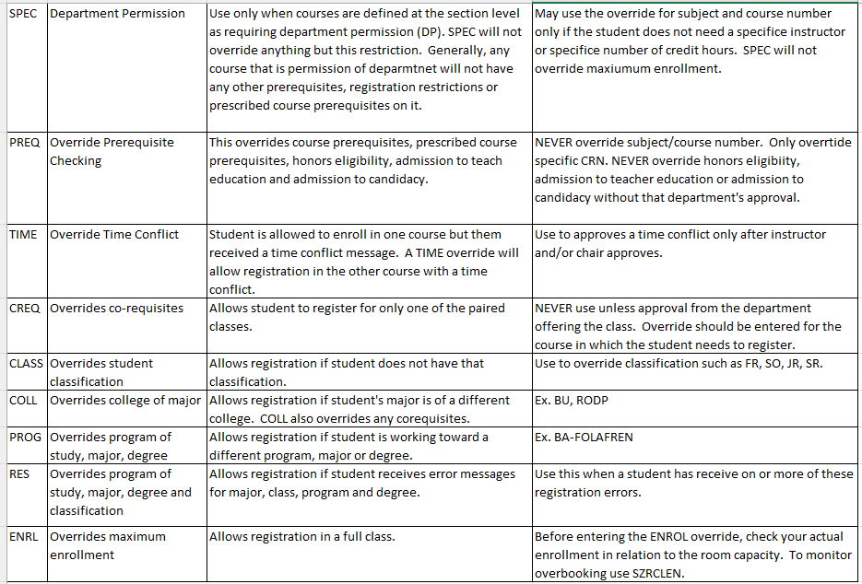
PERMITS

Slide 27
QUESTIONS?

Slide 28
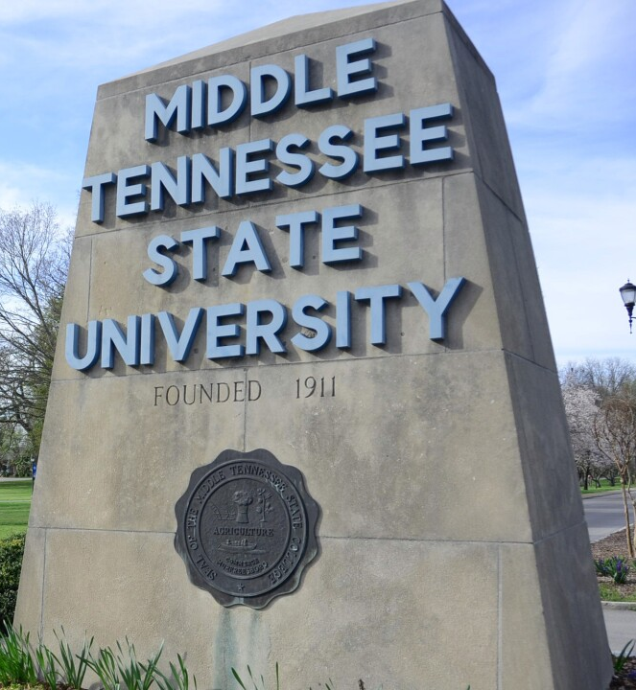
Contact Information
Scheduling
Tammy Maples – Tammy.Maples@mtsu.edu 615-898-5815
Christy Weir – Christy.Weir@mtsu.edu 615-494-7619
Cyndi Smith – Cyndi.Smith@mtsu.edu 615-898-5817
Registration
register@mtsu.edu
Kim Primas – Kimberly.Primas@mtsu.edu 615-494-8763
Anne Ford – Associate Registrar Anne.Ford@mtsu.edu - 615-898-2161

