Slide 1
Overall Creek Elementary
Alison Norton
5th Grade

Slide 2
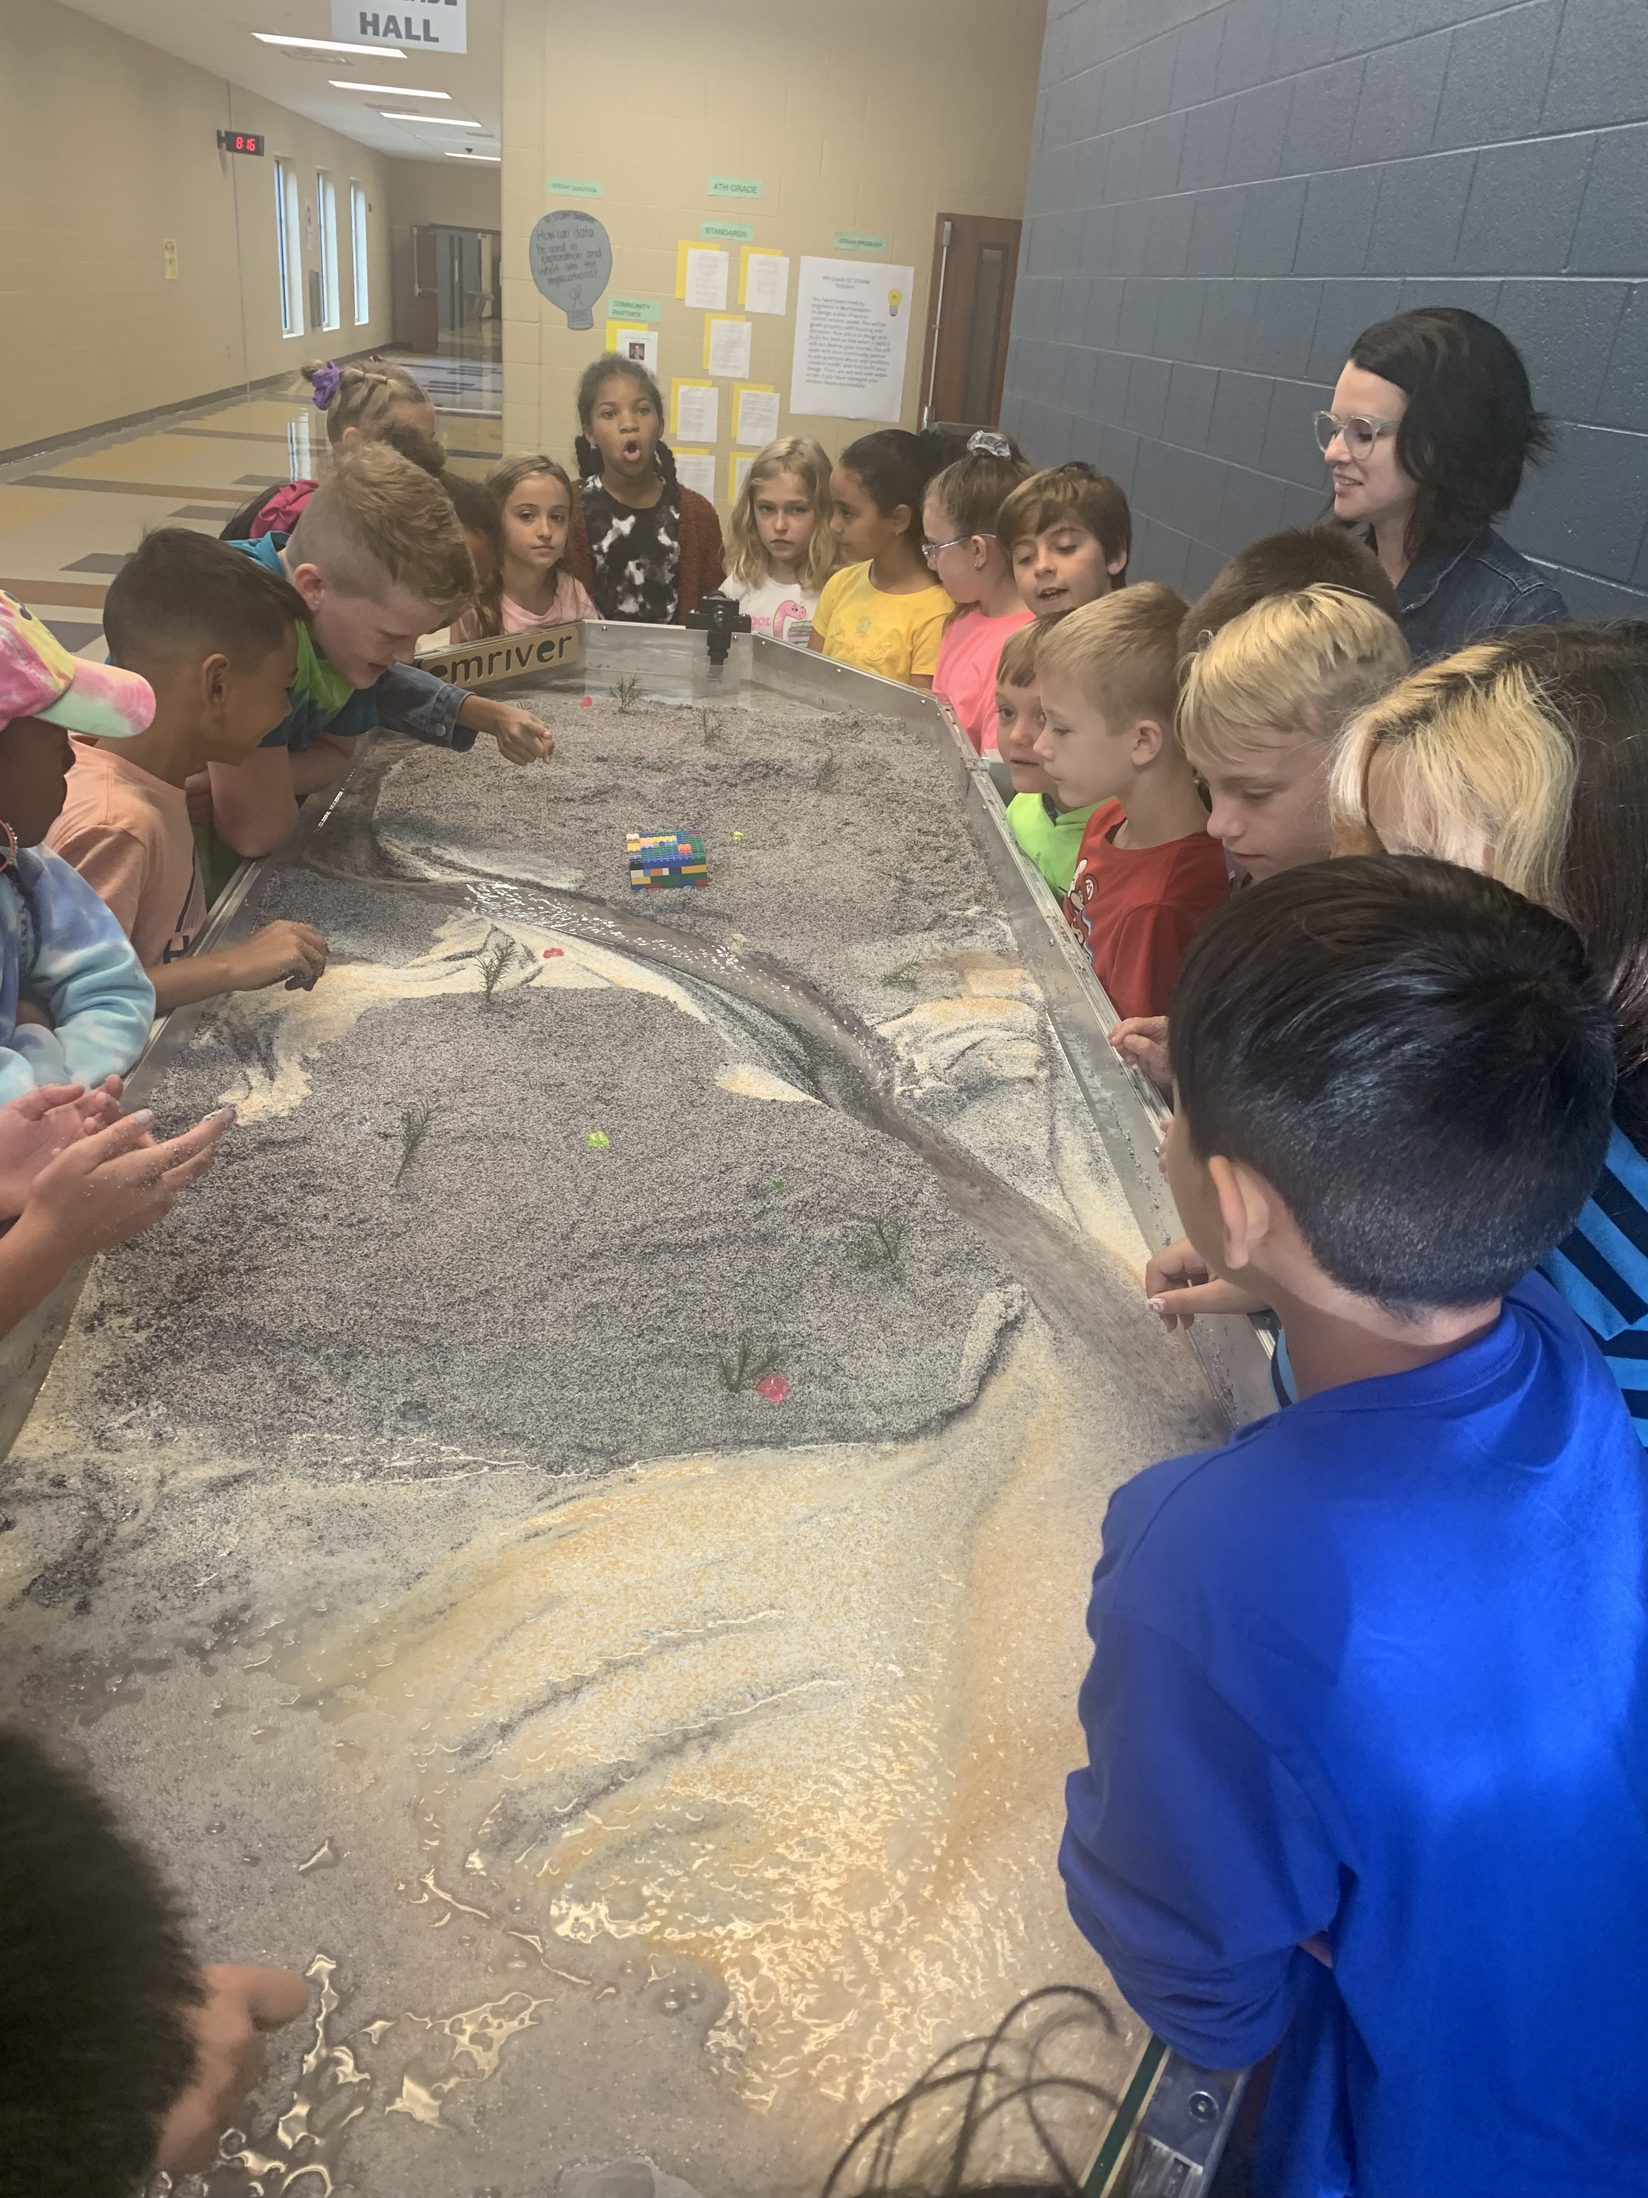
Emriver Stream Table
Inquiry based learning K – 5
Access for all learners
Engineering

Slide 3
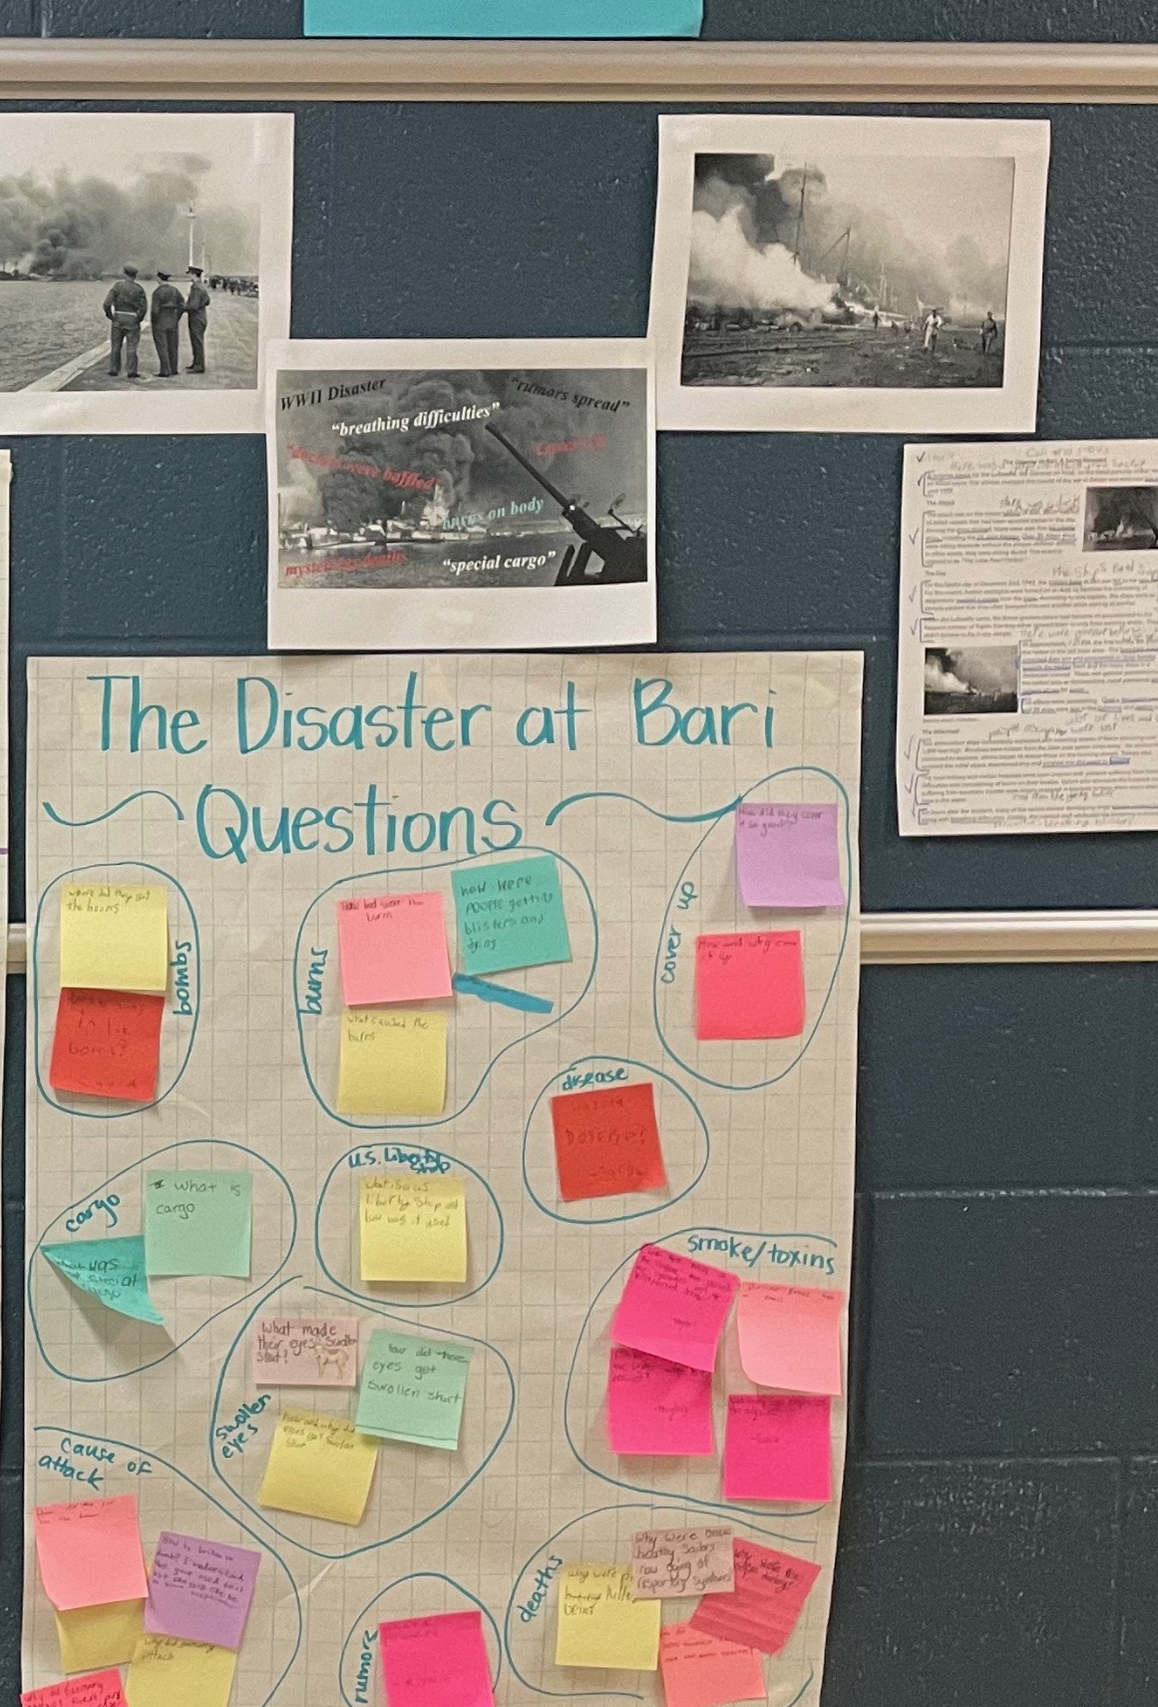
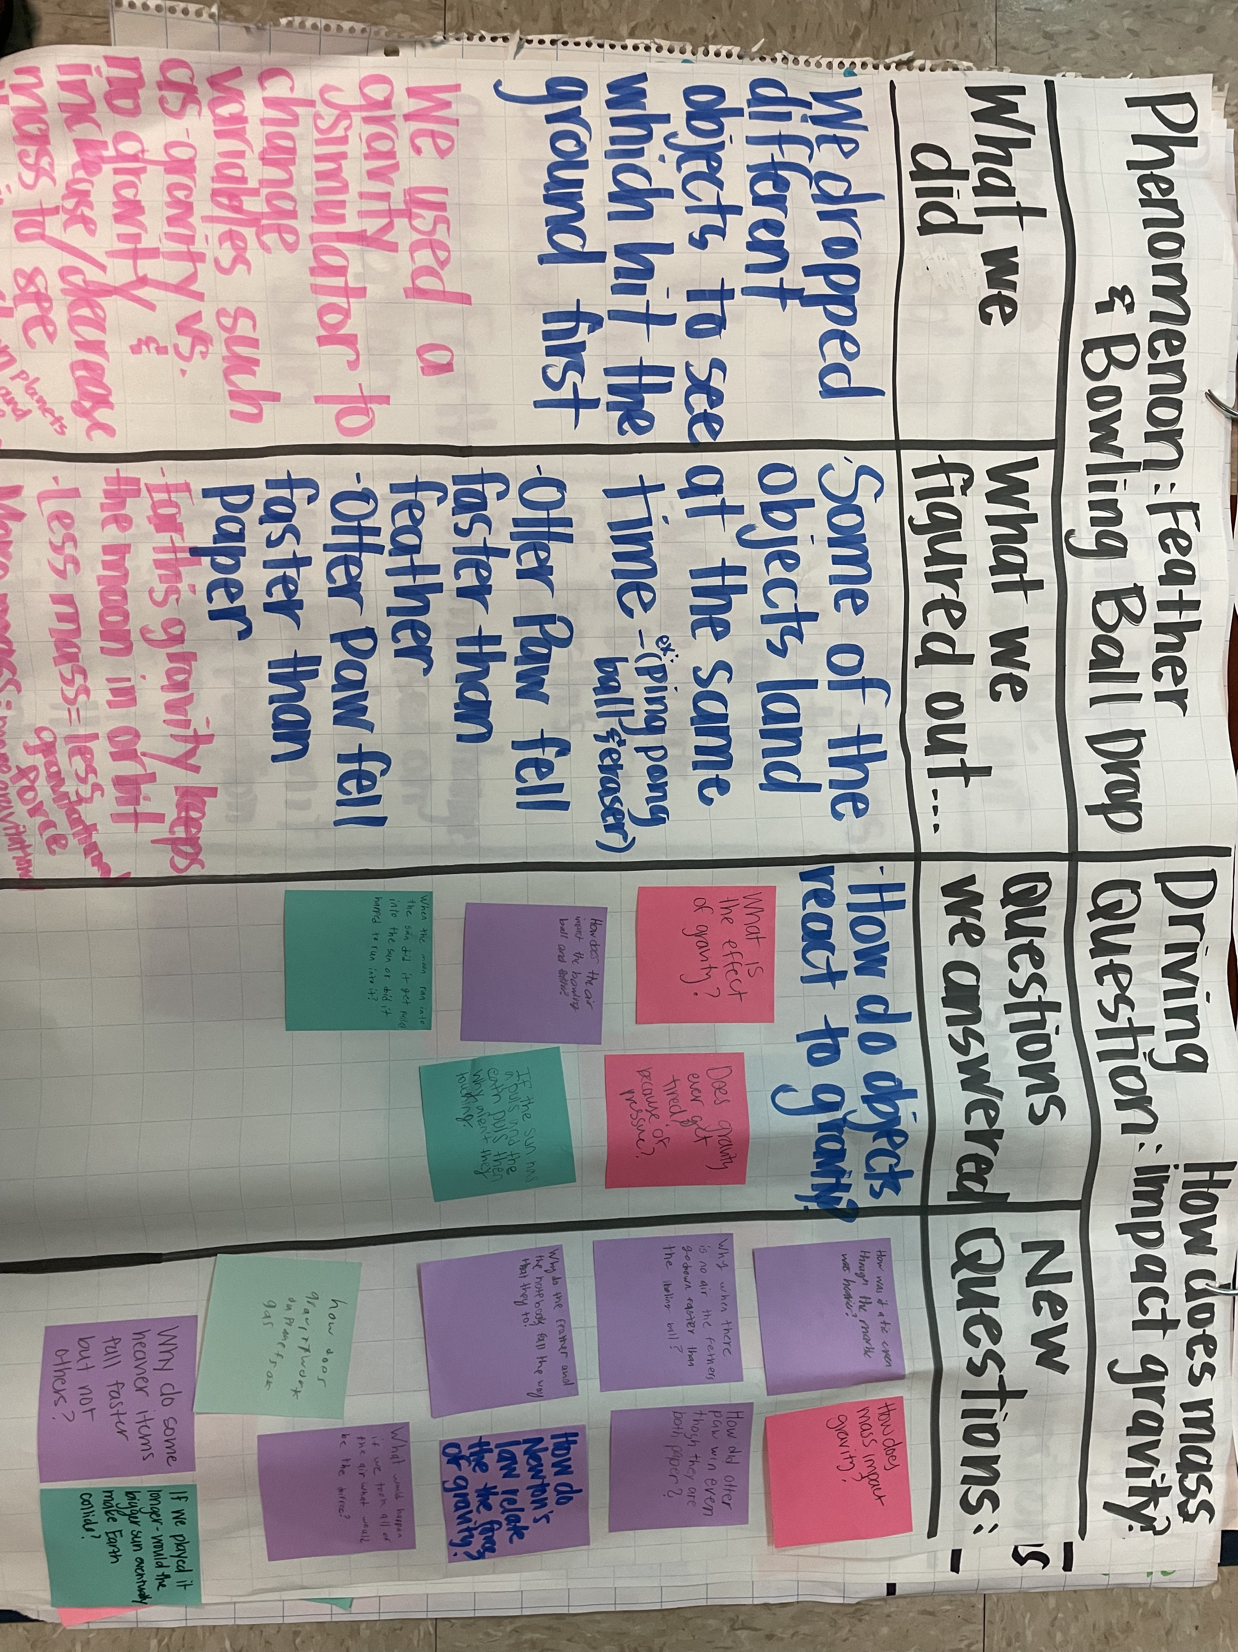
Storylines
Anchor learning through phenomenon
Benefit of storylines – student driven
Integration of learning
Notes:
I never had to tell the students what happened at Bari, the students got to what happened through exploration and inquiry. We use the 5E model (exploration,

Slide 4
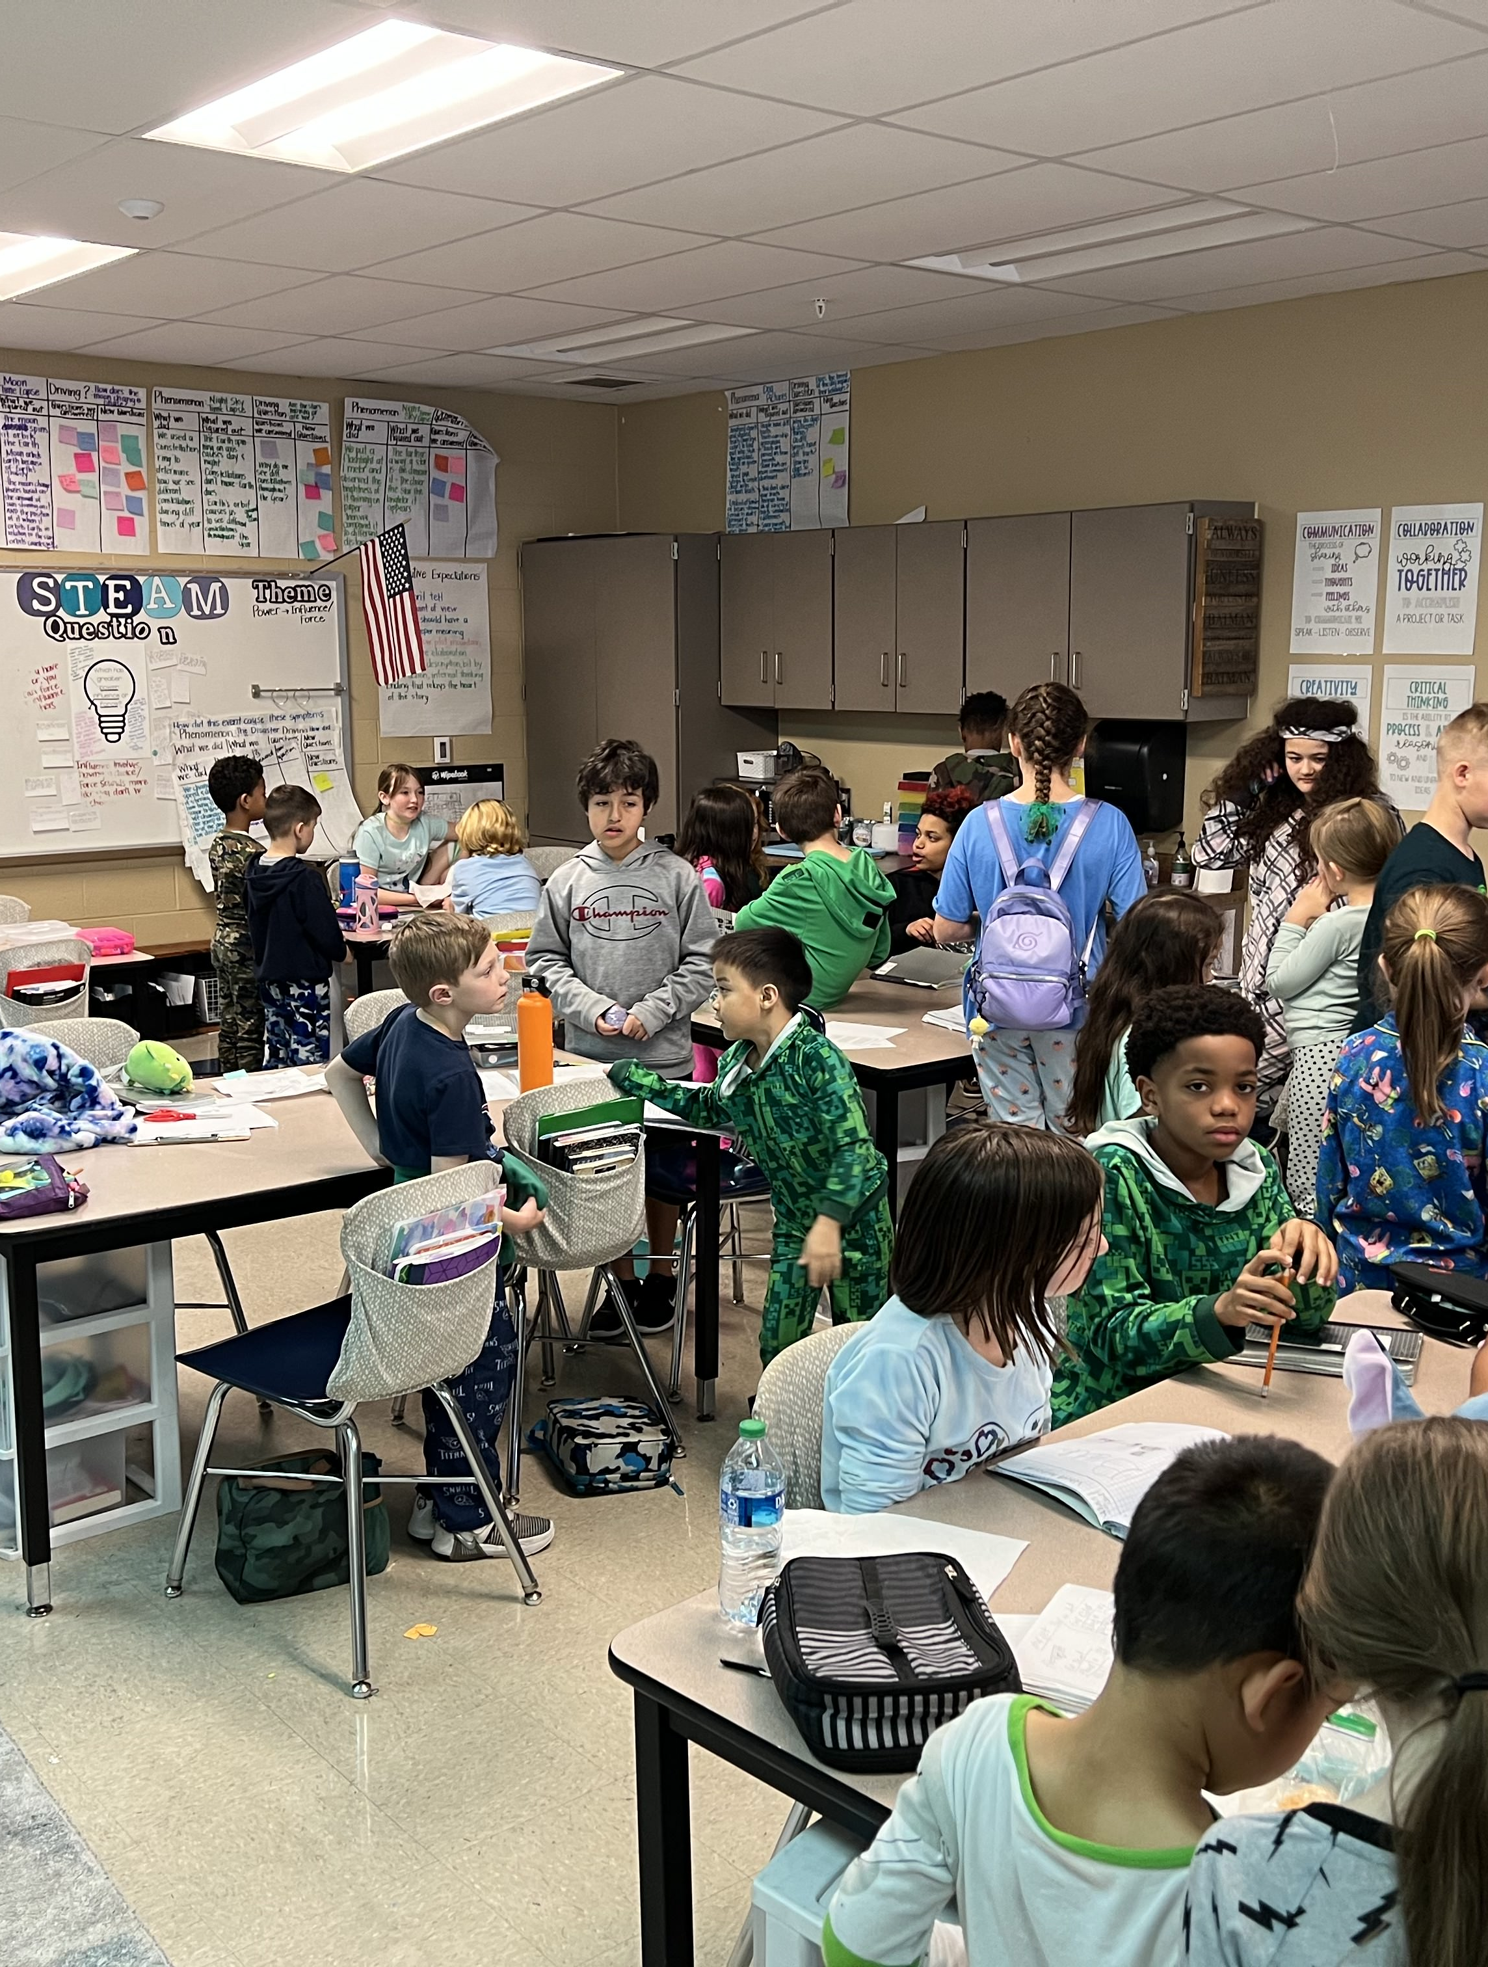
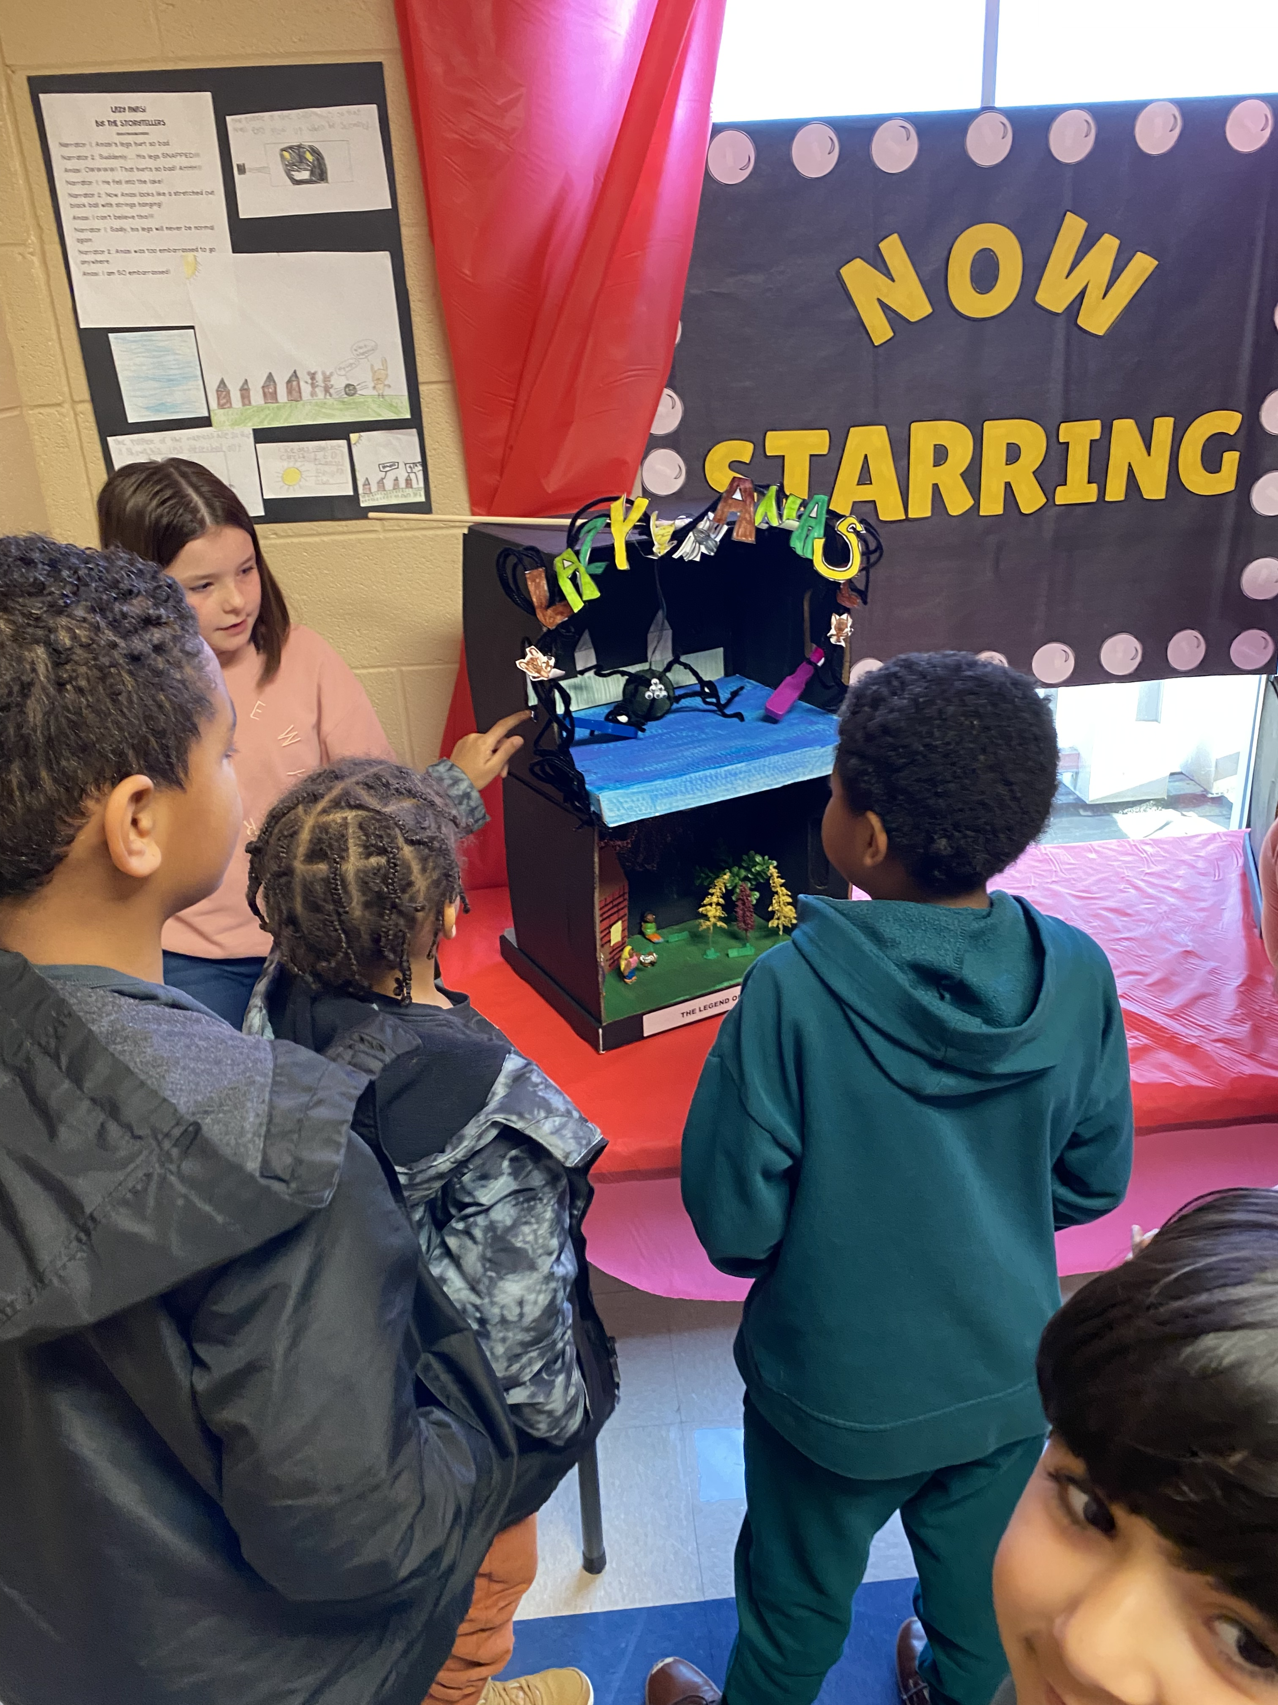
STEAM Walks to STEAM Talks
Where we were
Where we are now
Intentional discussions
Collaboration across grade levels
All students able to discuss vs STEAM Ambassadors
Connections

